Slide 1
Traditional music in Jordan

Slide 2
Traditional music in Jordan
In addition to popular music – folklore, and “according to the opinions of some musicologists – there is other artistic music, but with a difference in the degree of its refinement and function, it requires better made instruments.” Accuracy and mastery needs more diverse musical scales, a more organized and coordinated musical language, and a longer learning time. This music is created with artistic precision, and is based on solid theories and delicate aesthetic formulas, and it cannot be considered simple folklore.
Did you know?
Traditional artistic music in Jordan has the same characteristics and Arabic traditions as it is homophonic

Slide 3
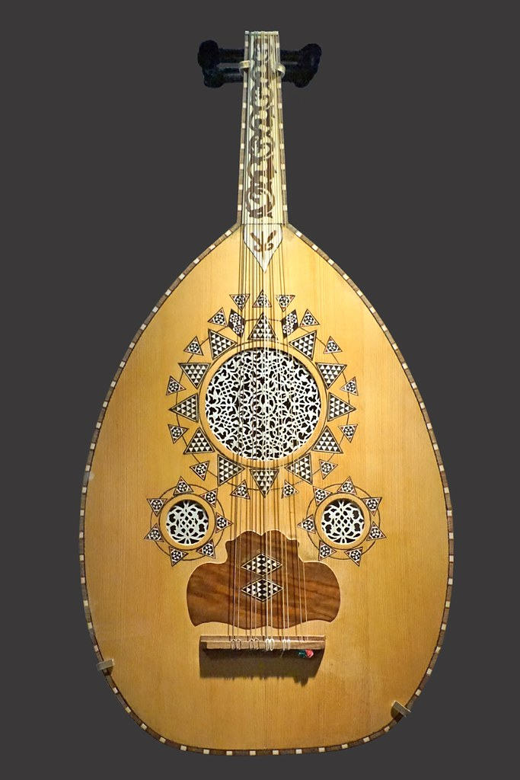
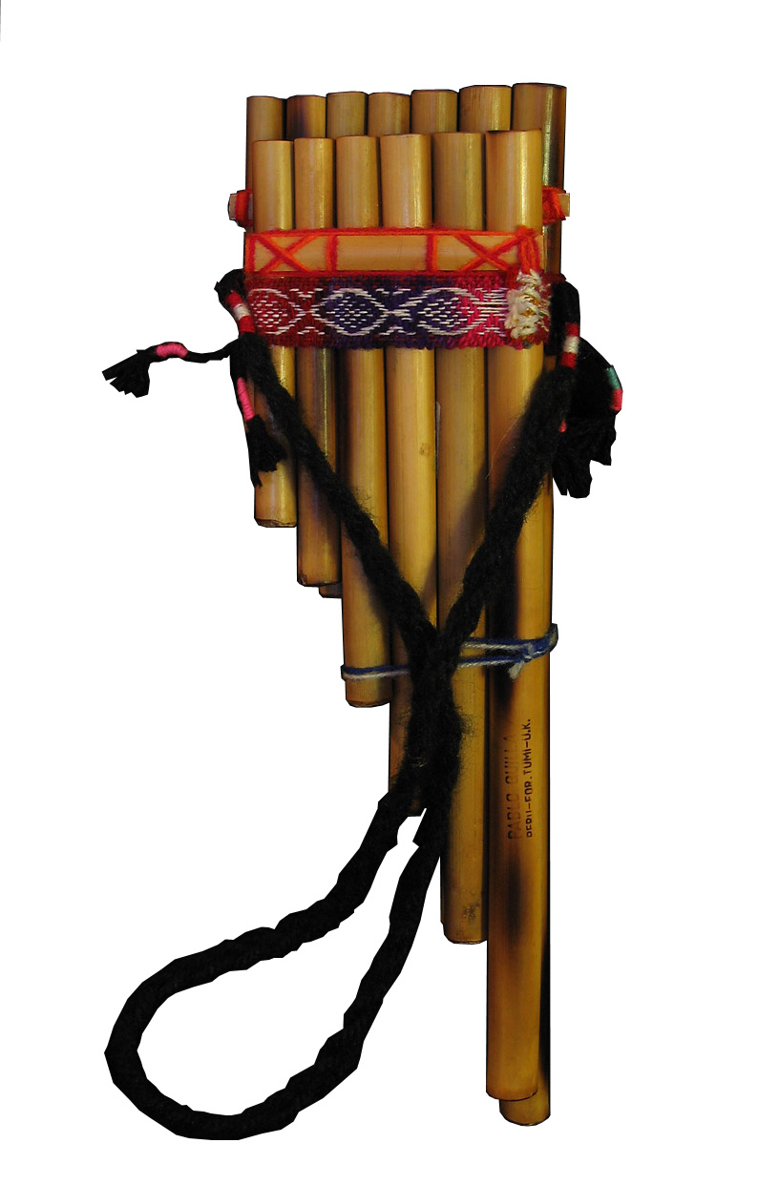
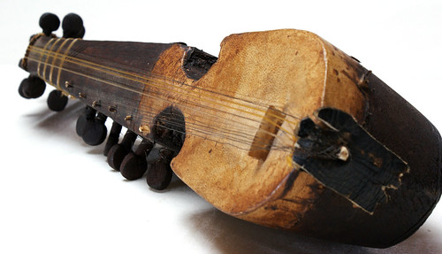
Instruments
The traditional music of Jordan has a long history. Rural zajal songs, with improvised poetry played with a oud, rabab, and reed pipe ensemble accompanying is popular.
Oud:
Reed pipe
Rabab:

Slide 4
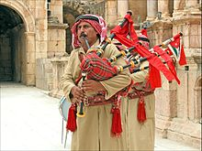
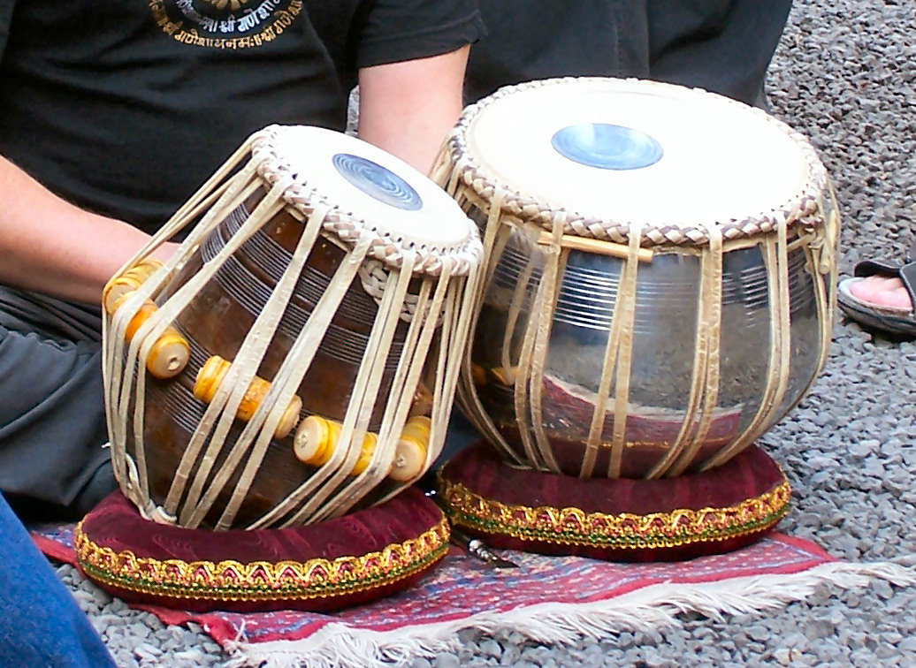
Music
folk music, type of traditional and generally rural music that originally was passed down through families and other small social groups. Typically, folk music, like folk literature, lives in oral tradition; it is learned through hearing rather than reading.
Traditional folk music
Folk metal.
Folk rock.
Neofolk.
Anti-folk.
Skiffle.

Slide 5
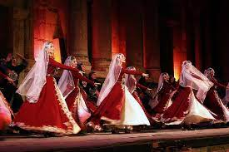
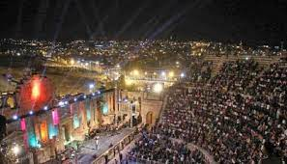
Jerash festival
The festival features folklore dances performed by local and international groups, ballet, concerts, plays, opera, popular singers as well as sales of traditional handicrafts. All this is done in the ruins of Jerash brilliantly floodlit dramatic.

Slide 6
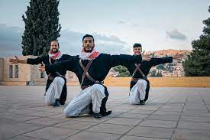
Amman
Dabke
Dabke is a popular Arab folk dance The dance is done on a variety of occasions but is most popular at weddings. While there are many variations of Dabkeh, it generally involves a long chain of dancers who perform a range of synchronized steps, stomps, jumps, and kicks.

Slide 7
Interview:
https://drive.google.com/file/d/1wQX8C-7zLsk2slIsYE3SsYWF0GtmPRnZ/view?usp=drive_link
Video:
https://drive.google.com/file/d/1y-CftnpxhZ-2SomtutKCQ3s1TgyKmKwZ/view?usp=drive_link
Done by:
PowerPoint: Elina + Bezawit
Interview: Adam
Pictures : Osama
Video : Bezawit

