Slide 1
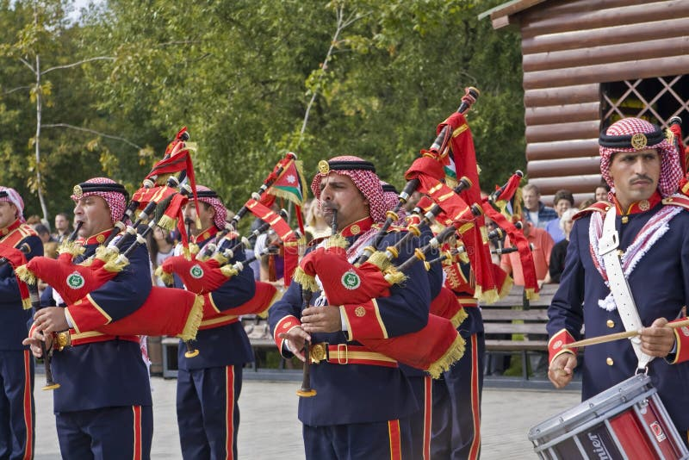
Traditional music in Jordan
By Daniel Boue , Roni imsih ,Elias akrook ,Karam shnoudi ,Saif obeidat

Slide 2
introduction
The traditional folk music of Jordan can be distinguished from that of its neighboring countries like Syria and Saudi Arabia by its strong Bedouin influence. They are classified as Countryside music ,Bedouin music ,and Marine music.

Slide 3
Interview on Jordan TV
https://www.youtube.com/watch?v=5DBVq0vRYhw

Slide 4
1.Country Side Music
It is a traditional folk that is spread in the countryside, cities and towns of Jordan, especially in the north and centre of Jordan, in fact this singing has entered all Jordanian cites with strength. The Songs of the countryside were faster and more graceful than those of Bedouin cities due to the Moving Rhythm of life in it's Seasons and Occasions.
The majority of rural musical forms are preformed collectively, accompanied by folk dances (dabke), which are spread across Jordan and mastered by vast majority of Jordanians.

Slide 5
2.The Bedouin music
This is the singing that pertains to the human groups inhabiting the Jordanian dessert. Bedouin singing is characterized by The lack of rhythm and melody and decorations. Most dessert singers tend towards a high sharp voice with nasality in terms of outlet and a quick monotonous due to the isolation of the city.
The countryside preserved the authenticty of ancient Arabic singing through a valuable and important group of Bedouin.
The most important singing forms are:
The Hada, the Hijin, the Shoroqi and the Qasid (Samer)
There is a dance that accompanies the Samer of Qasid in which the men dance in circle and the Hashi (the women who dance with a sword in the middle of Samer's circle) participate with them.

Slide 6
3.Marine music
Marine music is very limited in Jordan due to very limited marine area overlooking the Red Sea in the city of Aqaba.
The singing there is accompanied by a very distinctive rhythms derived from waves of the sea with the use of semsemie instrument

Slide 7
Traditional Music Instruments of Jordan

Slide 8
Please watch this first
https://www.youtube.com/watch?v=n4b2ccIaf5U

Slide 9
1.Wind musical instruments
Wind musical instruments are defined as the most common traditional instruments in Jordan.
They are instruments from which sound is produced by the passage of air through their parts. Wind instruments are
considered the first musical instruments known to man in history, as the winds that passed between the holes
in the wood of trees, rocks and bones produced a whistle that caught man’s hearing and made him later benefit from it.
.

Slide 10
In making primitive models of monophonic wind instruments that he used to simulate the sounds of nature, he later came up with the idea of ​​making holes in tubes to extract several sounds from a single tube. With the passage of time
and the development of human civilization, these models continued to develop until they led
to the creation of wind musical instruments that still exist to this day. Jordanian people have known,
since ancient times, musical instruments, in their manufacture, development and performance, and historical monuments
indicate the importance of music in ancient Jordanian civilization.

Slide 11
Gerbeh, or bagpipes, is a woodwind instrument with enclosed reeds attached to a bag that holds a continual supply of air. Across the Anglophone world, the Scottish Great Highland bagpipes are the most well-known example, but bagpipes have been played for millennia in huge parts of Europe, Northern Africa, Western Asia, the Persian Gulf region, and northern parts of South Asia.
The gerbeh is used in all traditional Jordanian and folk music and is always present at national events and celebrations.

Slide 12
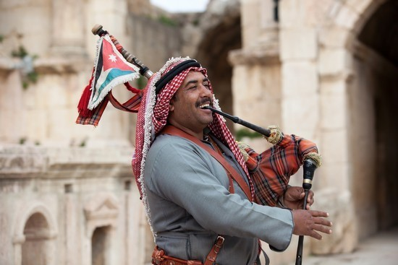
Gerbeh

Slide 13
Mijwiz, meaning “dual” in Arabic, is a traditional Middle Eastern double-pipe, single-reed woodwind instrument.
It is made up of two small bamboo pipes of similar length with reed tips joined together.
In the Levant, the mijwiz is used to accompany either belly dancing or dabke. Many popular folk songs feature the mijwiz.

Slide 14
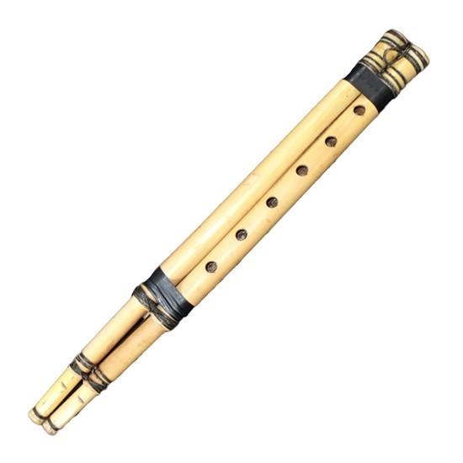
Mijwiz

Slide 15
2.Rebab
is the term given to a group of related bowed string instruments
.It is one of the first known bowed instruments, dating back to the 8th century.
The rebab is employed in a wide range of musical groups and genres.
Its body varies from being ornately carved, as in Java, to simpler variants,
such as the 2-string fiddle of the Nile which may have a body carved from half a coconut shell.

Slide 16
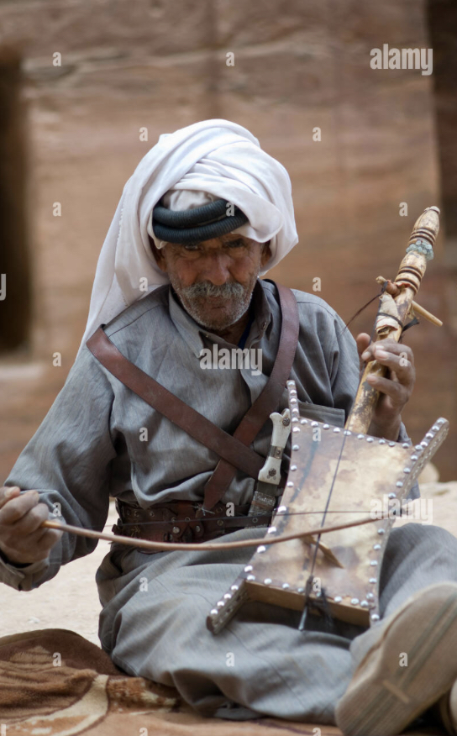
Rebab Famous among the Bedouins

Slide 17
3.Tablah
Tablah is a single-head membranophone with a goblet-shaped body that is regarded as the national symbol of shaabi music.
While seated, the tablah can be played by holding it under one arm or by laying it sideways on the lap.
Some drums can have shoulder straps so that they can be played while standing or dancing. When lightly played with the
fingertips and palm,
it provides a resonant, low-sustain sound.

Slide 18
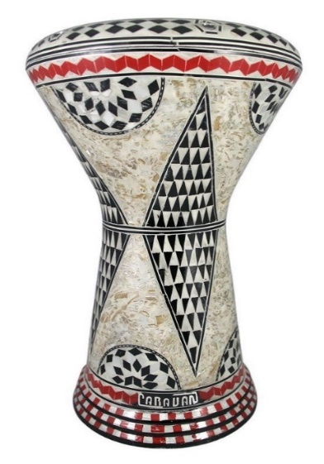
Tablah

Slide 19
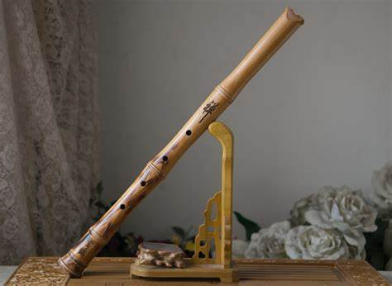
Shababa

Slide 20

Arghul

Slide 21
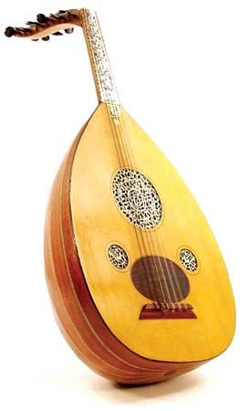
Oud

Slide 22
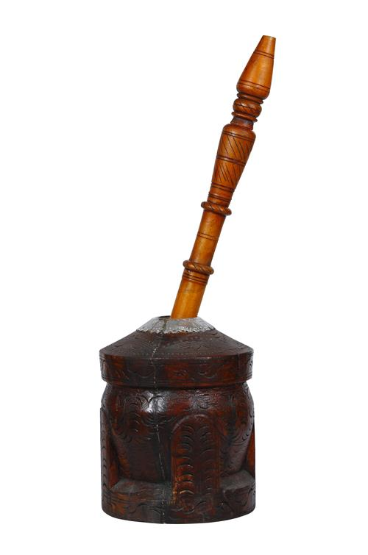
Al Mihbash

Slide 23
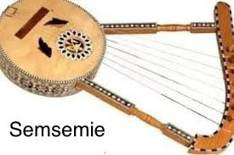
Famous in the city of Aqaba

Slide 24
Links
https://www.jordanheritage.jo/wind-instruments/
https://www.jordannews.jo/Section-119/Music/Dances-and-instruments-of-Jordan-18718
https://traditionalarabicmusic.com/music_of_jordon.html

