Slide 1
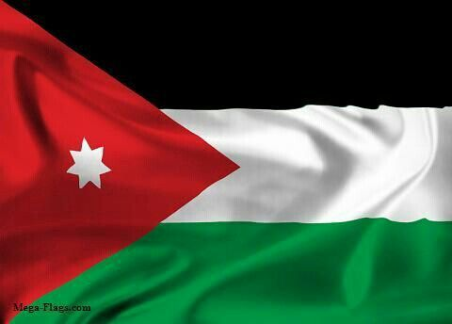
DABKEH
PowerPoint made by maha haddad
Group MEMBERS: john sidawi, naya hajjara , REEM ATAWI, MAHA HADDAD
6F

Slide 2
WHAT is DABKEH?
Dabkeh is a Jordanian traditional dance. It is the national dance of Jordan and several other neighboring countries. It is a form of both circle dance and line dancing and is widely performed at weddings and joyous occasions. In Jordan, Dabkeh is the traditional folk dance that goes back generations and is danced by men, women, or both, with different steps and different rhythms.
https://journeynorth.org

Slide 3
MORE ABOUT DABKEH
The name “Dabke” is thought to have been derived from the Levantine Arabic word dabaka (دبكة), which can be roughly translated to “stamping of the feet”. It perfectly describes the essence of the dance. Dabke is characterized by people stamping their feet rhythmically in lines or circles. The dancers’ arms will often be interlocked with one another. They will usually sing or chant along with the Dabke music in the background, too. The formation of dancers will form from left to right. At the head of the formation is the leader (called raas or lawweeh), who sets the rhythm and the steps for the rest. The lawweeh mustn’t just be an expert at Dabke, but he must also be accurate, quick, and capable of improvisations. The leader will continuously alternate between facing the dancers and the audience. Dabke is an incredibly joyous and energetic kind of communal dance. It is only ever performed on happy occasions. It is a very popular type of wedding dance in Palestine, for example.
https://citydance.org

Slide 4
Types of dabkeh
There are major 6 types of Dabkeh
1- Al-Shamaliyya الشمالية
2- Al- Sha’rawiyya الشعراوية
3- Al-Karaadiyya الكرادية
4- Al-Farah الفره
5- Al-Ghazal الغزل
6- Al-Sahja السحجة
https://citydance.org

Slide 5
Videos of Dabkeh in Jordan:
1-Independence day in schools (Eid al-Istiklaal)-https://youtu.be/agsIyF2INZ4?si=dFSUi3HSLlTZnL1K
2-Jordanian weddings- https://youtu.be/nTj7Nc5s4mg?si=We3aDR2dDXiylF6d
3-Dabkeh performances- https://youtu.be/Os4cF1UXz_c?si=ToVApzolHDHqxU_j

Slide 6
John Sidawi’s interview about Dabkeh:

Slide 7
Resources:
https://journeynorth.org
https://citydance.org
https://citydance.org/dabke-dance/
https://youtu.be/agsIyF2INZ4?si=dFSUi3HSLlTZnL1K
https://youtu.be/nTj7Nc5s4mg?si=We3aDR2dDXiylF6d
https://youtu.be/Os4cF1UXz_c?si=ToVApzolHDHqxU_j

Slide 8
Thank you
maha.haddad@nos.edu.jo
#DABKEHFORLIFE

