Slide 1
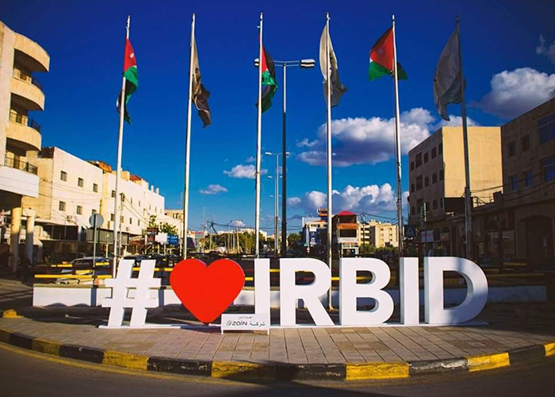

Slide 2
Irbid traditions
Irbid has many traditional foods like: chacheel,Makmoura and many more

Slide 3
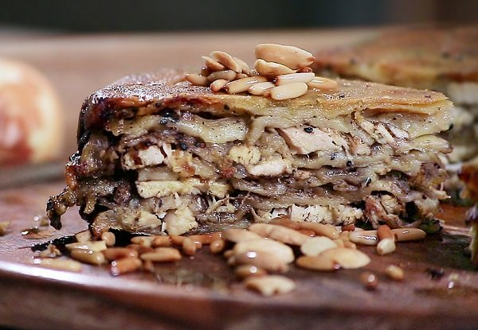
But today we will talk about Makmoura
Makmoura is traditional northern Jordan dish

Slide 4
How to make Makmoura
You start with mixing flour water olive oil black sesame seeds and a pinch of salt as for the filling we need oil chicken and lots of onion and you cant forget the condiments like black pepper cardamom turmeric and cumin

Slide 5
Interview questions
What is makmoura?
A dish that requires patience, makmoura translates as buried and is prepared by alternating layers of dough with lamb or chicken, onions and an array of seeds and beloved regional spices such as sumac and cumin.

