Slide 1
Solving Computer Problems Safely and Responsibly
By: Natali Nijmeh

Slide 2
Nowadays, our world is digitally connected and computers and networks have become essential parts of our lives. We rely a lot on these devices, and this exposes us to various risks. To confirm that our data is safe we need to ensure the safety of our computers, securely use the internet and properly use and store hardware.

Slide 3
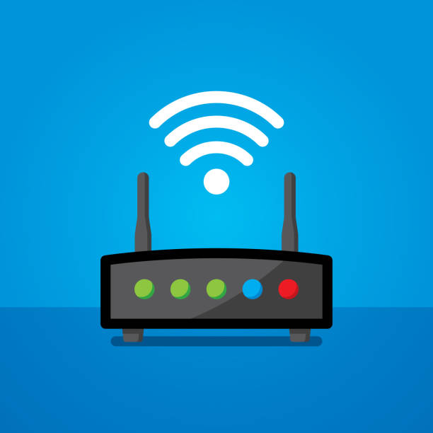
To solve network problems ,you should:
Never deal with the problems of your home network unsupervised.
Use a secure and trusted WiFi connection
Avoid connecting to networks that don’t require a password as they are an easy target for attacks.

Slide 4
To keep your computer safe, you must:
Secure it with a strong password and regularly update the password to boost security.
Install an antivirus software to protect the computer from viruses and other malicious programs.
Beware from phishing as it can be in the form of emails or websites asking for personal information.

Slide 5
To handle hardware properly, you should:
Avoid overheating by providing the computer and hardware with proper ventilation
Handle with care by treating everything gently and avoid dropping the hardware
Never apply force when connecting cables
Never move a device until you make sure all cables are disconnected

Slide 6
In conclusion, using computers, networks and hardware is important in our world. And digital safety is the key to a secure online experience.

