Slide 1
How to be safe whilst fixing computer problems
Made by: Sanad Qussous

Slide 2
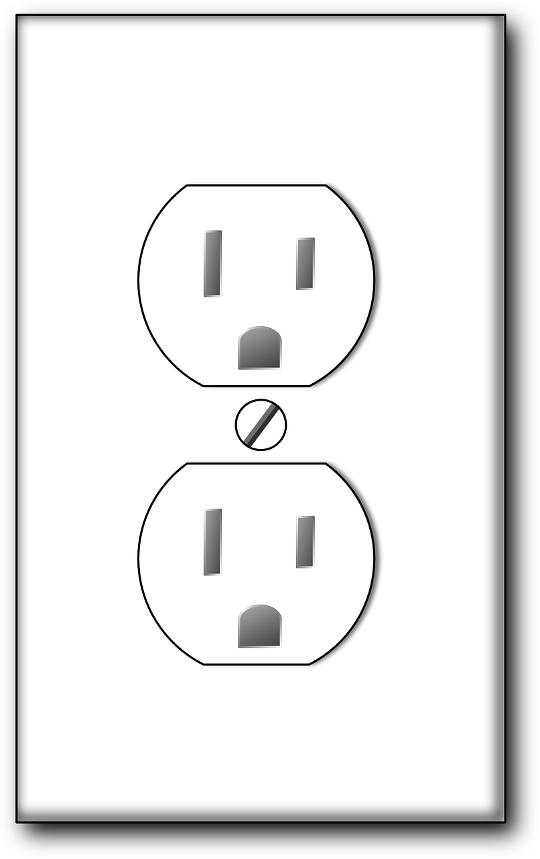
Connecting/Disconnecting devices from an outlet
You should always make sure that you turn off the outlet before plugging/unplugging something into/from the outlet, if you don’t, the electricity might jump to your hand causing an electric shock.

Slide 3
Do not open the case of your computer or any other device.
Don’t open the case of any electronic device if you’re not a professional, you could touch the wrong thing causing the device to malfunction, worst case scenario, you would get electrocuted.
If your computer is not working/having problems, always bring it to a technician

Slide 4
Using force whilst plugging/unplugging a device from an outlet
Never use a lot of force pushing/pulling a device out of an outlet, it could cause the outlet to break, causing a fire, or you getting electrocuted. Make sure to always use light pushing/pulling force to plug/unplug something, and if something seems to not go in, don’t try to plug it in.

Slide 5
Holding heavy things.
If you're trying to hold your computer/any other device, and it seems heavy, put it down, you don’t want it falling on the ground, breaking it, or it falling on your leg. Tell your parents if you ever want to move something heavy

