Slide 1
How to solve computer problems?
By faris saadeh

Slide 2

The Computer Won’t Start
A computer that suddenly shuts off or has difficulty starting up could have a failing power supply. Check that the computer is plugged into the power point properly and, if that doesn’t work, test the power point with another working device to confirm whether or not there is adequate power.

Slide 3
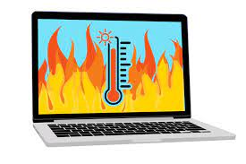
Overheating
If a computer case lacks a sufficient cooling system, then the computer’s components may start to generate excess heat during operation. To avoid your computer burning itself out, turn it off and let it rest if it’s getting hot. Additionally, you can check the fan to make sure it’s working properly.

Slide 4

Dropped Internet Connections
Dropped Internet connections can be very frustrating. Often the problem is simple and may be caused by a bad cable or phone line, which is easy to fix. More serious problems include viruses, a bad network card or modem, or a problem with the driver.

Slide 5

Strange Noises
A lot of noise coming from your computer is generally a sign of either hardware malfunction or a noisy fan. Hard drives often make noise just before they fail, so you may want to back up information just in case, and fans are very easy to replace.

