Slide 1
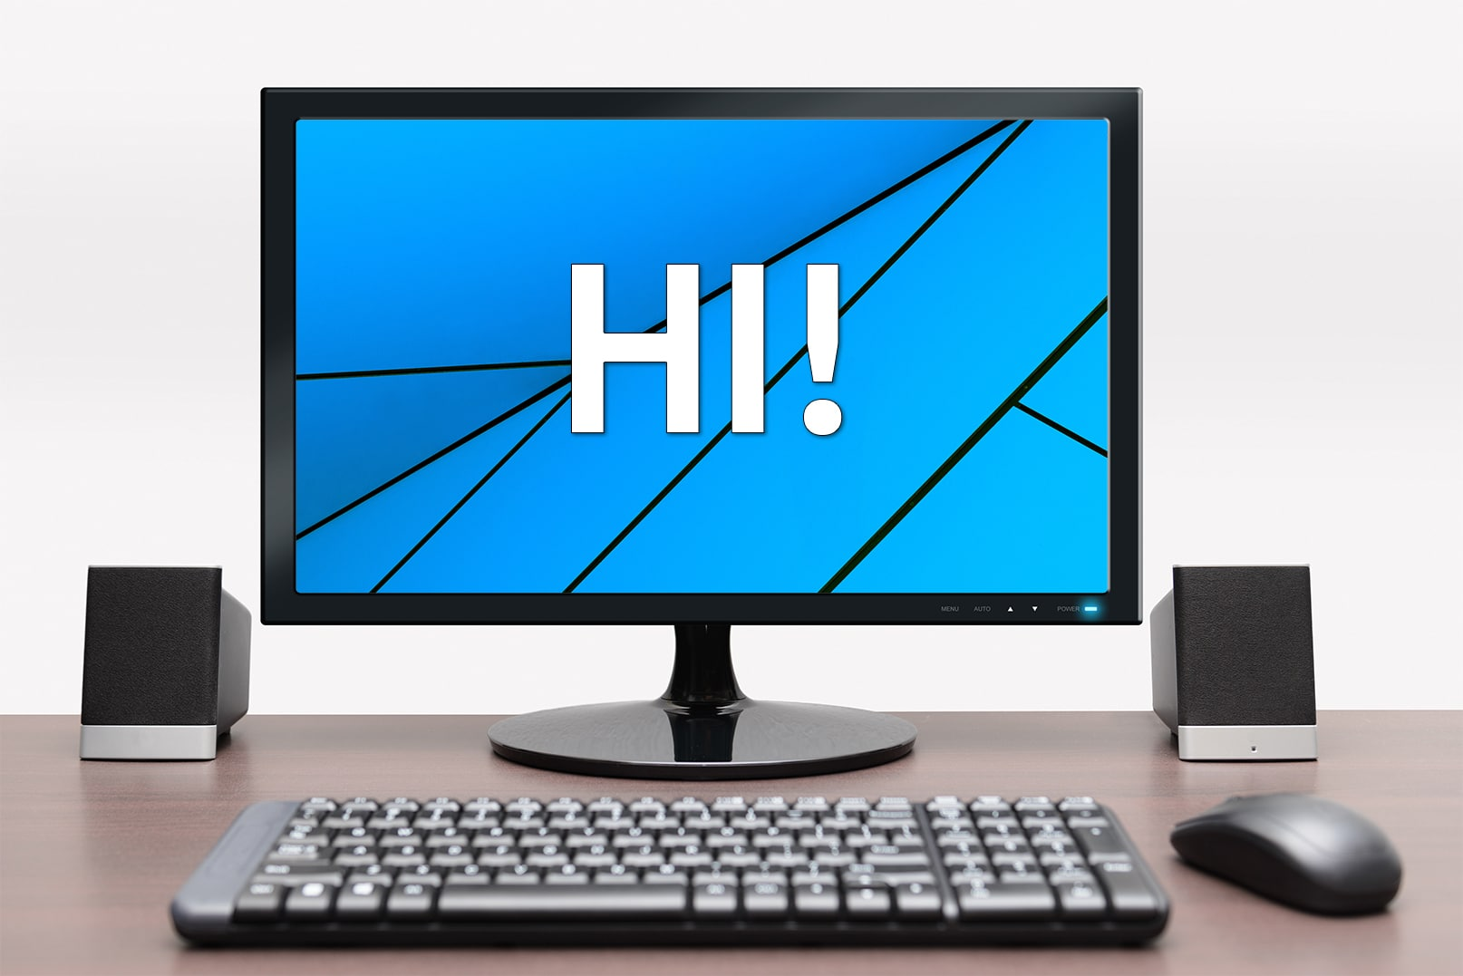
Staying safe while using a computer
By: eyad jumaian 8e

Slide 2
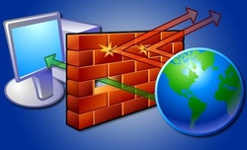
Use a firewall
A firewall is a security system designed to prevent unauthorized access into or out of a computer network.

Slide 3
RATs are (remote administration programs)
RATs are remote administration programs that have been embedded into an unsuspecting victim's computer.

Slide 4
Don't open suspicious attachments or click unusual links in messages.
Opening an infected attachment can have serious consequences. It may launch a key logger which steals personal information such as usernames and passwords, takes periodic screenshots, grabs sent emails or harvests credit card numbers and bank details.

Slide 5
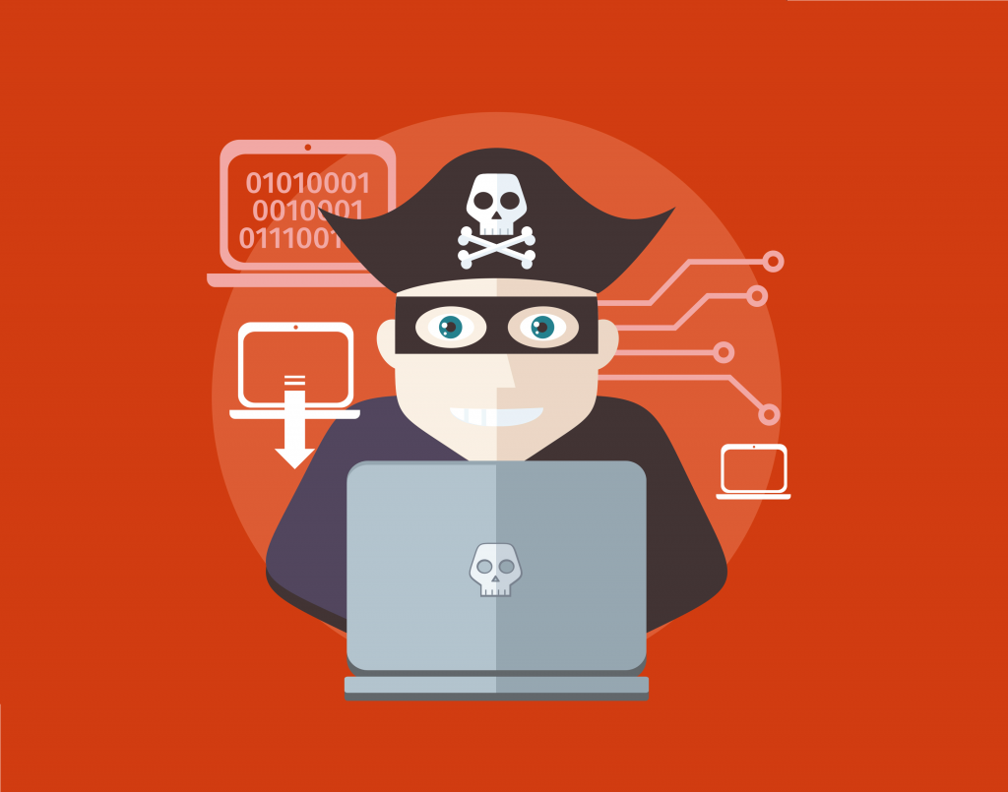
Stay away from pirated material
Accessing free or cheap content is not the bargain you think it is! Digital piracy refers to the illegal copying or distribution of copyrighted material via the Internet. It negatively affects the creative industries, including film, TV, publishing, music and gaming.

