Slide 1
Stay Safe
By: Marah Badran

Slide 2
Solving network problems
When solving computer problems, you will be working with electrical equipment. It is important that you stay safe while doing so, Always follow your school computer and use safety rules, and always check with your parents before trying to deal with problems with your school network.

Slide 3
Safety rules
Switch off power points at the wall before connecting or disconnecting a mains electricity cable.
Do not open the case of your computer or any other device.
Never use force when connecting or disconnecting a cable or component.
Make sure all cables are connected before attempting to move a device. (ex: a printer.)
Do not lift heavy equipment on your own.
If in doubt, STOP and ask for help.

Slide 4
Notes
When you are trying to solve network problems, record:
The location of the computer.
The steps you have followed.
Any error messages you see on screen.

Slide 5
Username and Password
If you are having problems logging on to a network, check you are using the correct username and password.
A password is case sensitive. That means it matters if you use upper case letters instead of lowercase ones. Check you haven’t left “Caps lock” on.
If you have forgotten your password, use the “forgot password?” link to change it. You will need an email address that a new password can be sent to. At school, you will need to ask your IT technician to change your password.

Slide 6
How to have a safe password
Make sure you mix up between Caps and Lowercase letters.
Make sure you add numbers.
Always use ( @, #, !, ?, $,*…)
Never share your password with anyone.

Slide 7
Home network
If you are having problems with connecting to your home network, check:
You are entering your password correctly.
That wireless is turned on.
Whether other people in the house have a connection. If they do, the problem is likely to be with your device not the router.

Slide 8
Basic checks to carry out on your home network router
Is the router plugged into an electric socket? Is the socket switched on?
Check that any cables connected to the back of your router are secure.
*If everything else fails, reset your router. Turn off the power switch or turn off the electricity socket. Wait 30 seconds then turn the router back on again. Do not press any button marked ‘reset’ on the router.

Slide 9
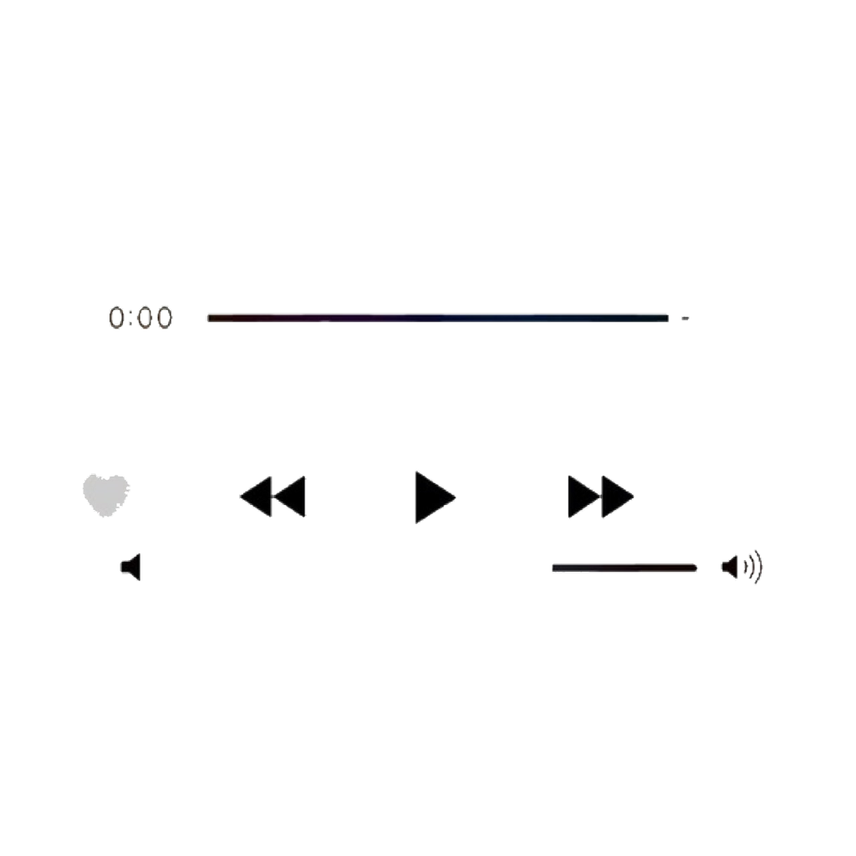
Thank you for listening.
Hope this helped
This Photo by Unknown Author is licensed under CC BY-NC

