Slide 1
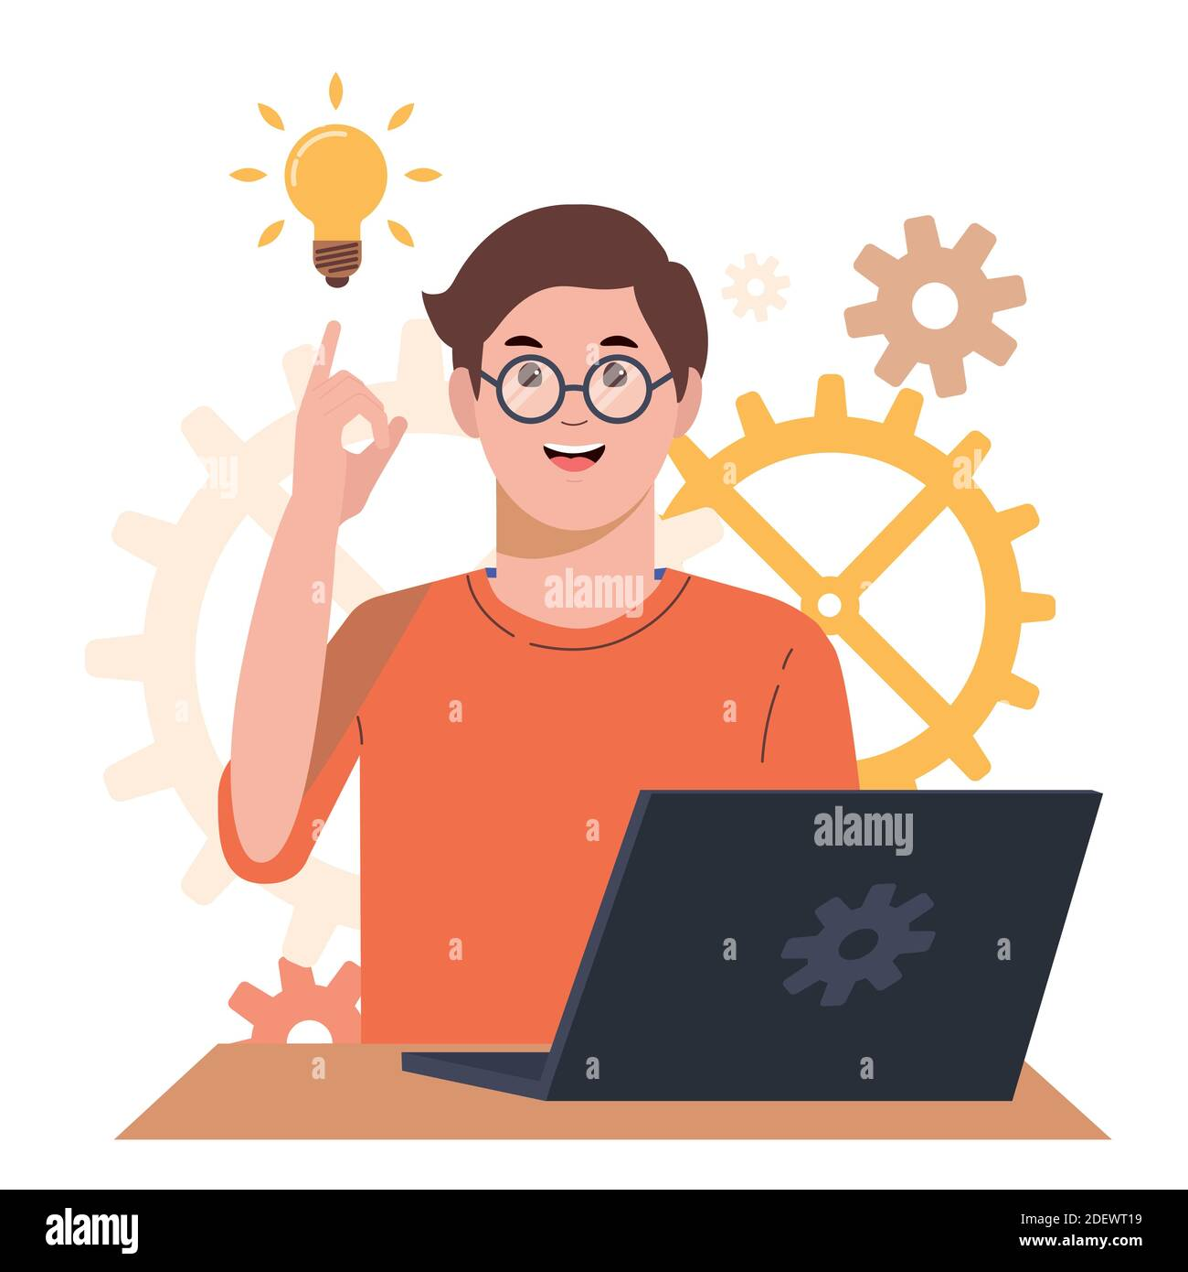
Act Responsibly and safely when solving computer problems

Slide 2
Responsible Problem Solving points

Slide 3
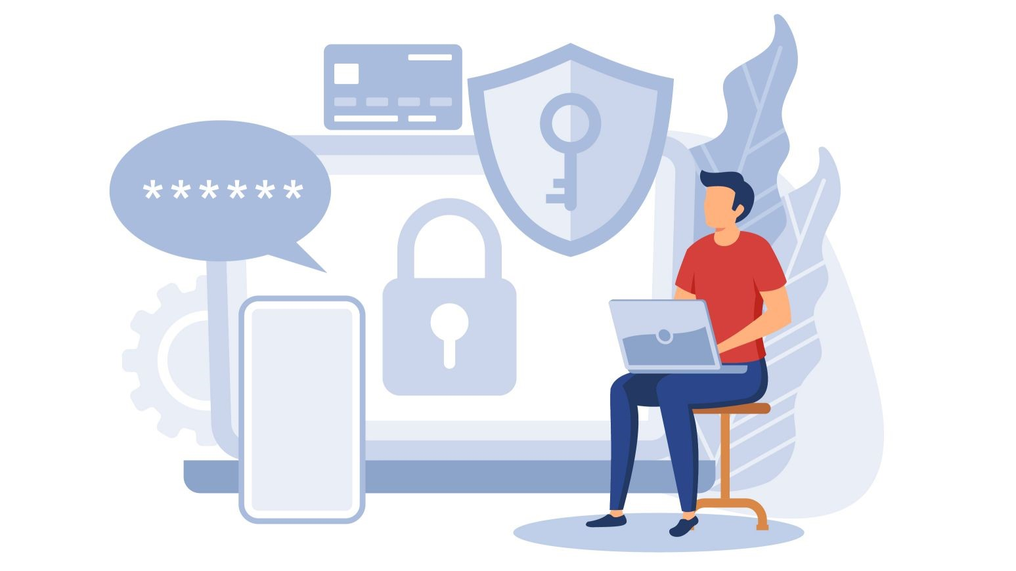
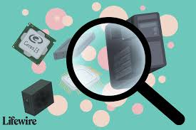
Physically Secure Your System
Physical protection for your computers and devices is as important as online safety measures. While exploiting a network hack can be limited by time and a properly configured system, a stolen computer gives a hacker almost unlimited power to access your data.
Install Tracking Software
A computer can be tracked through Wi-Fi if it goes missing. Some specialized software can also alert you and authorities about the location of your system when it is moved away from designated safe locations.

Slide 4
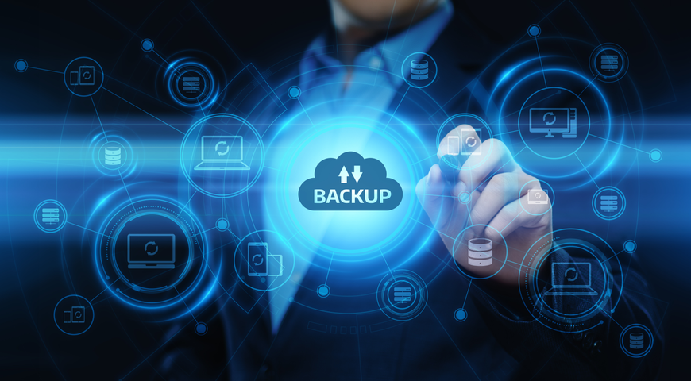
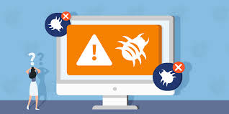
Keep Backups Up to Date
Data and the software on a computer are what makes it more valuable. A backup is like a second PC, with it you can restore your PC to its previous state or create a new PC with your existing data.
Use Antivirus
Antivirus is an important part of a computer’s security arsenal. They protect your system against malicious software and other threats. An antivirus can quickly detect and remove malware before it can cause serious damage.

Slide 5
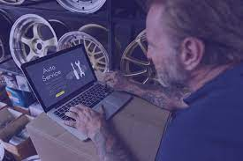
Don’t Click on Suspicious links
Don’t try complex repair without proper Knowledge

