Slide 1
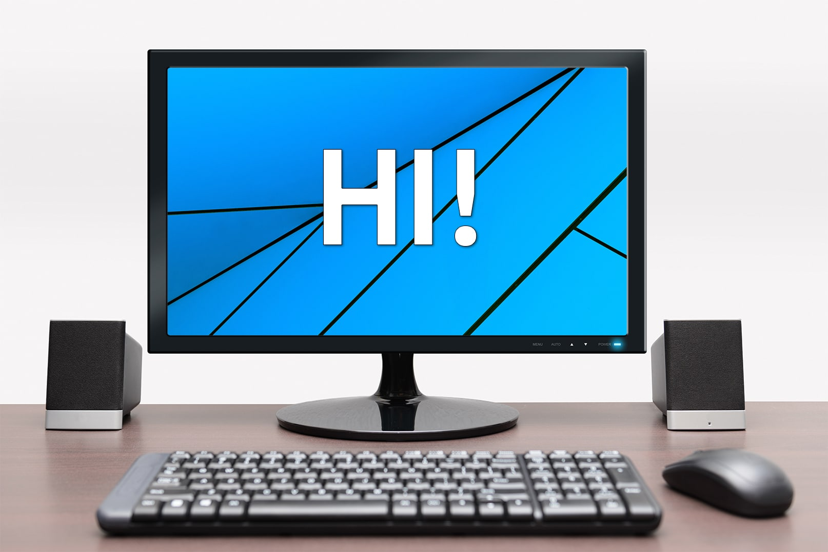
How to fix the computer
This Photo by Unknown Author is licensed under CC BY-NC-ND

Slide 2
How to Fix Lag on Your PC or Laptop
Identify and Remove Resource-Intensive Applications.
Optimize Web Browser and Internet Connections.
Optimize and Defragment the Hard Drive.
Scan for Harmful Software and Malware.
Update Old and Insufficient Hardware.

Slide 3
if the computer takes a long time to turn on
Guide to fixing slow startup.
Method 1: Disable Fast Startup.
Method 2: Disable processes with high startup impact.
Method 3: Make adjustments to your virtual memory.
Method 4: Defragment your computer's hard drive.
Method 5: Update your graphics card drivers

Slide 4
Fix sound or audio problems in windows
Check your speaker output.
Run the audio troubleshooter.
Verify that all Windows Updates are installed.
Check your cables, plugs, jacks, volume, speaker, and headphone connections.
Check sound settings.
Fix your audio drivers.
Set your audio device as the default device.

