Slide 1
Solving Computer Problems
Done By: Sama Al.Soury
8A

Slide 2
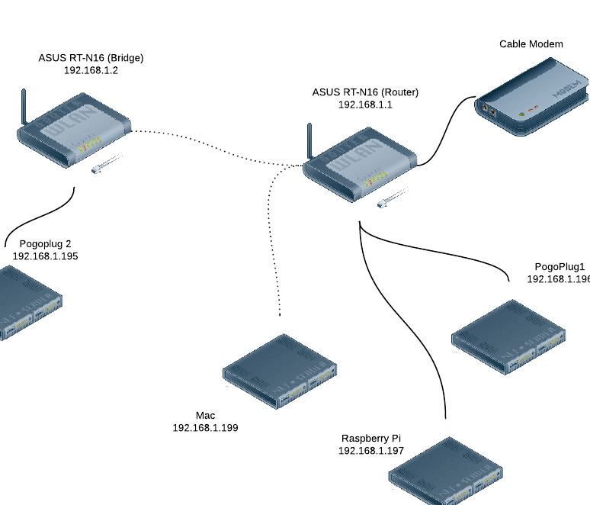
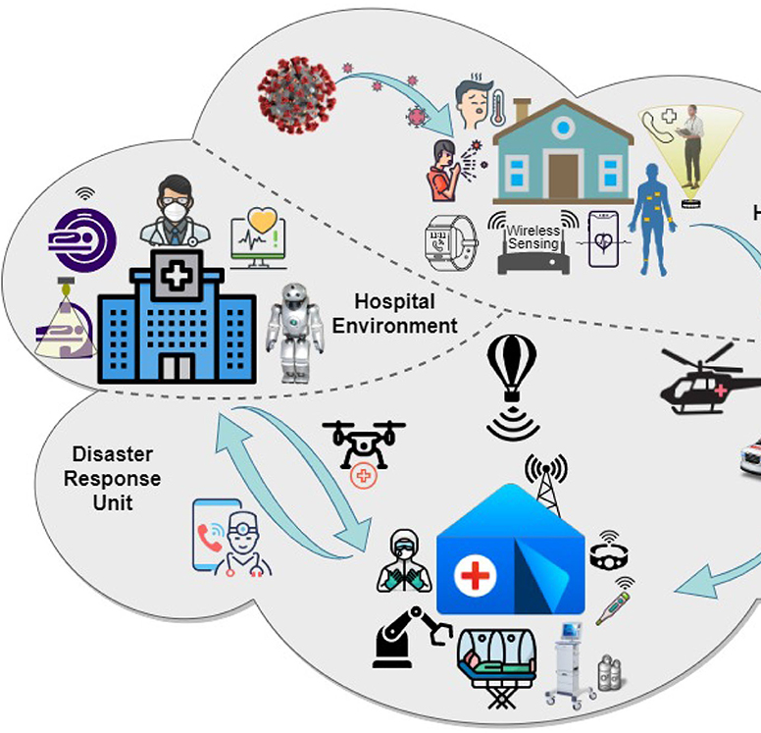
Computer problems
When you are solving computer problems you will be working with electrical equipment so you priority is to stay safe. Always follow safety rules or instructions. Here are some things you can do to stay safe:
Switch off power points at the wall before connecting or disconnecting a mains electricity cable.
Do not open the case of your computer or any other device.
Never use force when connecting or disconnecting a cable or component.
Here is a little video on how to improve your problem solving skills
https://www.youtube.com/watch?v=hiqoCvPs_Jc

