Slide 1
ACTING RESPONSIBLE AND SAFE WHEN SOLVING COMPUTER PROBLEMS
Prepared by: Joyce Zananiri
Grade: 8 – “A”

Slide 2
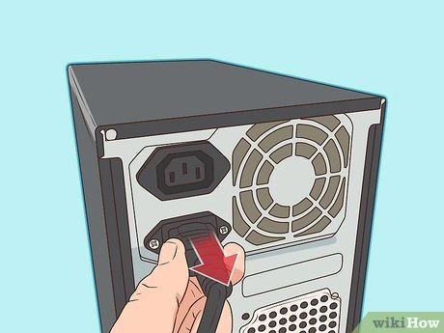
Fully shut down and unplug the computer before you make any attempt to start repairing the computer device.

Slide 3
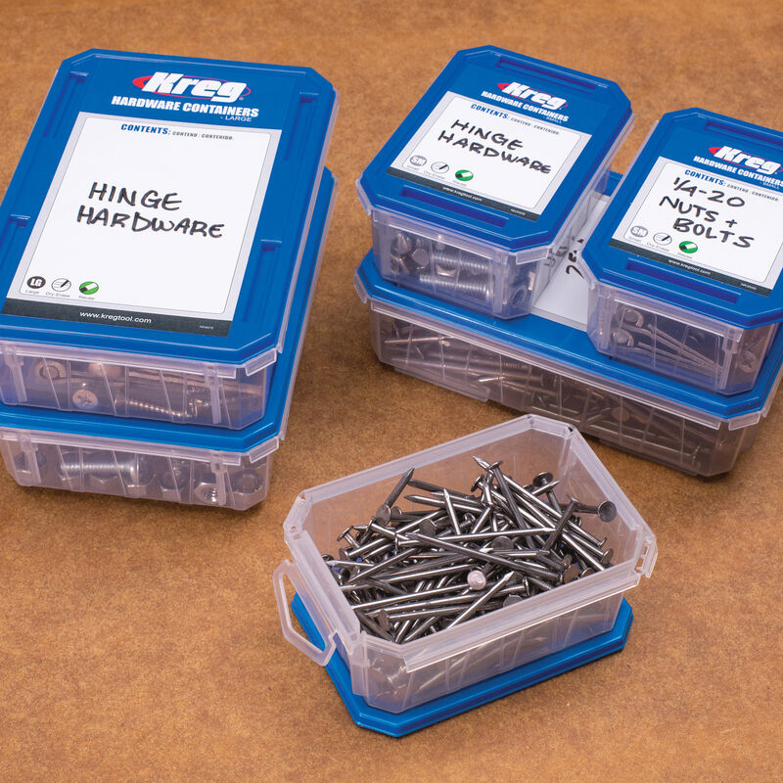
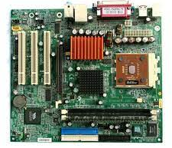
Prepare a place to keep any screws you may remove, a container or piece of paper with labels for each part (case, motherboard, CD drive…etc.) to avoid confusion between the similar looking screws.
Mother
board

Slide 4
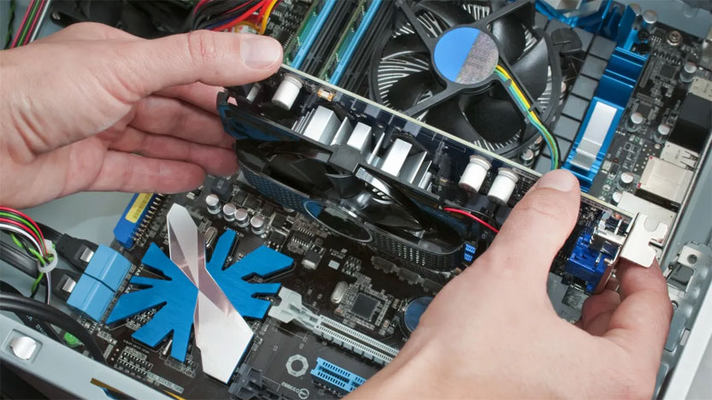
If a component doesn't come out easily, do not forcefully remove it. Instead, check that you are removing it correctly and that no wire or other parts are in the way,

Slide 5
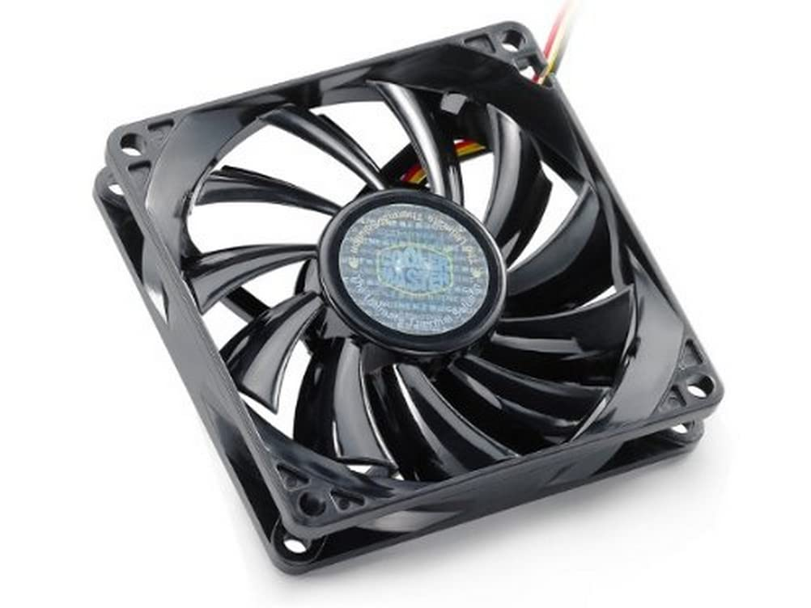
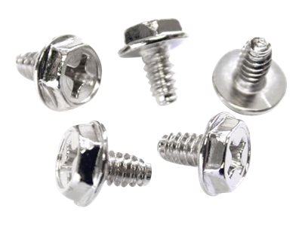
Be careful not to drop any small parts (particularly screws) into unreachable areas such as into the computer fan or disk drive.

Slide 6
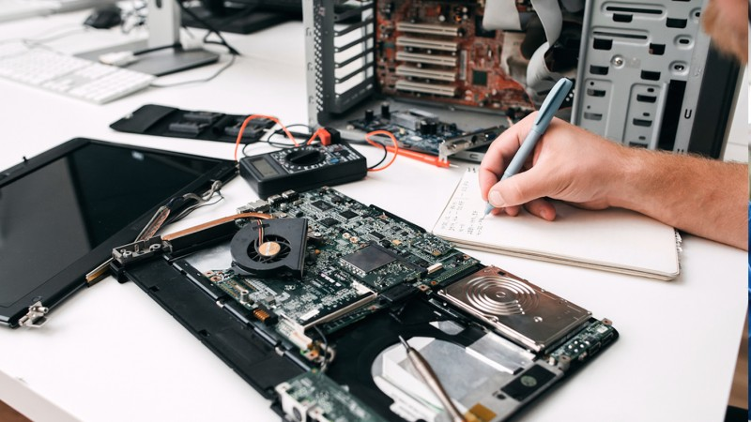
Take notes of what it may caused the computer failure, In case you may need a help from a computer technician profession.

Slide 7
Have a safe experience in assembling your computer!

Slide 8
THANK YOU!

