Slide 1
HOW TO KEEP YOUR COMPUTER SAFE
By : jouri abu azzam

Slide 2
1^{st:}
USE A FIREWALL
A firewall is a software program or piece of hardware that blocks hackers from entering and using your computer.

Slide 3
2nd:
USE AN ANTI-MALWARE APP
Installing an anti-malware app and keeping it up to date can help defend your PC against viruses and other malware.

Slide 4
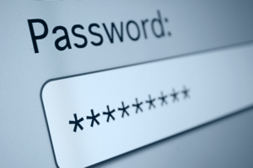
3rd:
USE A STRONG PASWORD
A strong password includes a strong , long , and difficult for someone else to guess example : m#P52s@ap$V

