Slide 1
Name : Lamar (8A)

Slide 2
solving computer problems

Slide 3
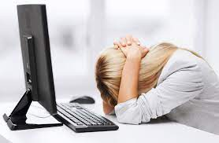
How can we solve computer problems?
Close Background Tasks
Look for Program Updates
Reboot
Look for Program Updates.

Slide 4
What are the 5 common computer problems? 1 ; PC Will Not Turn On. 2 ; Audio Issues. 3; Blue Screens

Slide 5
