Slide 1
Online Danger

Slide 2
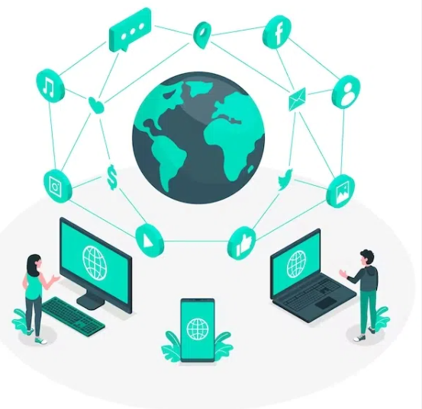
Pros of the internet
1- Making things faster.
2- Easier communication from far distances.

Slide 3
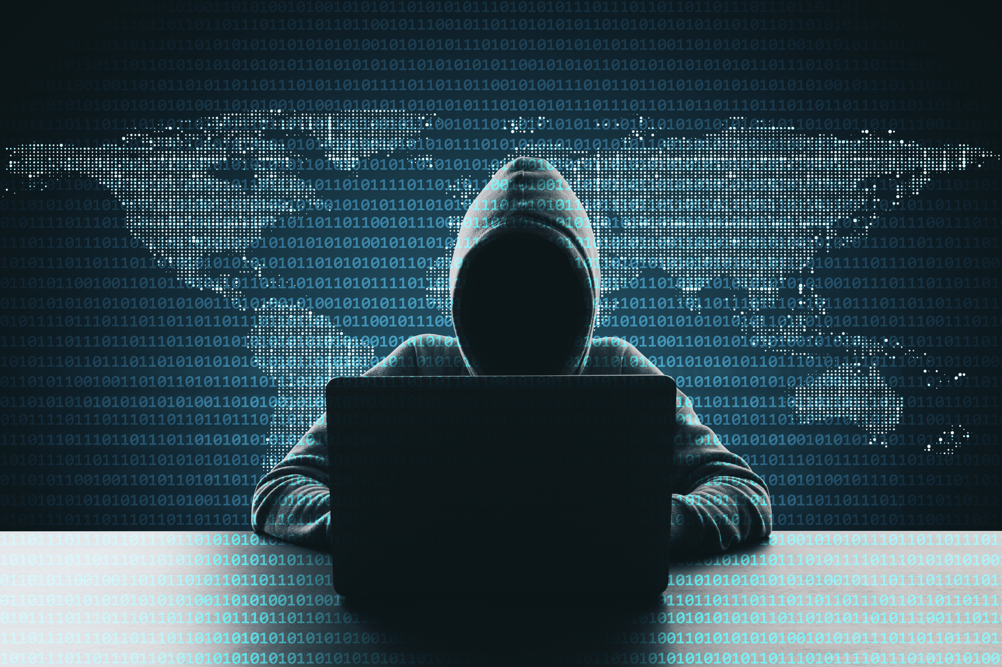
Cons of the internet
1- danger (danger of the internet could be done easily if you are not aware of it and it could be done in different ways like hacking bank account and seeing address ETC).

Slide 4
THANK YOU
By: karam saleh class:7F

