Slide 1
How to solve computer problems
Done By: Natalie Al-Sharqawi

Slide 2
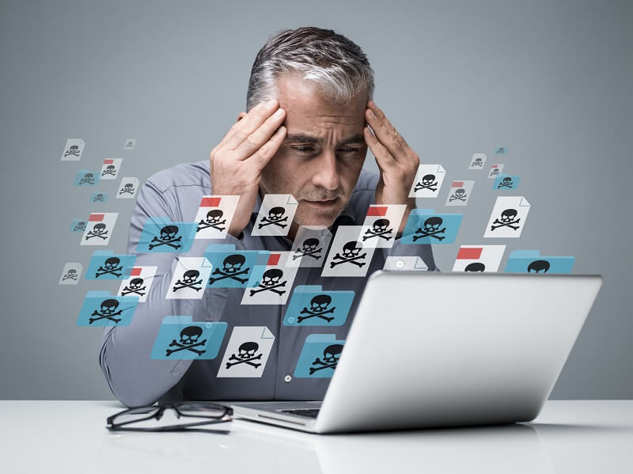
Things to try when u have Troubleshooting :
Consult Google
Reboot
Check C connections
Look for Program Updates
Close Background Tasks
Clean Up Your Hard Drive
Run an Antivirus

Slide 3
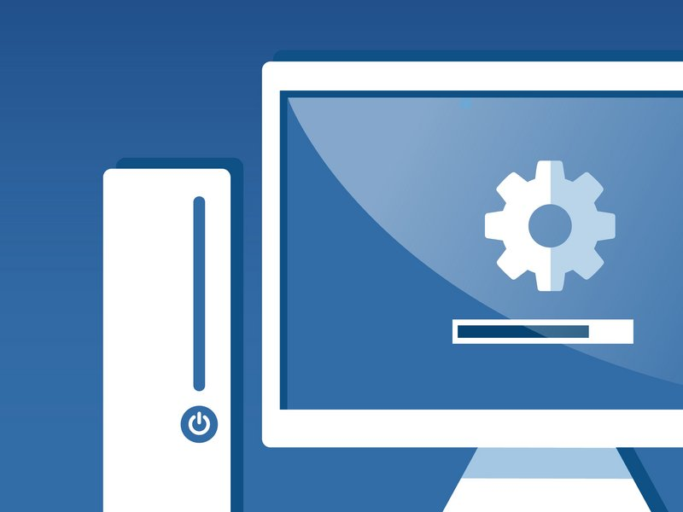
5 easy fixes for common computer problems :
Run a thorough virus Scan
Update your software
cut down on the bloat
Test your Wi -Fi Connection
Reinstall the operating system

