Slide 1
Realistic Fiction
What is realistic fiction ?

Slide 2
Learning Objective: to learn the definition of realistic fiction and to identify its features.
Realistic Fiction
It is a type of writing that seems like it could be real, but it isn’t.
It has characters, setting and events that could exist in real life.

Slide 3
Feature of realistic fiction stories :
Characters: characters are realistic and believable.
Setting : realistic places, places that are real or could be real. ( in a park or at school, not on the moon)
Events : actions or events that could happen to real characters.
Problem : realistic problem that the characters can face in their daily real life.
Solution : believable solutions due to characters actions.

Slide 4
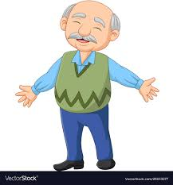
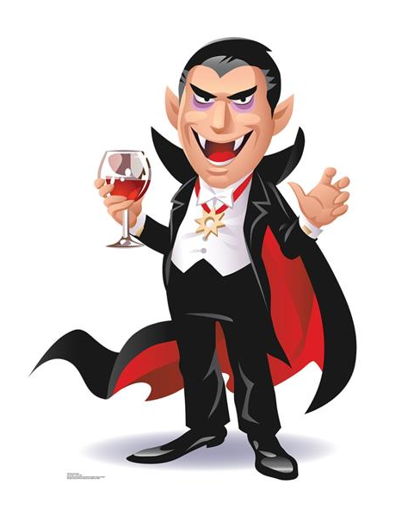
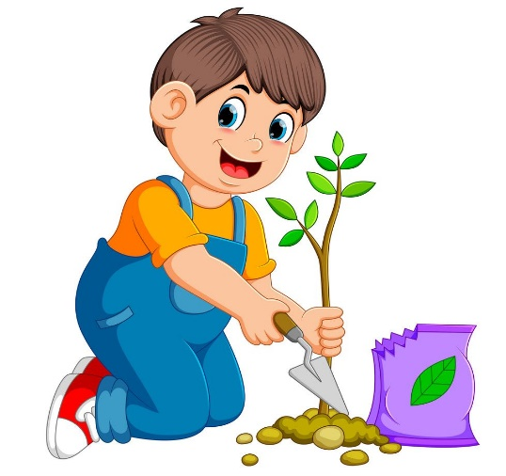
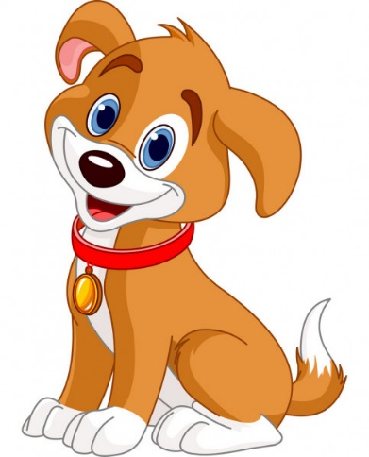
Characters:
Characters who have normal human powers.

Slide 5
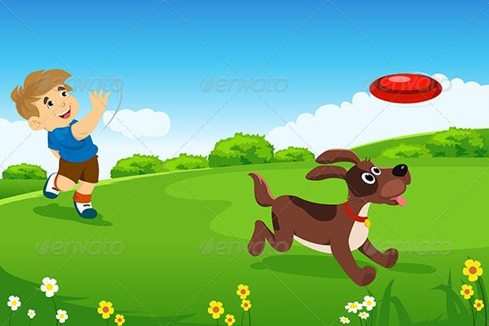
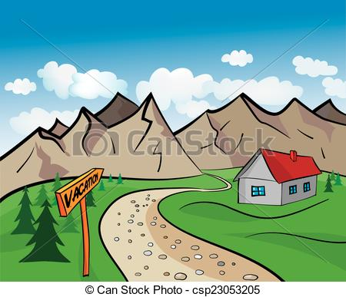
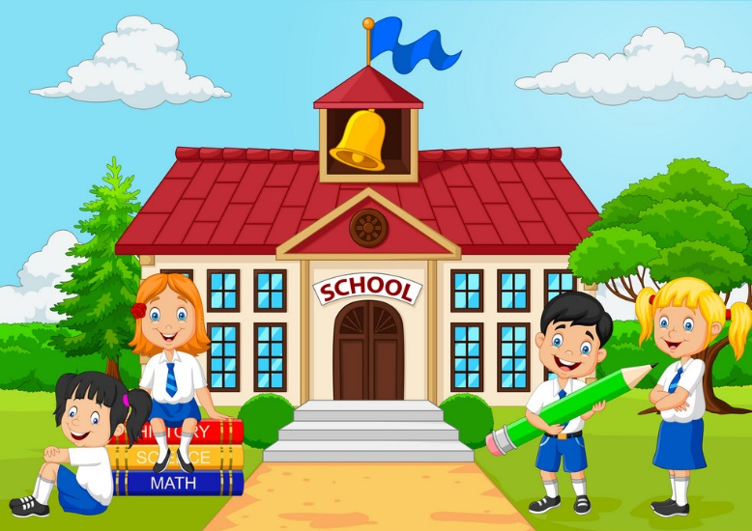
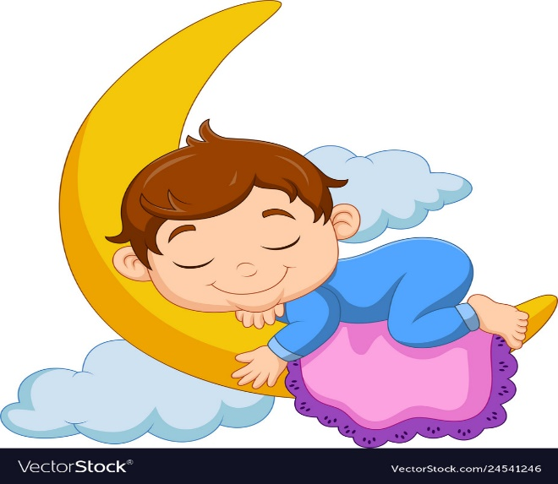
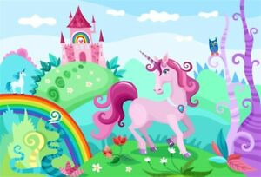
Setting :
Realistic descriptive setting. Real places.

Slide 6
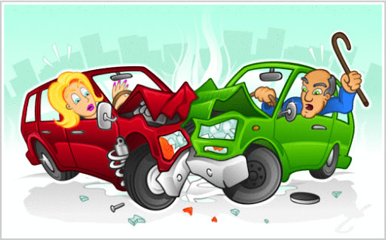
Events:
Everything in the story could happen to real people living in our natural physical world.
Problem:
A real problem that the characters might face.
Solution : A real way to solve the problems.

Slide 7
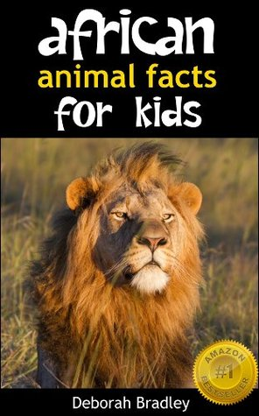
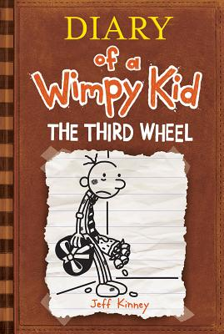
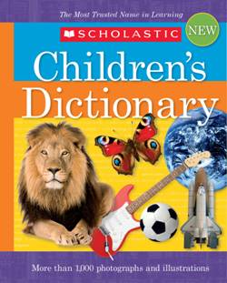
Let’s do the following exercises together.
Q.1 Sort the following books into fiction and non-fiction:
Non-fiction
Fiction
Non-fiction

Slide 8
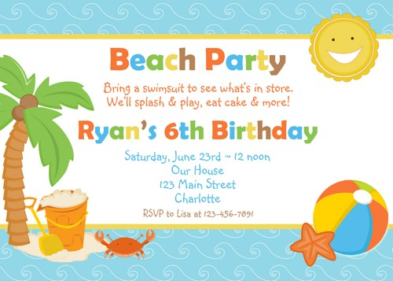
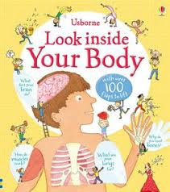
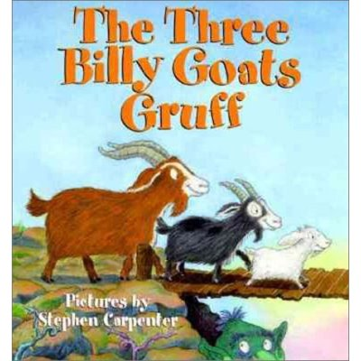
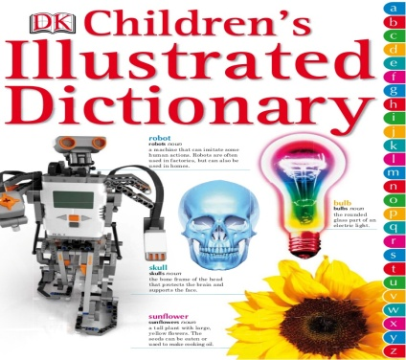
Q.2 Sort the following books into fiction and non-fiction:
Non-Fiction Fiction Fiction Non-Fiction
N-

Slide 9
Your Task:
Watch the following video.
https://www.youtube.com/watch?v=w6HhKlpp7ok
Do you think it is a realistic fiction story? How do you know? Explain your answer.
Yes it is. It seems to look like real but it isn’t.

