Slide 1
Safety when solving computer problems
By Mohammed Mustafa

Slide 2
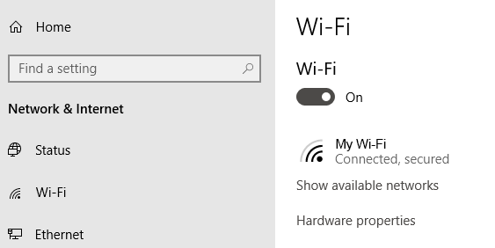
Check your Wi-Fi settings

Slide 3
2. Check Your Access Points (switch off before connecting and disconnecting to main electricity cable)

Slide 4
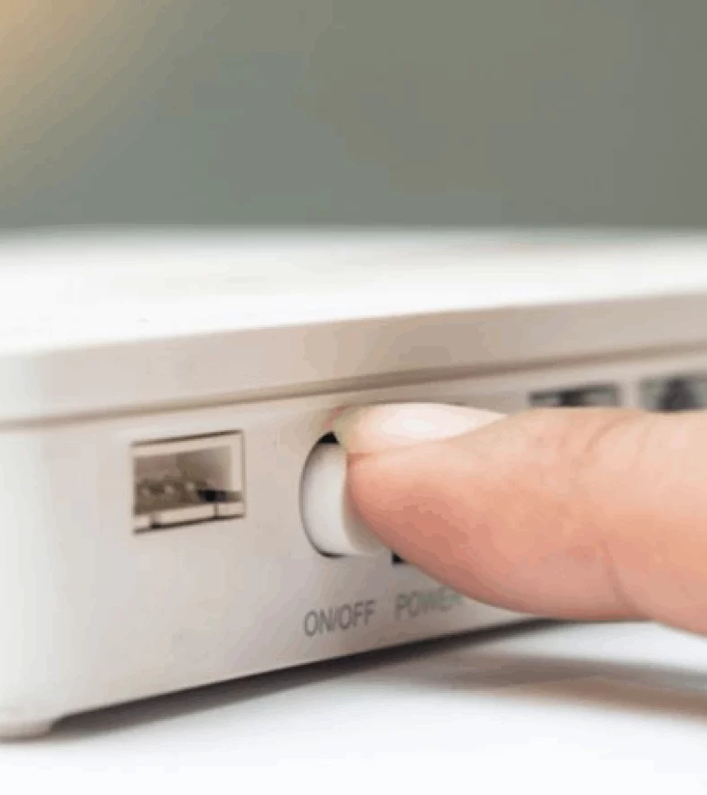
3. Go Around Obstacles and restart router make sure not to open the computer case or any device

Slide 5
4. Check if cables are connected or disconnect the cables if you need to move the device

Slide 6
5. Don’t lift heavy equipment and always ask a grown up for help

