Slide 1
How to be responsible and safe when solving computer problems
By:tina ghawi

Slide 2
Solving network problems
You will be working with electrical machinery when resolving computer issues. Your safety is your first priority. Always abide by your school's computer usage guidelines. Before attempting to fix issues with your home network, always check with your parents.

Slide 3
Safety rules you should follow:
Prior to connecting or detaching a mains electrical cable, turn off all power outlets at the wall.
keep the case of your computer or other device closed.
Never force a cable or component into place or out of it.
Before attempting to relocate an equipment, such as a printer, check sure all cords are cut.
Never lift heavy objects on your own.
When in doubt, STOP and seek assistance.

Slide 4
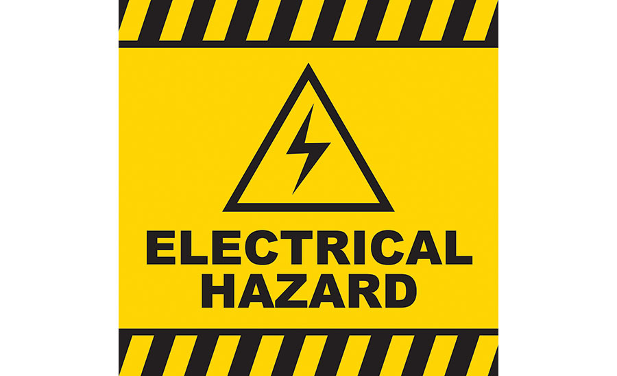
Electrical hazard
Electric shock and burns from contact with live parts are the two main risks of working with electricity. harm caused by arcing, which occurs when electricity leaps from one circuit to another. fire caused by improper electrical installations or equipment.

