Slide 1
Staying Safe Online
By Carol Alamat 8D

Slide 2
Never open E-mails from unknown people
Before opening email messages, consider if a sender is trustworthy.
Use caution when opening an email from an unknown sender who may wish to harm your computer or steal your identity.
This Photo by Unknown Author is licensed under CC BY-SA-NC

Slide 3
Keep Software Updated
To minimize the risk of malware infection or security breach.
The latest software update will provide the latest security patches, the best performance, and also make it harder for hackers to hack into your device.

Slide 4
Never open unsecure websites
Check if there is a lock at the beginning of the website, that determines that the website is safe and secure for use
Check if it begins with “Https", the S stands for secure.

Slide 5
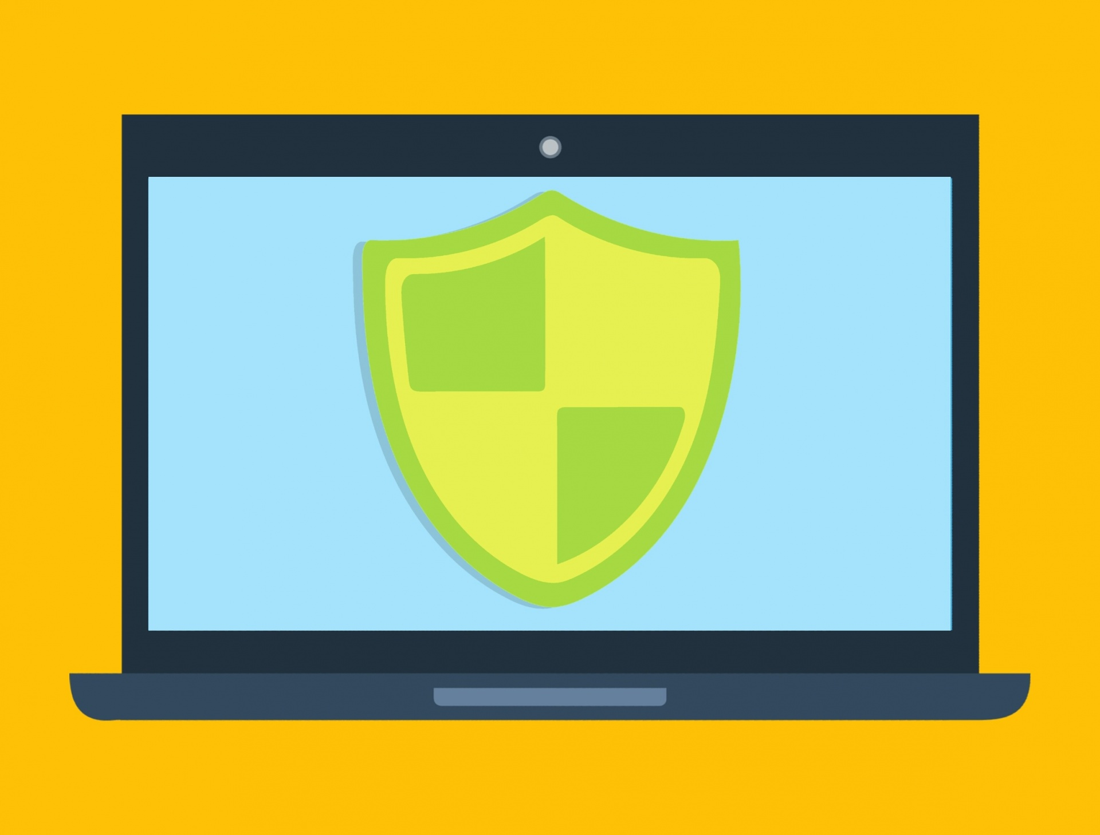
Install an antivirus and keep it updated
Antivirus software is a vital component of your overall online and computer security strategy in its protection that helps safeguard against data and security breaches along with other cyberthreats. When looked at simply, a computer virus is similar to a flu virus.

Slide 6
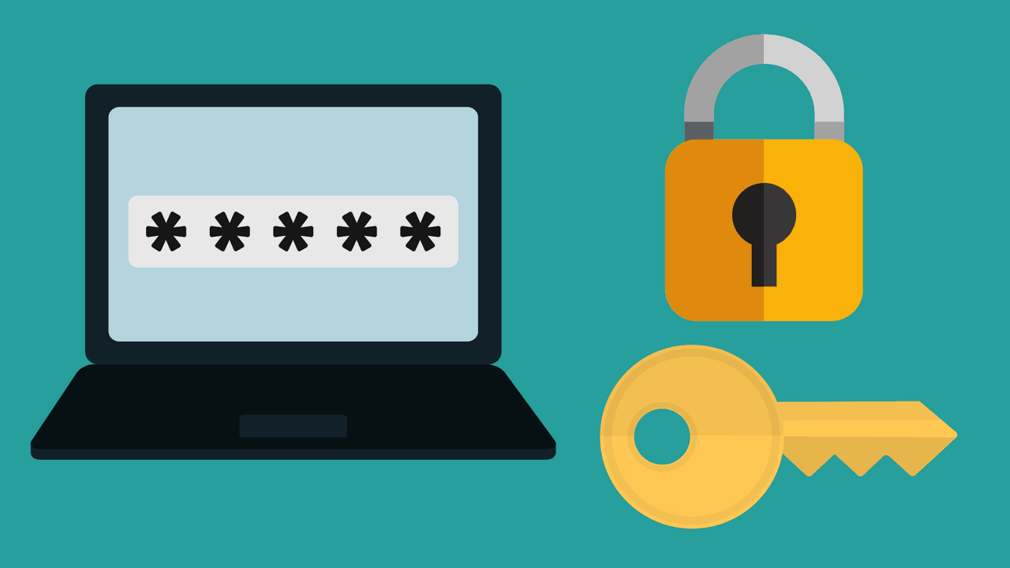
Use a strong password
Change passwords frequently.
Use upper and lower case letters.
Numbers and special characters.
Password should be at least 8 characters(number and letters).
Don’t use common sequence numbers, birthdates and family names.
Use a two step authentication ,whereby the sight will send you a code to your device for security.
This Photo by Unknown Author is licensed under CC BY-NC

