Slide 1
Being Safe While Solving Computer Problems
HaSHem Abdulrazik-8F

Slide 2
Why to be safe while solving your computer problems
Being safe while solving your computer problems is really important and challenging as well, if your not safe and careful a lot can happen in a short period of time.
Example; hackers can get into your accounts and hack them or maybe steal information or work, specially your bank accounts they can make a transfer for a large amount of money in your account and even more problems can happen.

Slide 3
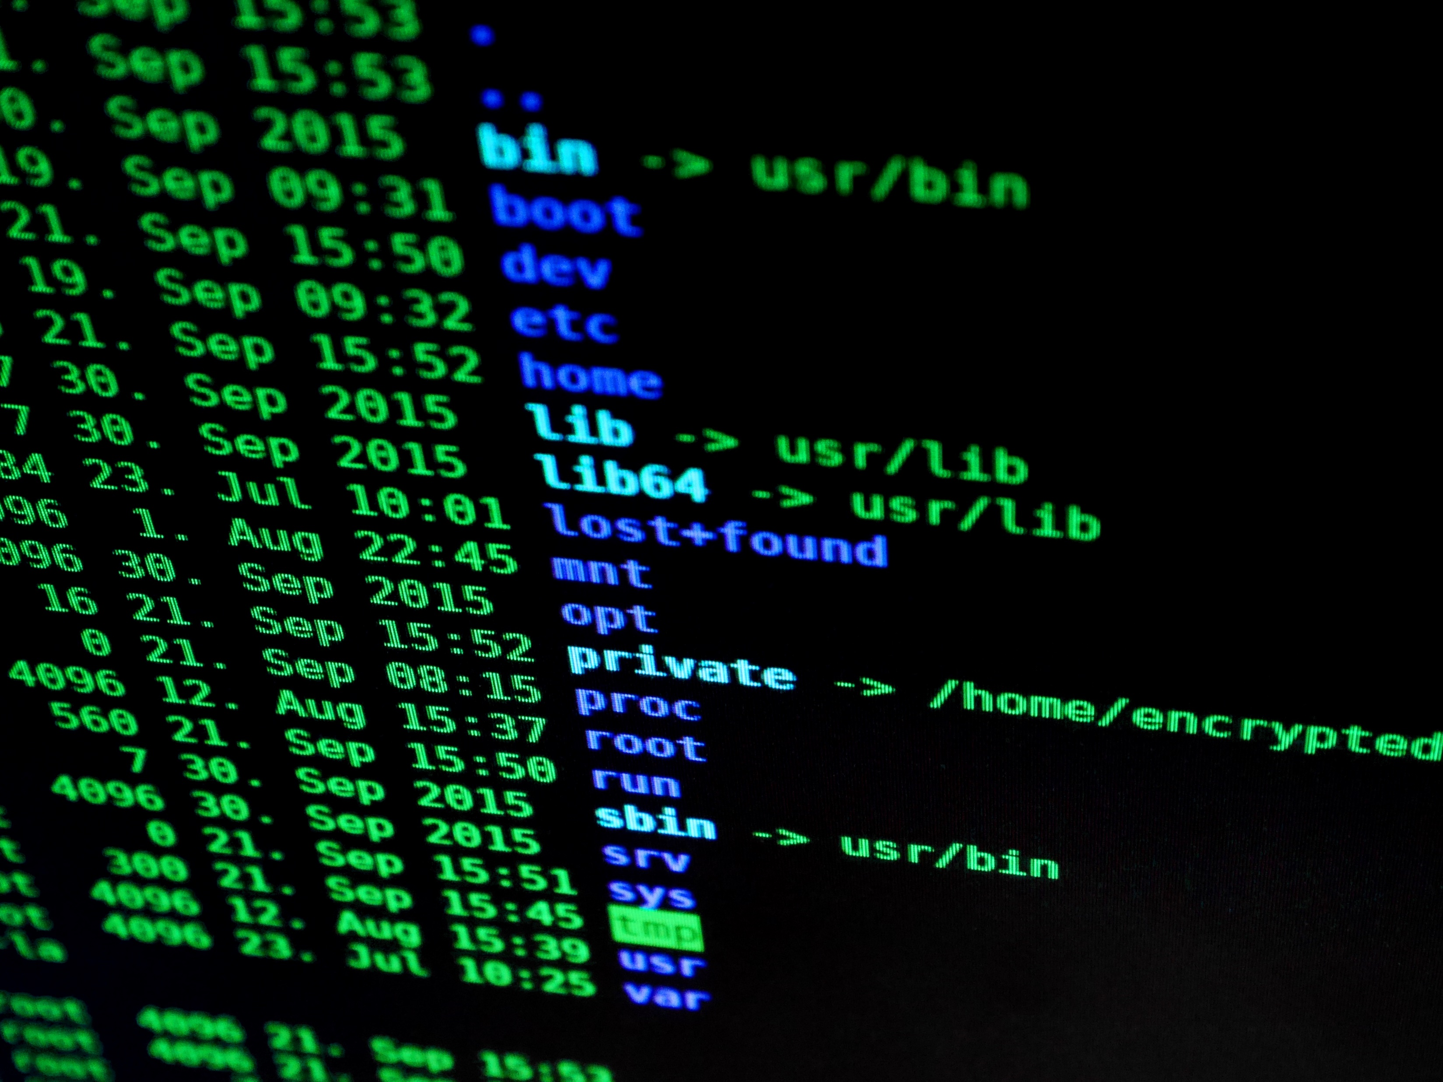
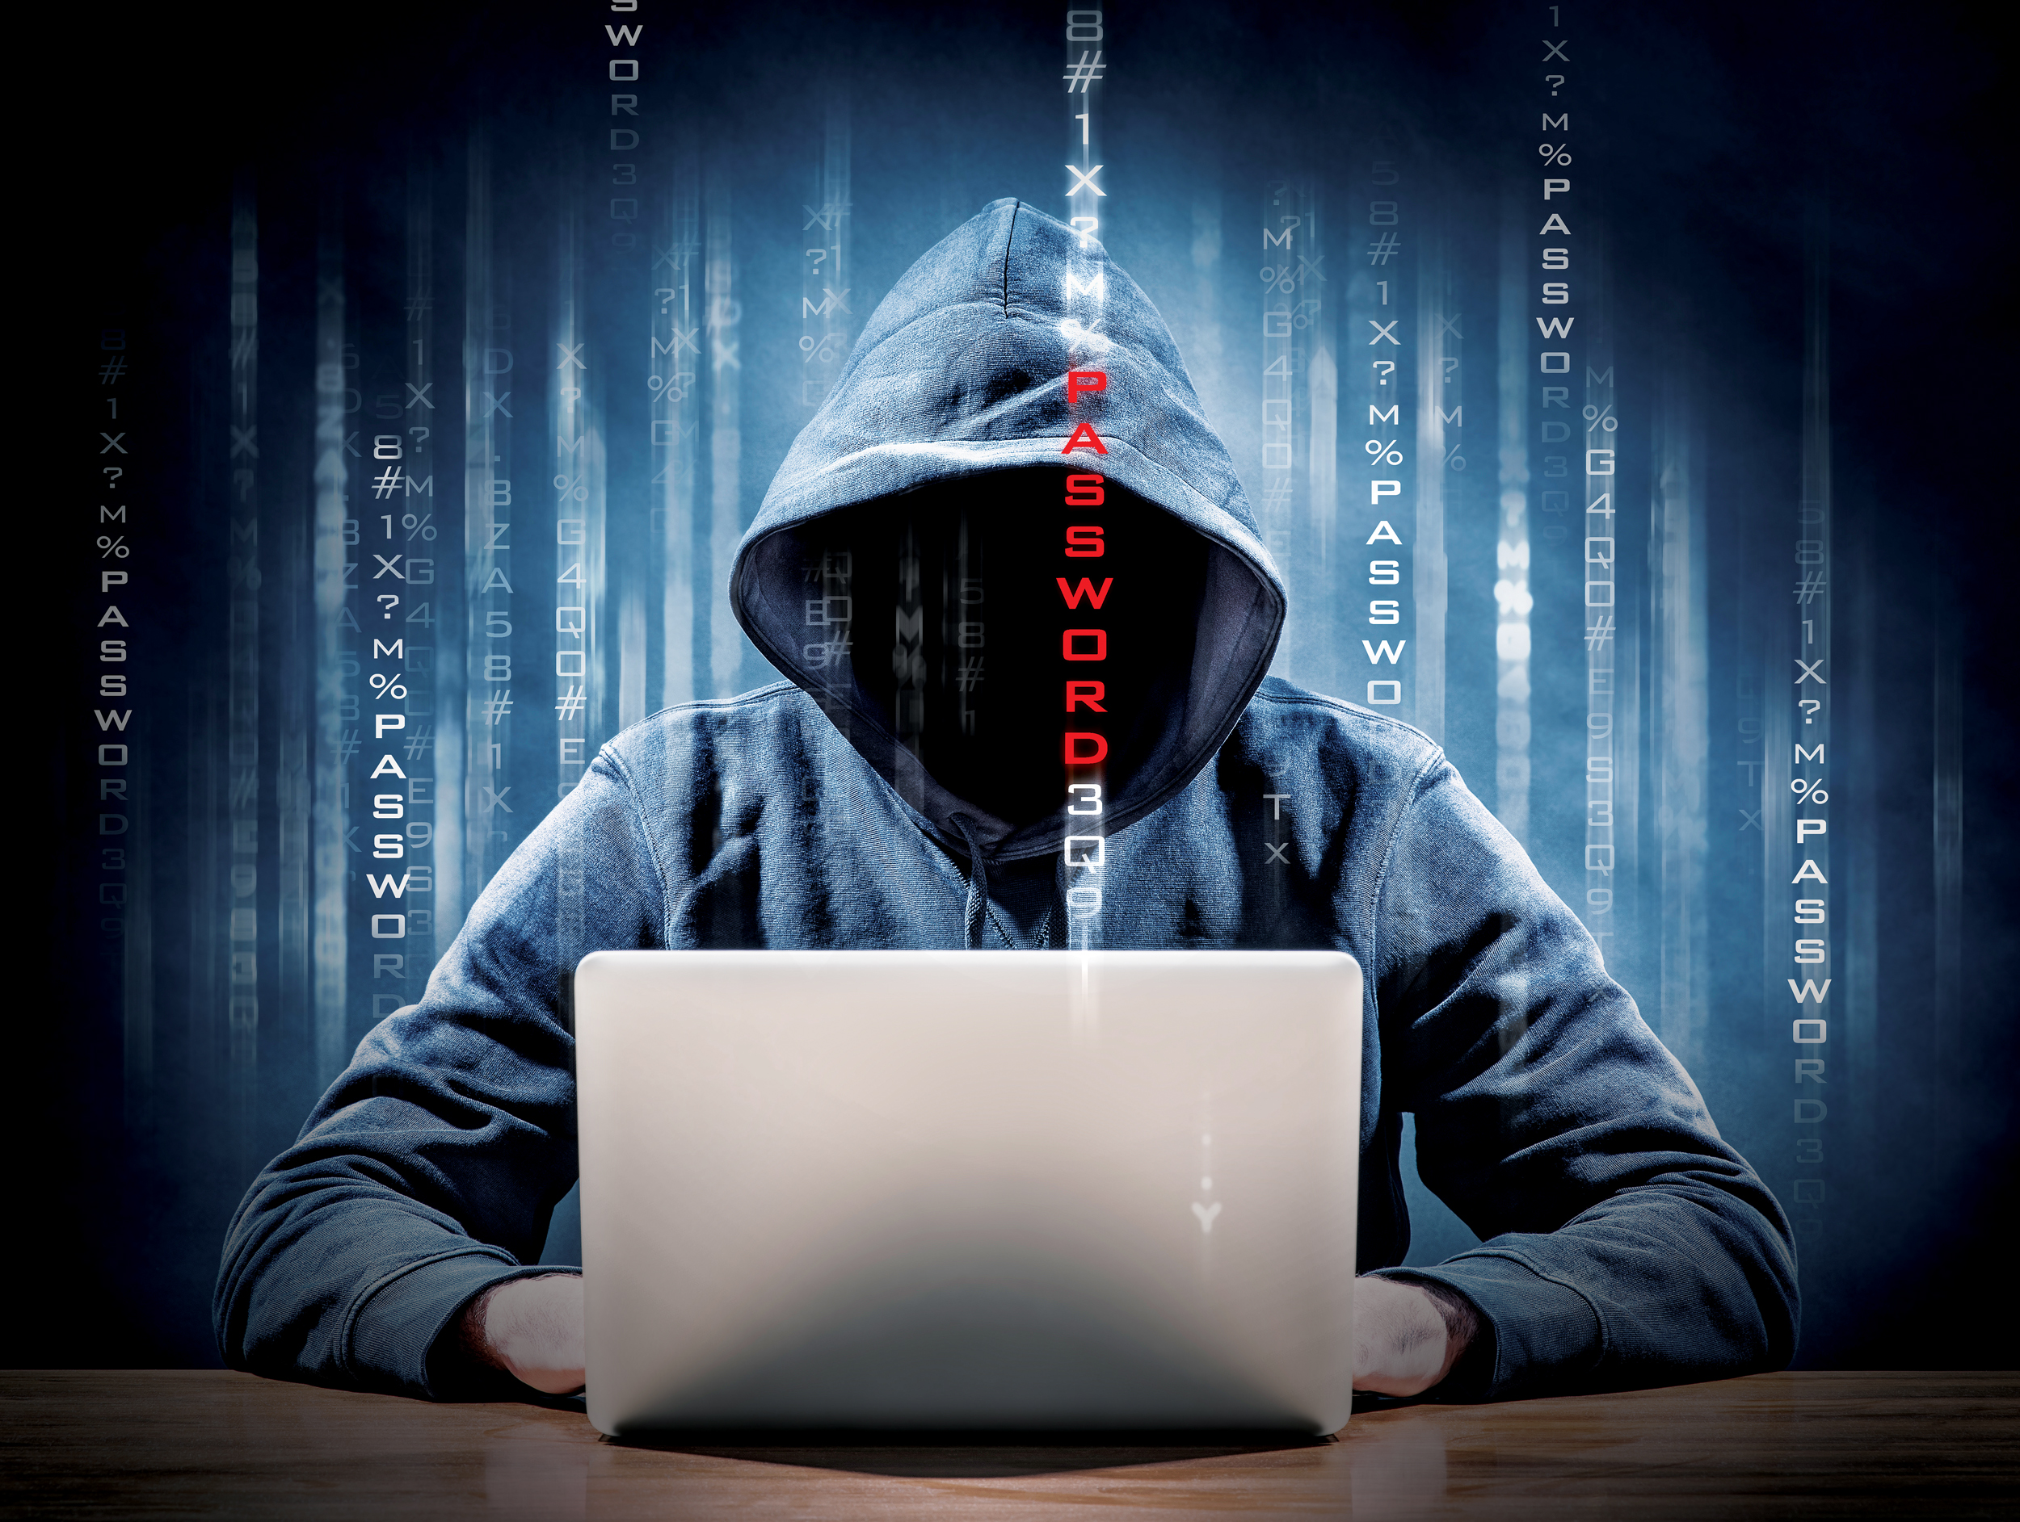
What can happen if your not safe
If your not safe you can easily get hacked, and people can steal money from your bank account or even private information.
They can also black mail you by telling you that they have pictures or videos and if you don’t give them what they want they’ll post it and embarrass you on the internet.

Slide 4
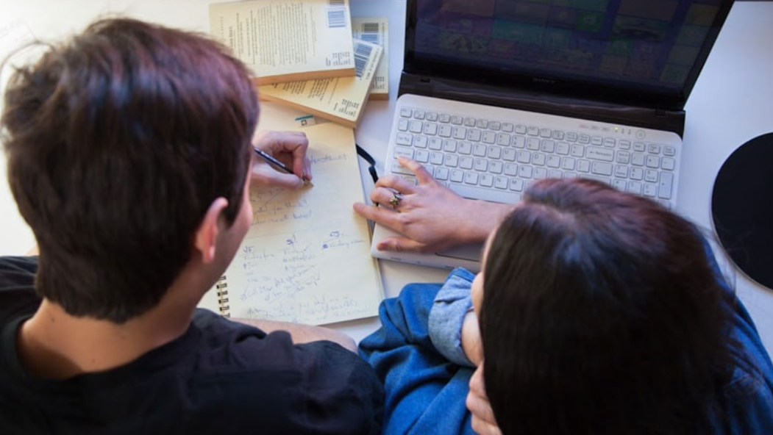
How to be safe?
1.Have a strong password.
2.Use a firewall to secure your computer from hackers.
3.Install antivirus software.
4. Install antivirus software to thwart hackers.
5. Avoid linking accounts.

