Slide 1
Ways to keep your data secure, and maintain the health of your computer
Created By: Omar Alsumrain

Slide 2
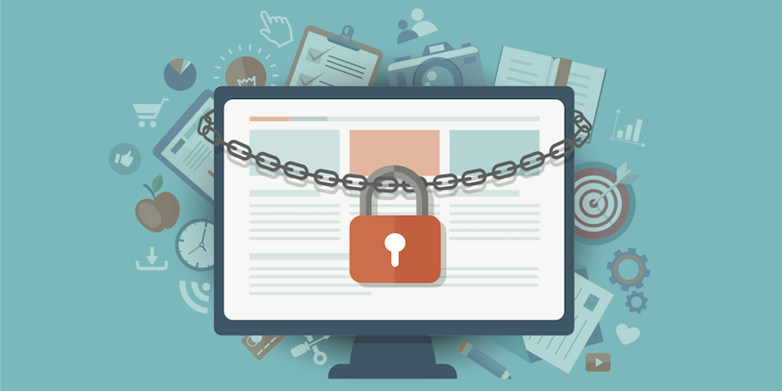
Keep your data and informtion secure online
Use Strong, Unique Passwords: Create strong and complex passwords for your accounts, and avoid using the same password for multiple sites. Consider using a reputable password manager to help you keep track of them.

Slide 3
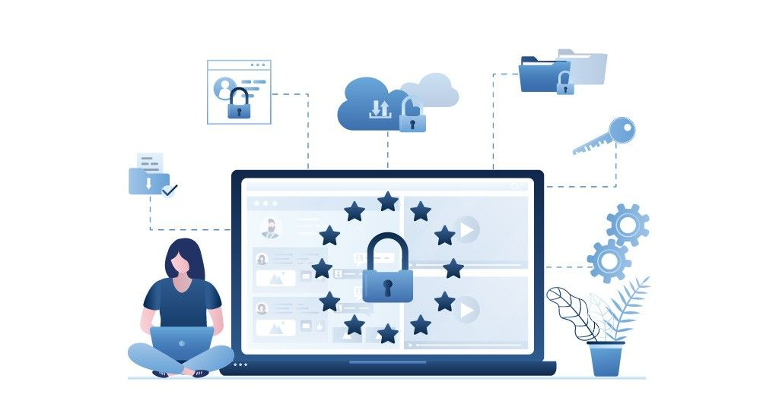
Keep your data and information secure online
Install Antivirus Software: Use reputable antivirus and anti-malware software to scan and protect your computer from viruses, malware, and other malicious software.
And scan for malware and viruses regularly.

Slide 4
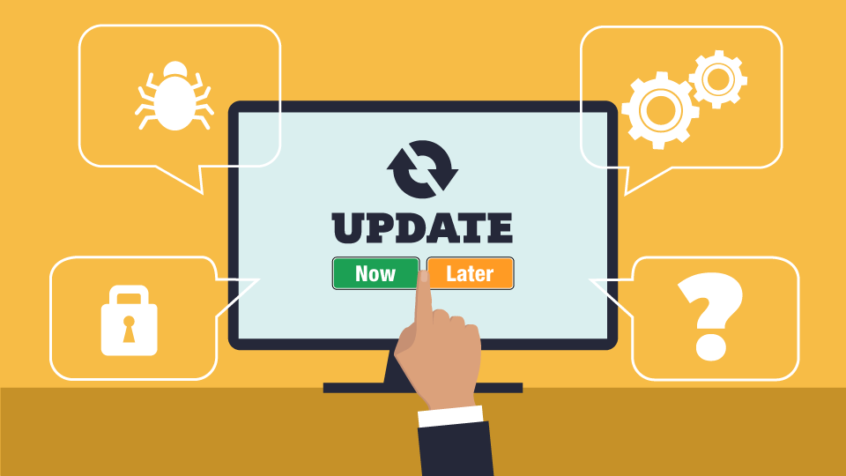
Keep your data and information secure online​
Keep Software Updated: Regularly update your operating system, web browsers, and software applications. Updates often include security patches that protect your computer from known vulnerabilities.

Slide 5
Keep your data and information secure online
Use a Firewall: Enable a firewall on your computer to monitor and filter incoming and outgoing network traffic, which can help block unauthorized access and malicious activities.

Slide 6
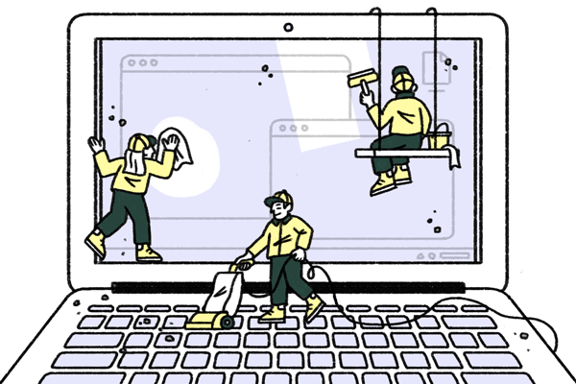
How to maintain the health and performance of your computer
Regularly Clean and Dust Your Computer: Dust and debris can accumulate inside your computer, leading to overheating and performance problems. Clean the internal components, including fans and heat sinks, periodically to ensure proper airflow.

Slide 7
How to maintain the health and performance of your computer
Update Drivers and Software: Keep your operating system, graphics drivers, and other software up to date. Outdated drivers can lead to compatibility issues and system crashes.

Slide 8
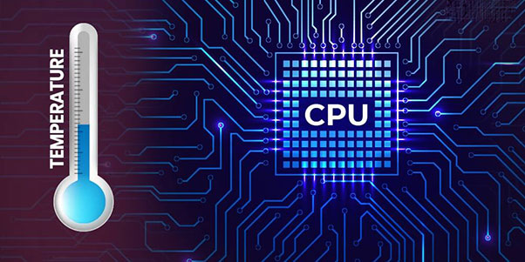
How to maintain the health and performance of your computer
Monitor Temperature: Use monitoring software to keep an eye on your computer's temperature. Overheating can cause performance issues and hardware damage. Ensure your computer has adequate cooling.

Slide 9
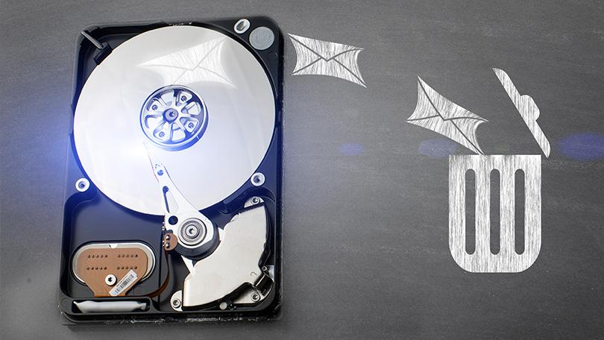
How to maintain the health and performance of your computer
Optimize Storage: Regularly clean up your hard drive by removing unnecessary files, programs, and temporary files. Consider using disk cleanup tools or third-party optimization software.

