Slide 1
Online Danger
By:Dina haddad

Slide 2
What can go wrong online?
Cyberbulling
Invasion of privacy
Identity theft
Falling for Scams
Hacking

Slide 3
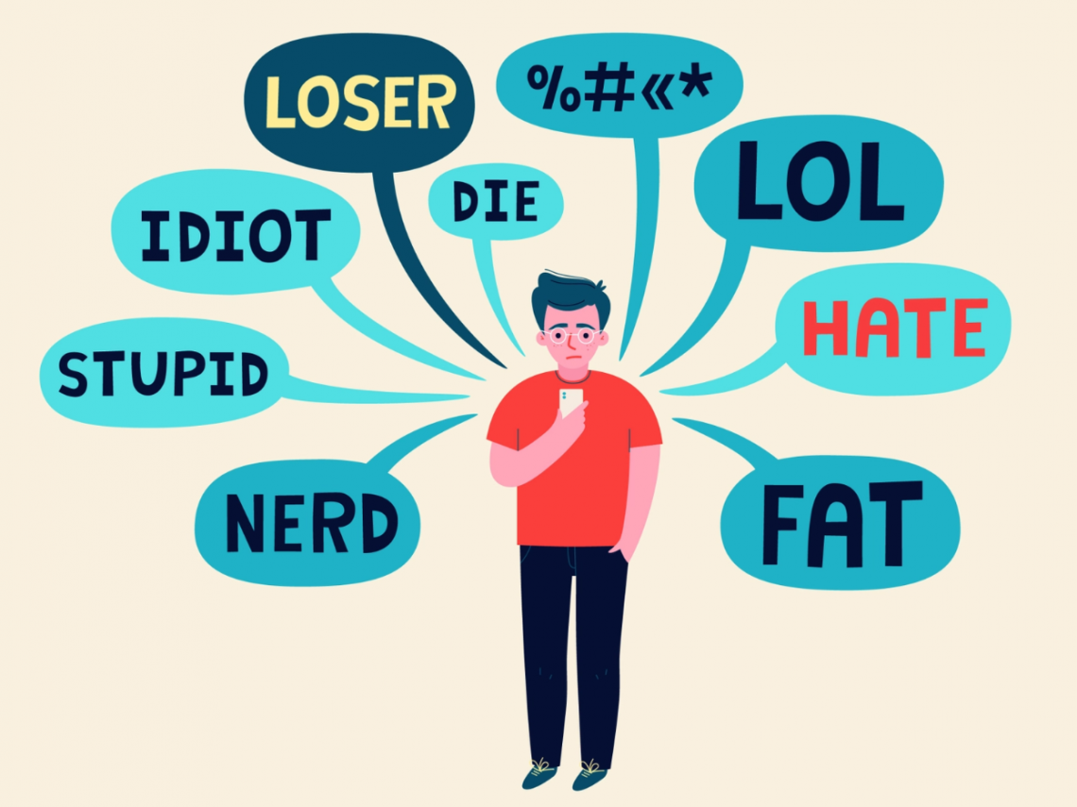
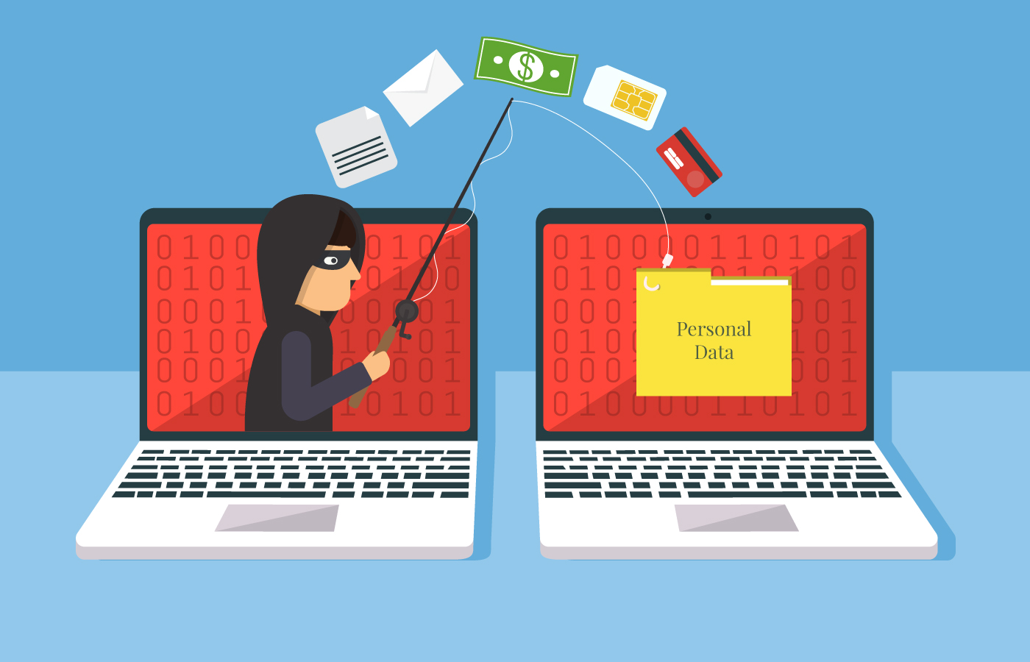
Examples:
Cyberbullying
Falling for scams

Slide 4
How to avoid the online danger
Get the latest anti-virus
Remember not to share your password.
Choose strong password.
Be careful of suspicious links.
Don’t post a full name, address, phone number, school name and other personal information.
Be careful about what images and messages you post, even among trusted friends.
Talk to a trusted person if you come across anything that you find offensive or inappropriate.
Be careful who you meet online.

Slide 5
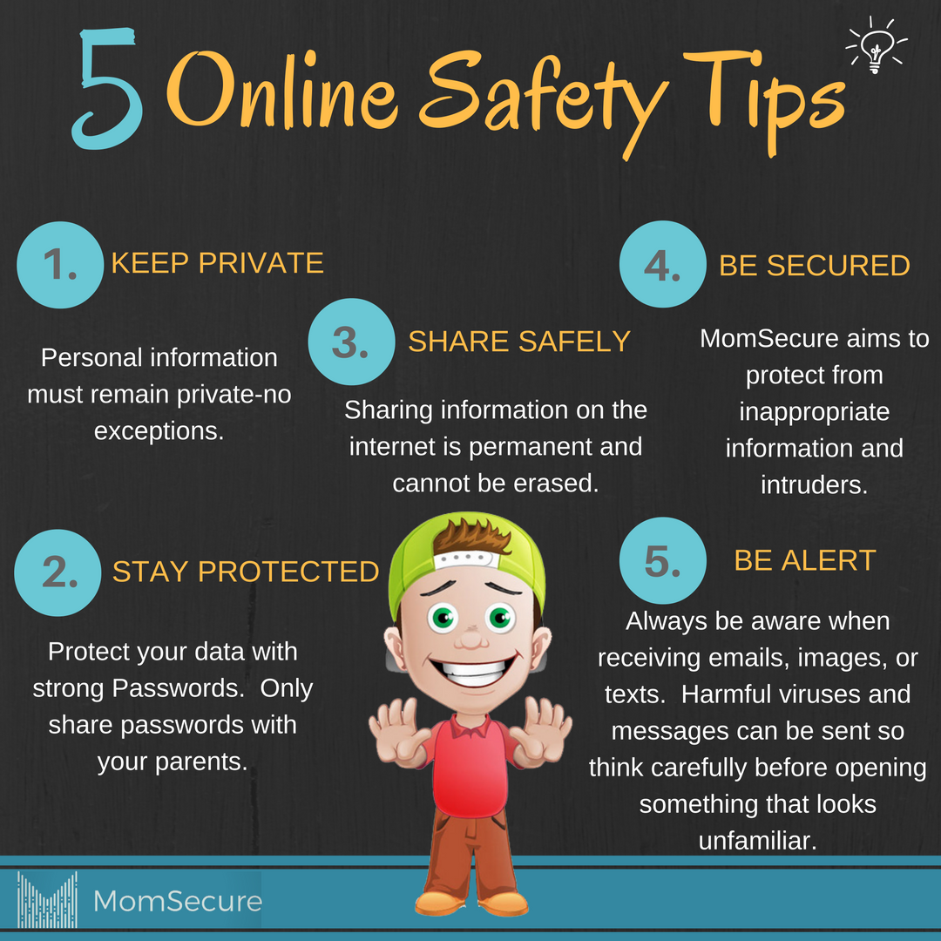

Tips to stay safe

