Slide 1
Cybercrime
Yasmine AbuHadba
7-F

Slide 2
Cybercrime is any criminal activity that involves a computer, networked device or a network. While most cybercrimes are carried out in order to generate profit for the cybercriminals, some cybercrimes are carried out against computers or devices directly to damage or disable them.

Slide 3
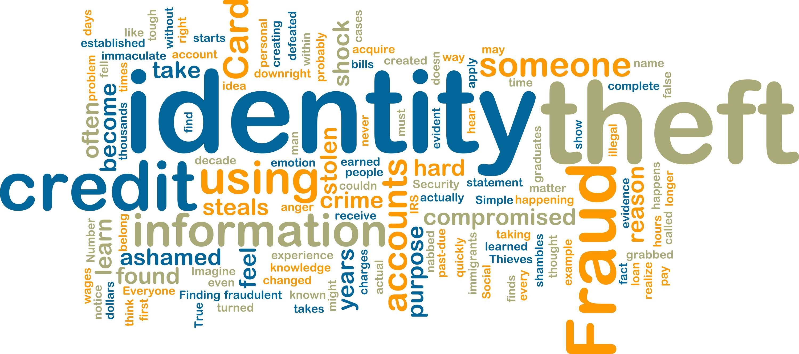
Cybercrime methods:
Identity theft:
Online identity theft refers to the attacker's use of online platforms to steal identities and commit online fraud. This can range from attacks on a user's social media account or e-commerce platform.

Slide 4
Phishing :
Phishing is a type of social engineering attack often used to steal user data, including login credentials and credit card numbers. It occurs when an attacker, masquerading as a trusted entity, dupes a victim into opening an email, instant message, or text message.

Slide 5
Scamming:
Cyber scams are scams that are carried out online. This could be through things like dodgy emails and websites, or fake accounts on social media.

Slide 6
Hacking:
Hacking is identifying and exploiting weaknesses in computer systems and/or computer networks. Hackers usually break into computer systems that hold a lot of personal information.

