Slide 1
Danger online
By: Salma Nabulsi
Grade 7D

Slide 2
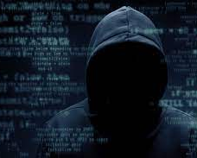
Cybercrime
cybercrimnal is someone who used the internet to commit their crimes. Some cybercriminals sell illegally over the internet. Some cybercriminals attempt to steal money and other possessions from people.

Slide 3
Identity theft
Identity theft is when a criminal steals personal information such as a person's name and address. They also steal official information such as social security numbers or passport numbers

Slide 4
Scamming
A criminal sends out an email that asks for money. Sometimes the email contains a threat that the victim owes money and will have to go to court if they do not pay the debt

Slide 5
Hacking
A criminal breaks into the computer system, usually to steal files or personal information. Hackers usually try to break into computers systems that hold a lot of personal information.

