Slide 1
malware
By Raad Atiyat 7d

Slide 2
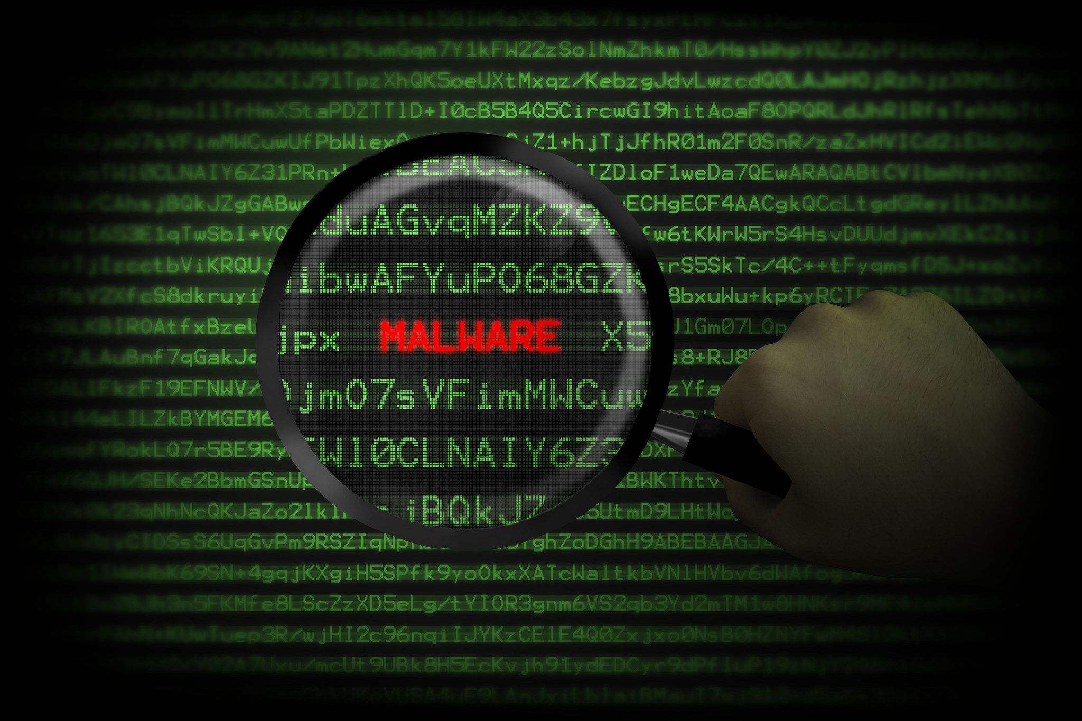
What is malware
malware can be put on your computer by hackers that can do many different things depending on the type

Slide 3
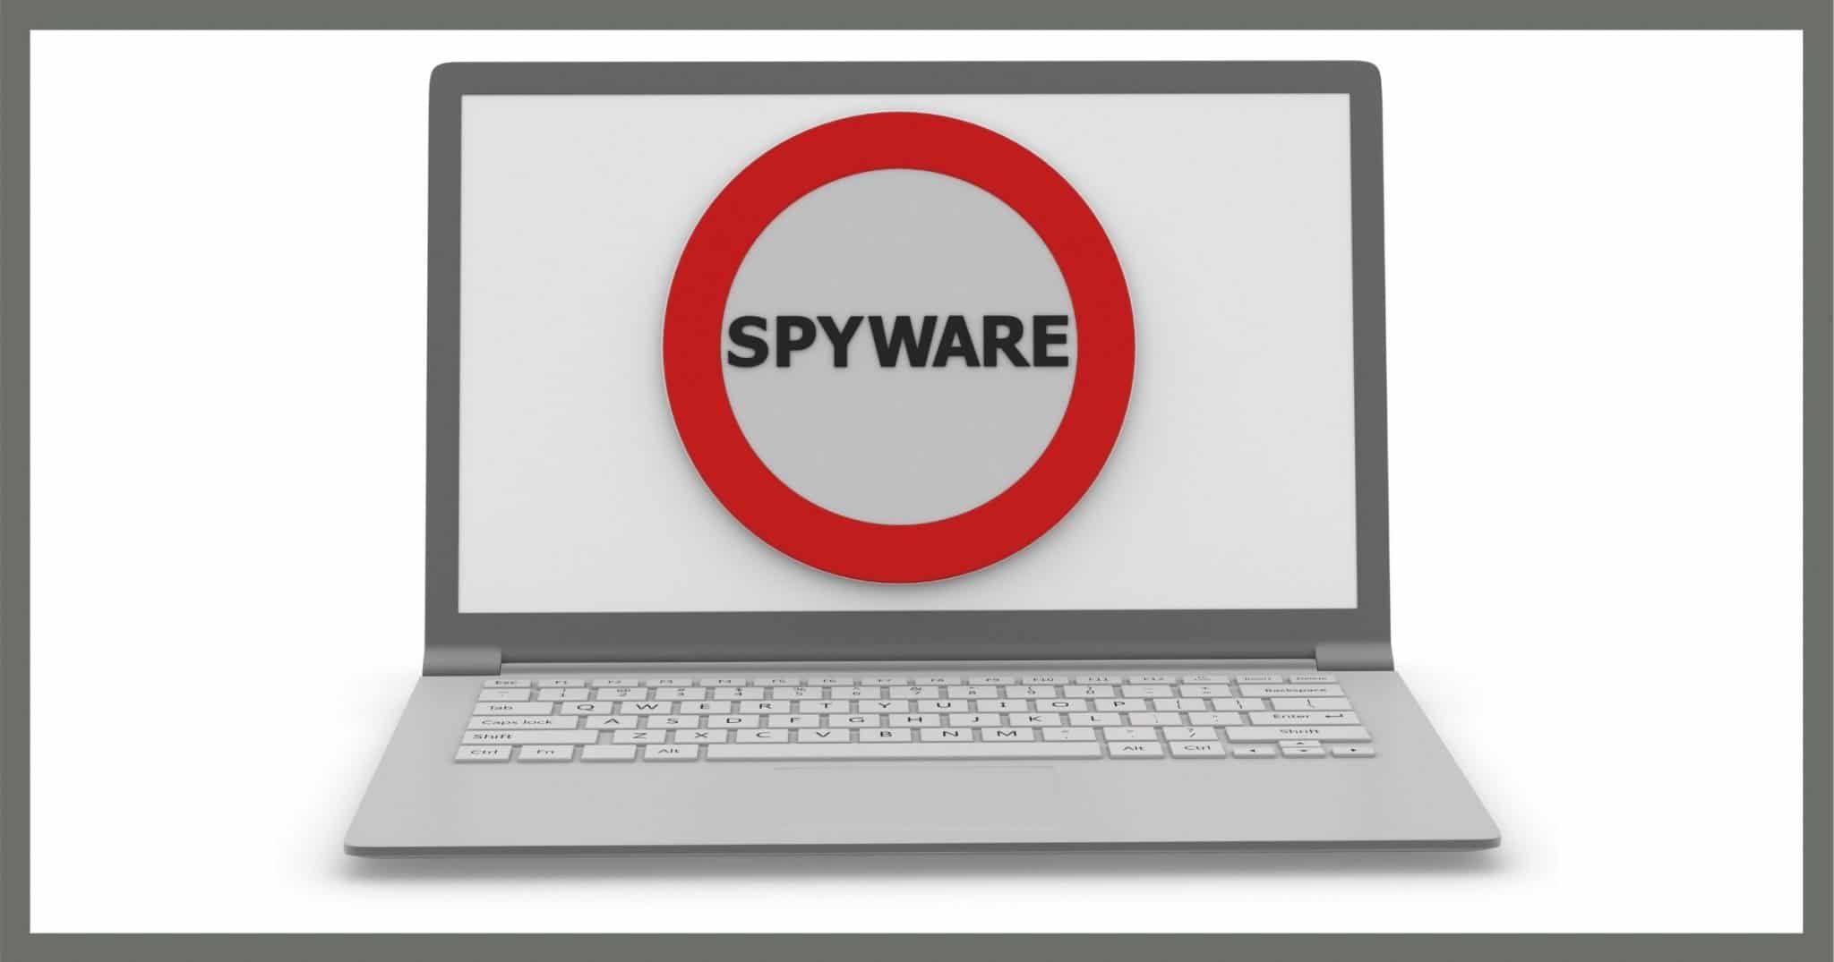
Spyware
Spyware is the most common malware and is used to see everything on your computer

Slide 4
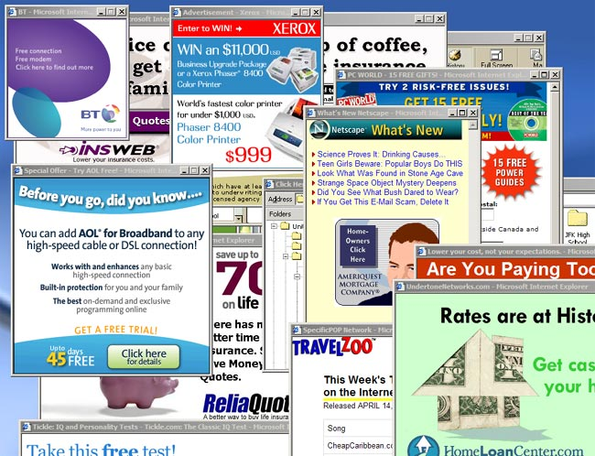
adware
Adware forces ads to pop up on your computer

Slide 5
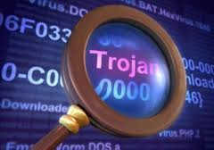
trojan
Trojans are malware hidden in other normal looking files

Slide 6

ransomware
Ransomware stops all data on a computer from being able to be used the hacker normally would ask for money to fix the data

Slide 7

How to stop malware
Getting an antivirus and avoiding possible viruses online so stay safe online

