Slide 1
Cybercrime
By alazar

Slide 2
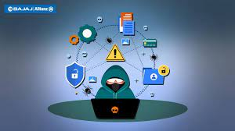
Cybercrime
Cybercrime is doing something illegal on the internet such as committing fraud, stealing identities, or violating privacy

Slide 3
Types of cybercrime
There are 4 types of cybercrime:
1- identity theft
2- phishing
3- scamming
4- hacking

Slide 4
Identity theft
Identity theft Is when a criminal steals personal information such as a person’s name and address. They also steal official information such as social security numbers or passport numbers.

Slide 5
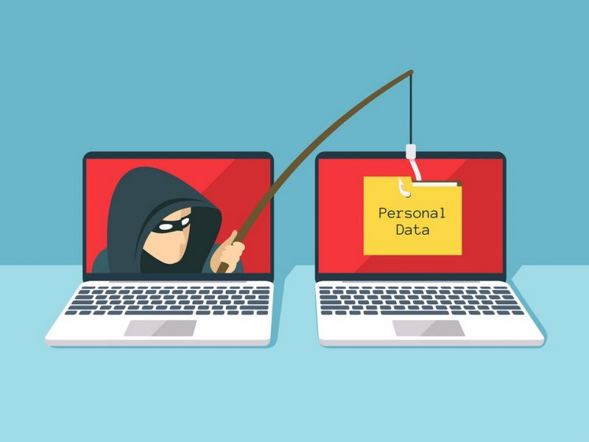
Phishing
Phishing is when a criminal creates a fake website that looks like the official, the criminal then writes a fake email that looks like it comes form the website.

Slide 6
How to protect yourself form cybercrime.
With the help of a firewall and VPN you can keep your internet network secure. A VPN encrypts all the traffics before it reaches your device. If the hackers want to attack your device, they cannot intercept anything except your encrypted data.

