Slide 1
Be safe
By :Nicola shnoudi

Slide 2
What is the internet
The Internet, is a worldwide system of computer networks which you can if you have permission, get information from any other computer (and sometimes talk directly to users at other computers)

Slide 3
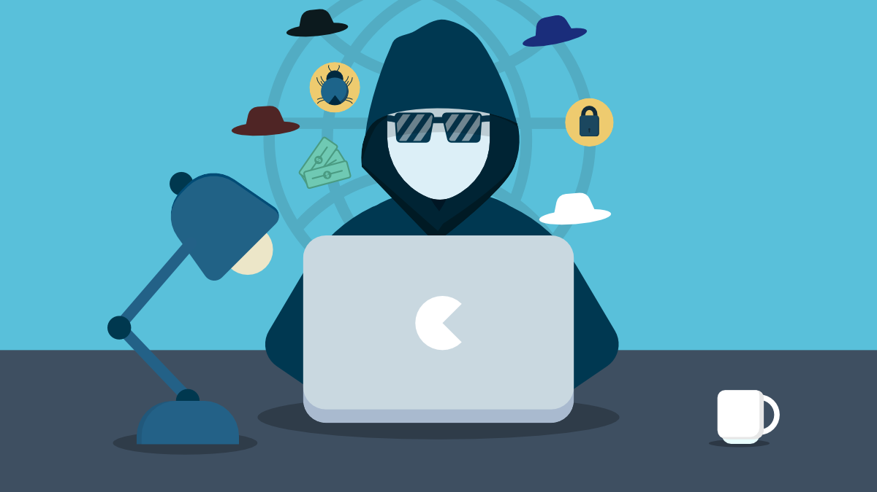
How to stay safe from the internet
The internet has lots of dangerous and harm full stuff like hackers ,viruses ,and devise ruining websites so we should be careful using the internet

Slide 4
How to take care of your laptop
Hackers
To take care of hackers you should keep your device updated and always check in your files if there is anything weird or any traces of hackers
Viruses
Viruses can make missing files or randomly shut down the device so reboot your device in safe mode
And change your password and your google password and check for suspicions apps

Slide 6
Stay safe
Thanks for watching

