Slide 1
Computer Problems
By: Samir Malky, 8F

Slide 2
Table of contents
Slide 3: What are computer viruses?
Slide 4: What can computer viruses do?
Slide 5: How to prevent computer viruses from infecting your device?
Slide 6: Signs of a computer virus
Slide 7: Avoid eating or drinking next to your computer.
Slide 8: Keep your computer clean.

Slide 3
What are computer viruses?
A computer virus is a type of malicious software, or malware, that spreads between computers and causes damage to data and software. Computer viruses can enter the device through malicious online downloads, infected email attachments, or by plugging in infected hardware like a USB stick.

Slide 4
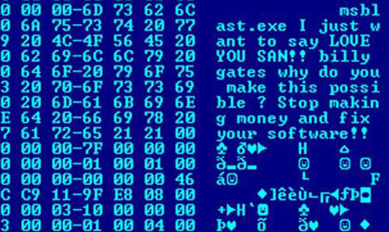
What can computer viruses do?
Computer viruses aim to disrupt systems, cause major operational issues, and result in data and leakage. All types of data can be leaked, deleted, or changed, for example: Private information, important files, photos etc. The virus then spreads from the document or software it is attached to through networks, drives, file-sharing programs, or infected email attachments.

Slide 5
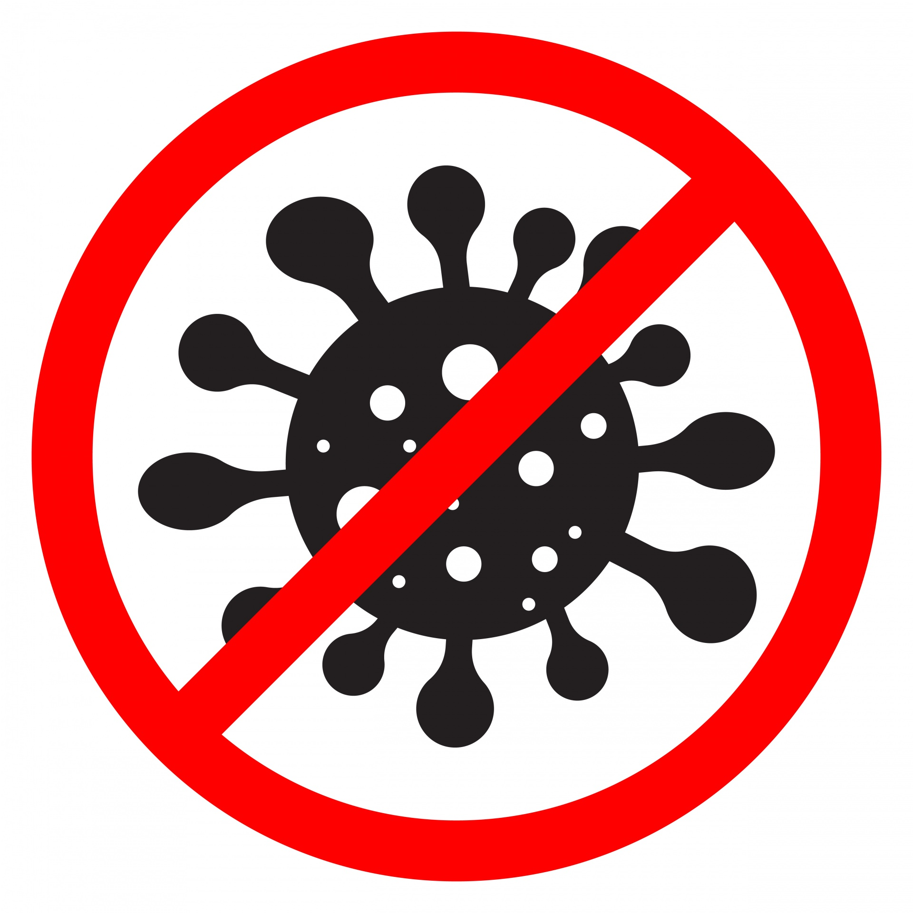
How to prevent computer viruses from infecting your device?
There are multiple ways to stop them, including:
Avoid any anonymous emails or links without adult supervision.
Use a trusted anti-virus product.
Avoid any suspicious pop-up advertisements.
Always keep your device up to date.
Backup your computer.
Do not plug in any suspicious or unnamed

Slide 6
Signs of a computer virus:
Computer has a very unusual slow performance.
Crashes (computer shutting down or apps closing) frequently, at random and/or unexpected times.
Missing files and data.
Web browser lagging or it constantly redirects.
Unexpected/Unwanted pop-up adds.

Slide 7
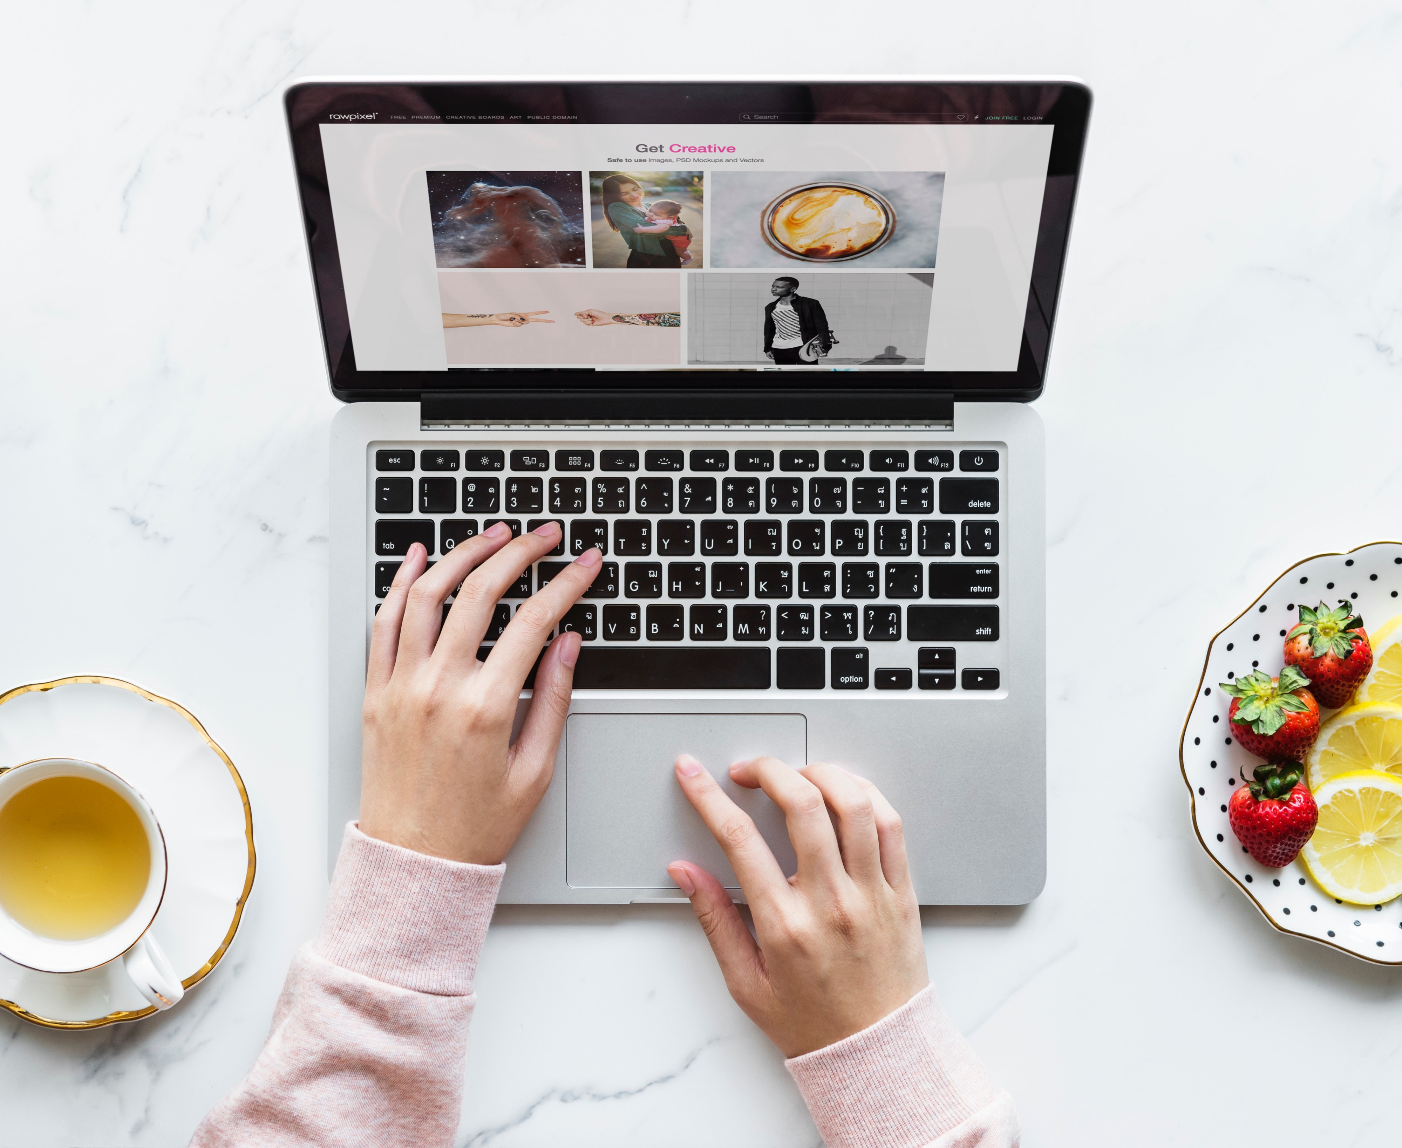
Avoid eating or drinking next to your computer.
Dropping food on your computer is bad, but spilling a drink on it is worse, it can cause permanent damage to the internal components of the computer. In the worst-case scenario, it can cause them to overheat and stop working. You should always ensure the cleanliness of your laptop by protecting against food, drinks and any other thing that could destroy it.

Slide 8
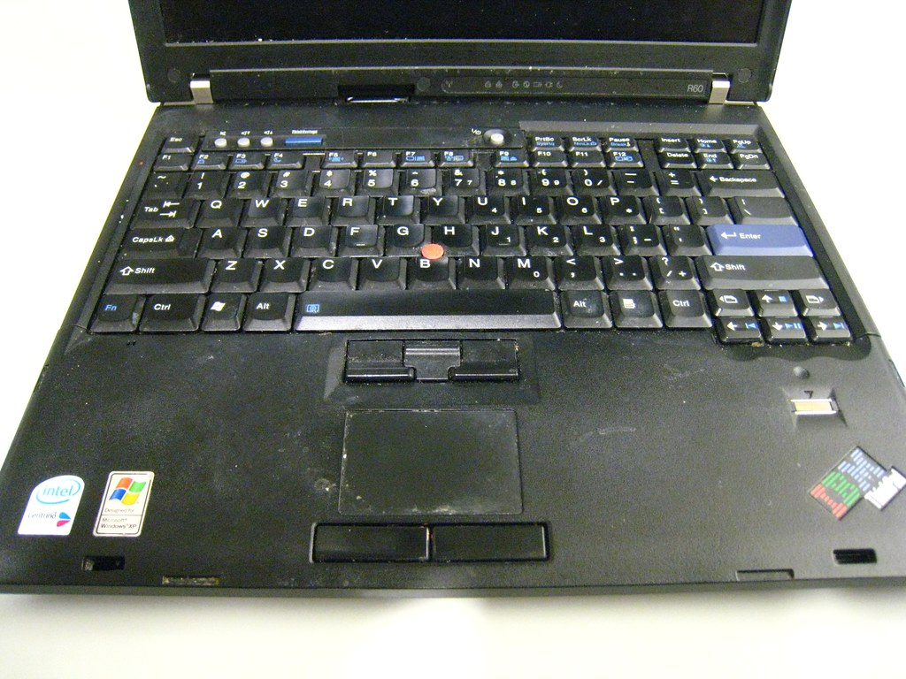
Keep your computer clean.
Dust and dirt are both bad for your house, but worse for your computer, the build-up of dust from a year can cause overheating because it clogs up the filters and fans. The negative effects of your computer overheating include your computer crashing, a shorter life span for your PC, and potential data loss. The best way to avoid this happening is to keep your PC clean and well ventilated.

Slide 9
Thank you for your time
and make sure to Stay Safe!

