Slide 1
Computer
By: Issa soudah

Slide 2
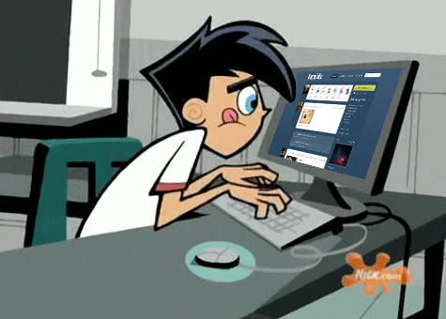
You need to safe when solving computer problems
You need to stay safe when solving computer problems because you will be dealing with electrical equipment and this can lead to a disaster.
This Photo by Unknown Author is licensed under CC BY-SA-NC
This Photo by Unknown Author is licensed under CC BY-SA-NC

Slide 3
You need to follow these rules
Do not open the case of your computer or any other device.
Never use force when connecting or disconnecting a cable or component.
Do not lift heavy equipment on your own
If in doubt ,STOP and ask for help.
Inform your teacher before doing something.

Slide 4
THANK YOU
Stay safe and be responsible.
This Photo by Unknown Author is licensed under CC BY-SA

