Slide 1
Computer HW
By Maria Awad 8E (press slideshow)

Slide 2
Why you should act responsibly and safely when solving computer problems?

Slide 3
Because any wrong action could have a risk of setting the computer on fire or your computer never working again you can also let hackers have easy access to your computer without you realizing
→→→→

Slide 4
And I’m sure that you are NOT broke so you can easily call someone to come fix your computer or you can go to someone who can fix your computer because you don’t have to save money and have a high risk of all the possibilities that I said in the other slide

Slide 5
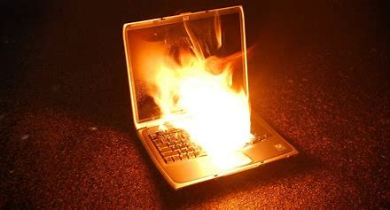

What might happen if you act unsafely and unresponsible
Pic 1
Pic 2

Slide 6
GOODBYE THANK YOU FOR READING!!!
I hope I didn’t bore you out

