Slide 1
How to act responsibly and safely when solving computer problems
By Talia Nazer 8A

Slide 2
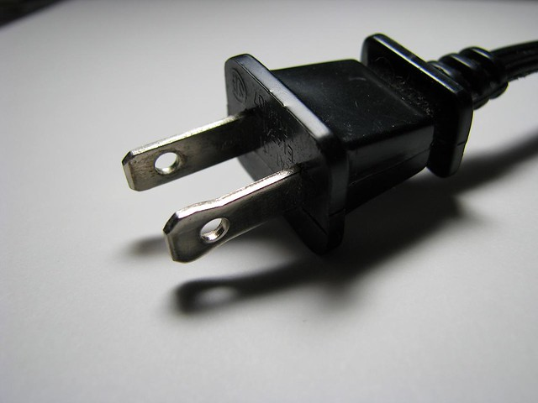
STEP 1
Switch off power points at the wall before connecting or disconnecting a mains electricity cable
To prevent any potential accidents or electrical shocks, taking this precautionary step ensures a safer environment for everyone.

Slide 3
STEP 2
Do not open the case of your computer or any other device
Its generally not recommended to open the case of your device unless you have the knowledge and experience, opening the case without proper understanding can potentially damage the components of the device. Its best to leave any repairs or upgrades to the professionals

Slide 4
STEP 3
Never use force when connecting or disconnecting a cable or component
Its never safe to use force when connecting or disconnecting a cable. Applying too much force can damage the connector or the device itself.

Slide 5
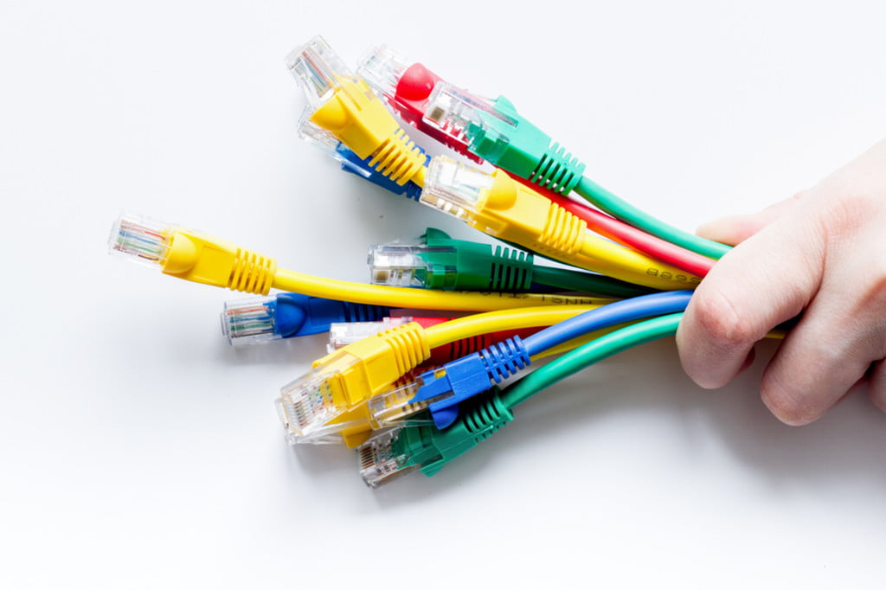
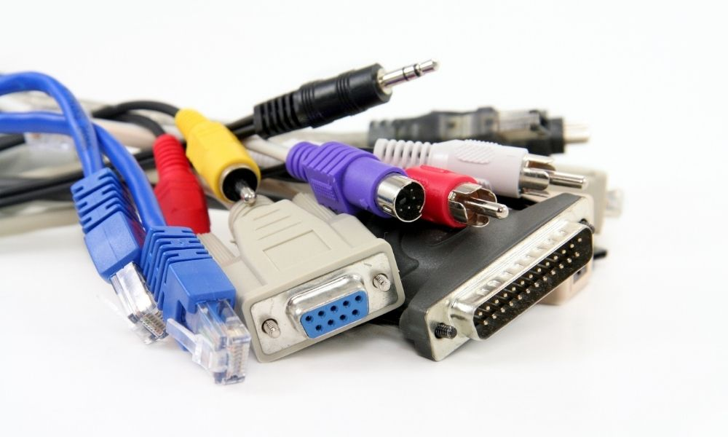
STEP 4
Make sure all cables are disconnected before attempting to move a device
Before you try moving any device make sure you disconnect any cables to ensure the safety of both you and the device , its important to disconnect all cables before moving it. This prevents any potential damage to the device or accidental tripping hazards.

Slide 6
STEP 6
Do not lift heavy equipment on your own
Its not good to lift heavy equipment on your own because it might potentially strain your back

Slide 7
FINAL STEP
If in doubt stop and ask for help
If you are unsure or have any doubts its best to ask for help from someone who can help

