Slide 1
Online danger
By: catherine habash
This Photo by Unknown Author is licensed under CC BY

Slide 2
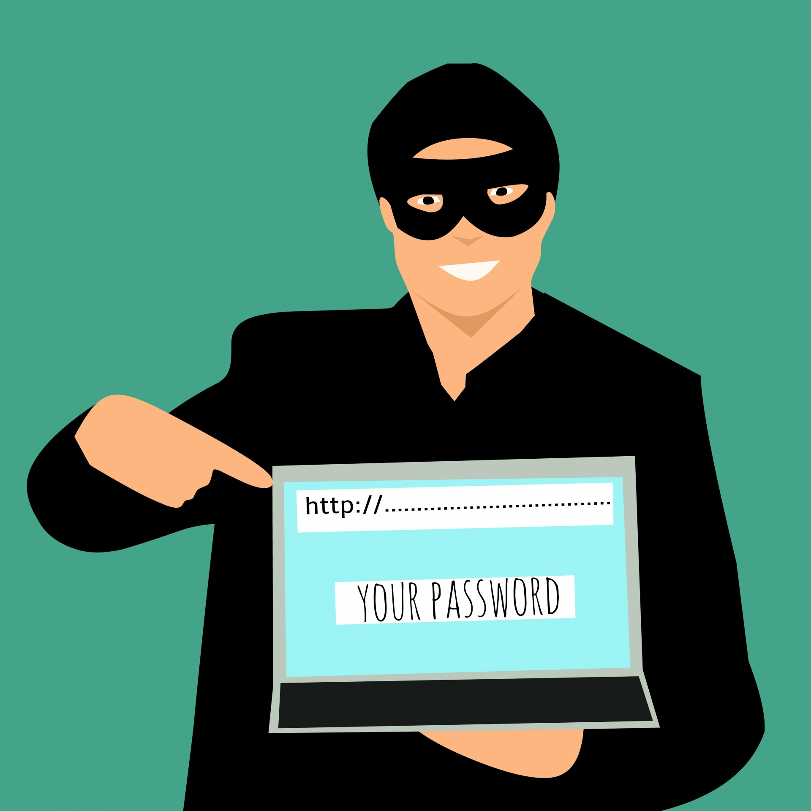
How to stay safe
What to do
Never give your password or any information of your accounts to anyone
Make sure the website ur using has (https) and a lock for you to be sure that its safe
Don’t talk to stragers on the internet and tell them about your life
This Photo by Unknown Author is licensed under CC BY-SA

Slide 3
Online shopping scam
What to do
Make sure it’s a trusted website so they don’t steal ur money or hack into ur bank account
Avoid shopping online because there is a lot of scammers that take ur money and don’t ship the item
This Photo by Unknown Author is licensed under CC BY

