Slide 1
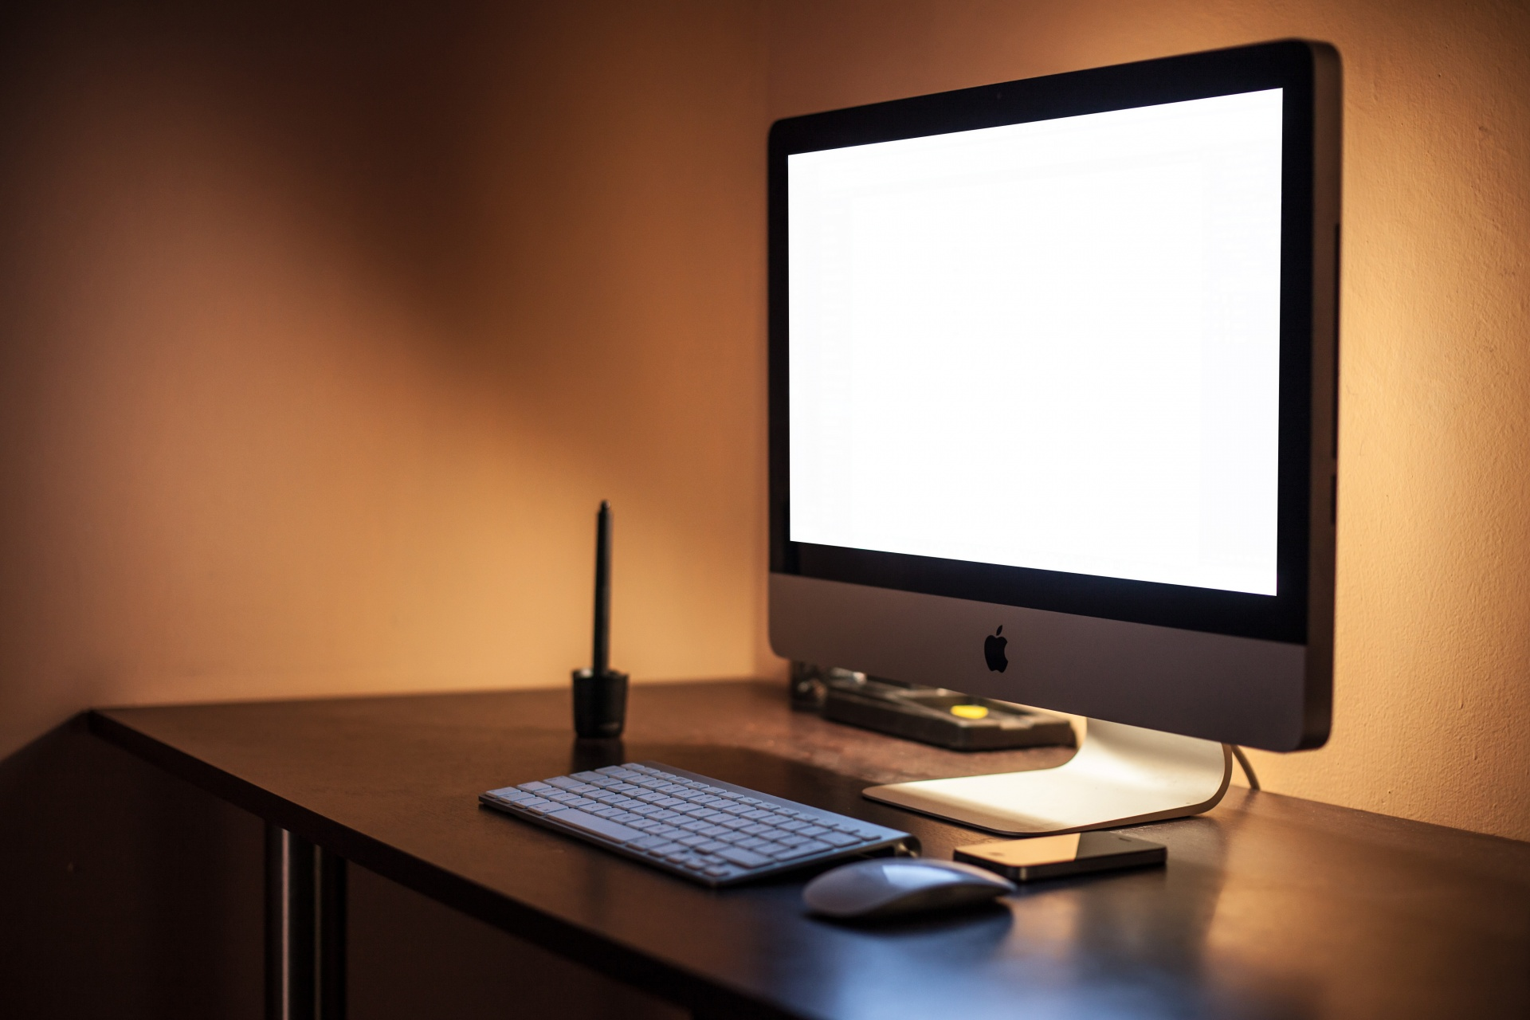
Stay safe!
By Yasir sultan 8c

Slide 2
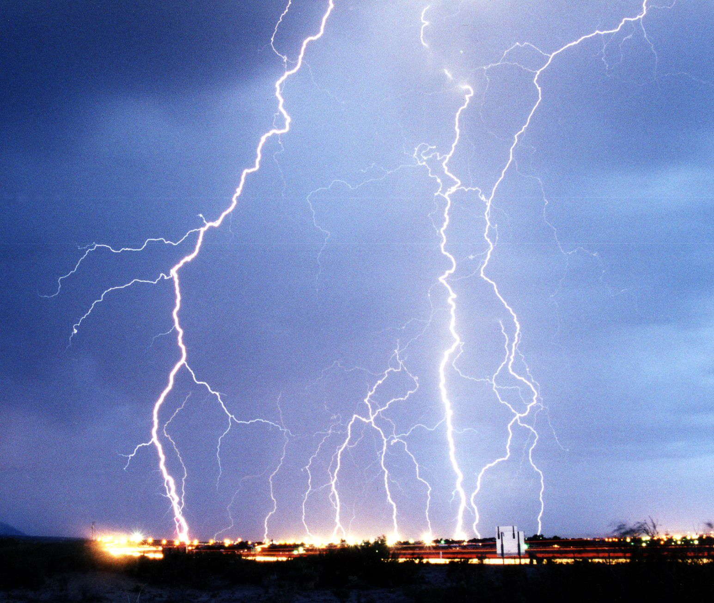
Solving network problems
When solving network related issues, you will find yourself working with electricity.
When working with electricity your main priority is your safety
So let us look at the safety measures in the next slide
This Photo by Unknown Author is licensed under CC BY-SA

Slide 3
Safety measures
1.Turn power off before connecting, or disconnecting main cables
2.Don’t use force when connecting, or disconnecting cables, as it can damage it
3.Remove all cables when moving a device
4.Don’t lift heavy things alone
5.If you don’t know what to do stop, and ask for help

Slide 4
The end

