Slide 1
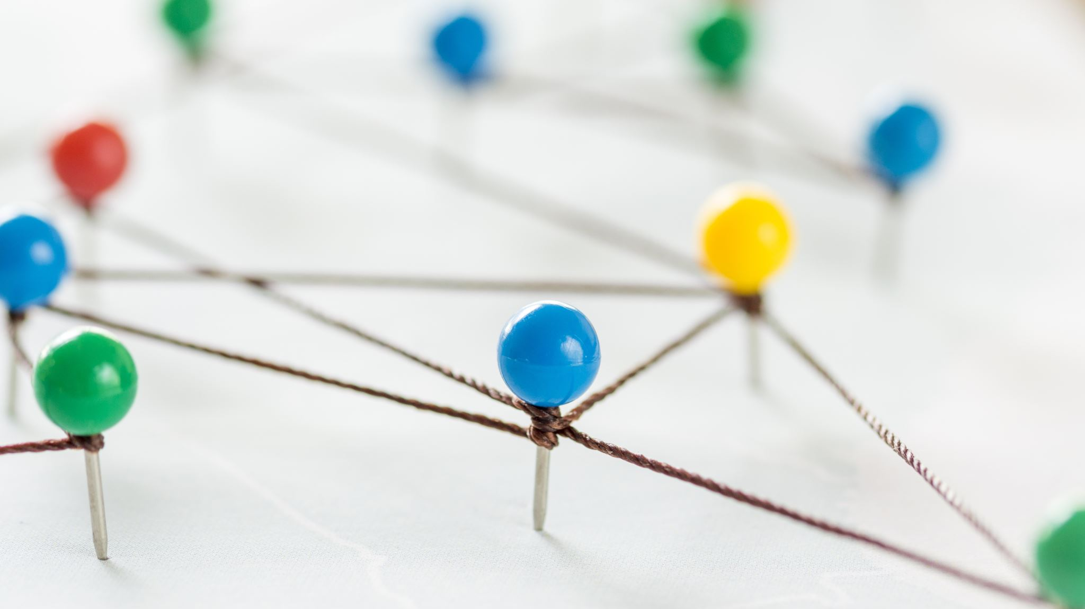
Solving Network Problems
By Noaf Sawalha

Slide 2
WHy?
When you are solving computer problems, you will be working with electrical equipment. Your priority is to stay safe. Always follow your school computer use safety rules. Always check with your parents before trying to deal with problems with your home network. To avoid having issues like these, continue reading.

Slide 3
Always follow these 6 rules
Switch off power points at the wall before connecting or disconnecting a mains electricity cable.
Do not open the case of your computer or any device.
Never use force when connecting or disconnecting a cable or component.
Make sure all cables are disconnected before attempting to move a device such as a printer.
Do not lift heavy equipment on your own.
If in doubt, STOP and ask for help.

Slide 4
Hopefully this helped
Thank you for reading:)

