Slide 1
How to act safely while solving computer problems
Elena Sahawneh (8E)

Slide 2
introduction
When solving computer problems, it is important to act and stay safe because you're using electrical equipment that could harm you.

Slide 3
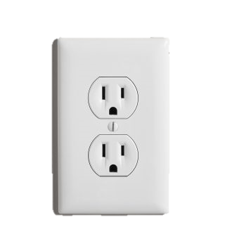
How to stay safe?
Turn off switches connected to power outlets in the wall before connecting or disconnecting a mains electricity cable.
Avoid opening your pc set up or any other computer or mobile devices
Don’t apply lots of pressure when connecting or disconnecting a cable.

Slide 4
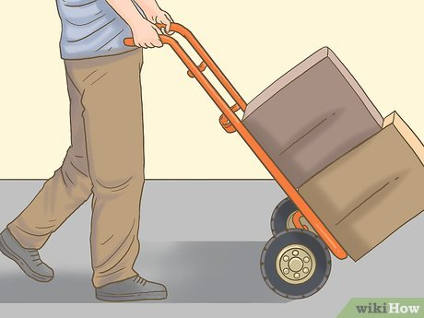
How to stay safe?
Ensure all cords are disconnected before trying to move a device.
Do not carry heavy devices alone.
Ask for help when you're uncertain about something

Slide 5
Thank you!☺

