Slide 1
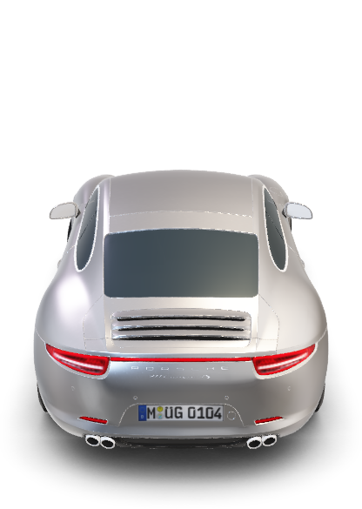
Porsche Carrera S

Slide 2
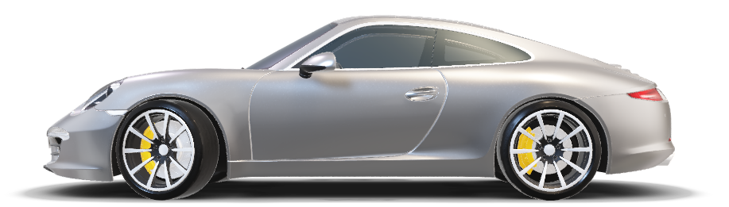
Porsche Carrera S

Slide 3
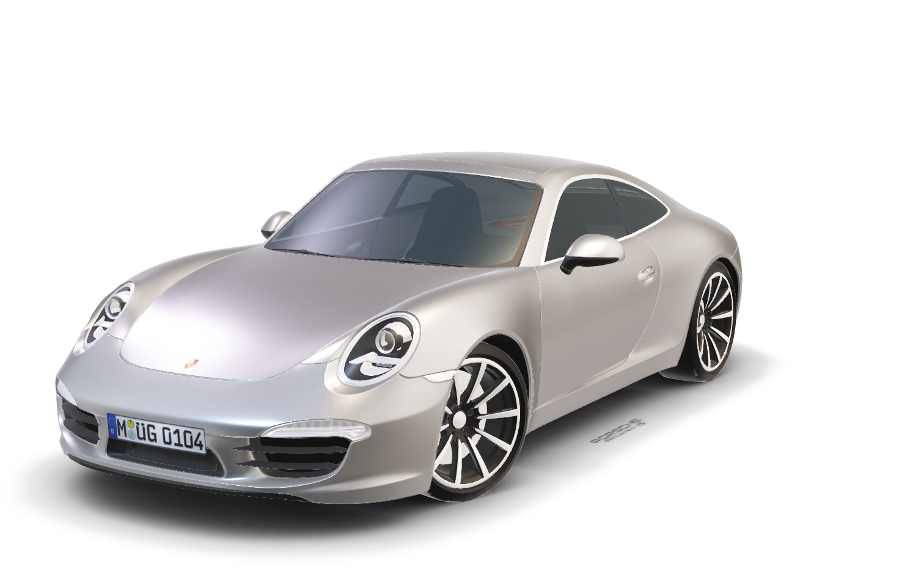
Porsche Carrera S
When contact with the road is even more important,
When every pound less means more agility.
That’s when sportsmanship takes over.
The 911 Carrera 4S is a commitment to purism,
A conscious release for increased driving pleasure
D E T A I L S :
4.0s
0-60 mph
379 hp
Max. power
180 mph
Top max speed

Slide 4
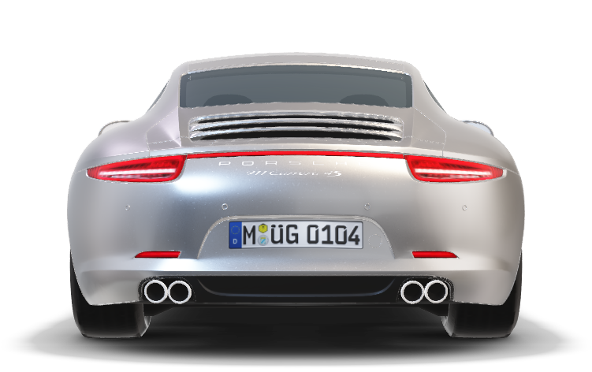
Porsche Carrera S
The harmony of tradition and modesty – the iconic flyline and the continuous light strip.
When contact with the road is even more important,
When every pound less means more agility.
That’s when sportsmanship takes over.
The 911 Carrera 4S is a commitment to purism,
A conscious release for increased driving pleasure
Timeless design,
Contemporary interpretation.
The shape of the 911 Carrera is
Unmistakable because of its iconic flyline and elegant roof lines. These
Have characterized Porsche since
1963, as have sports cars with astonishing performance.
D E T A I L S :
379 hp
Max. power
4.0s
0-60 mph
180 mph
Top max speed

Slide 5
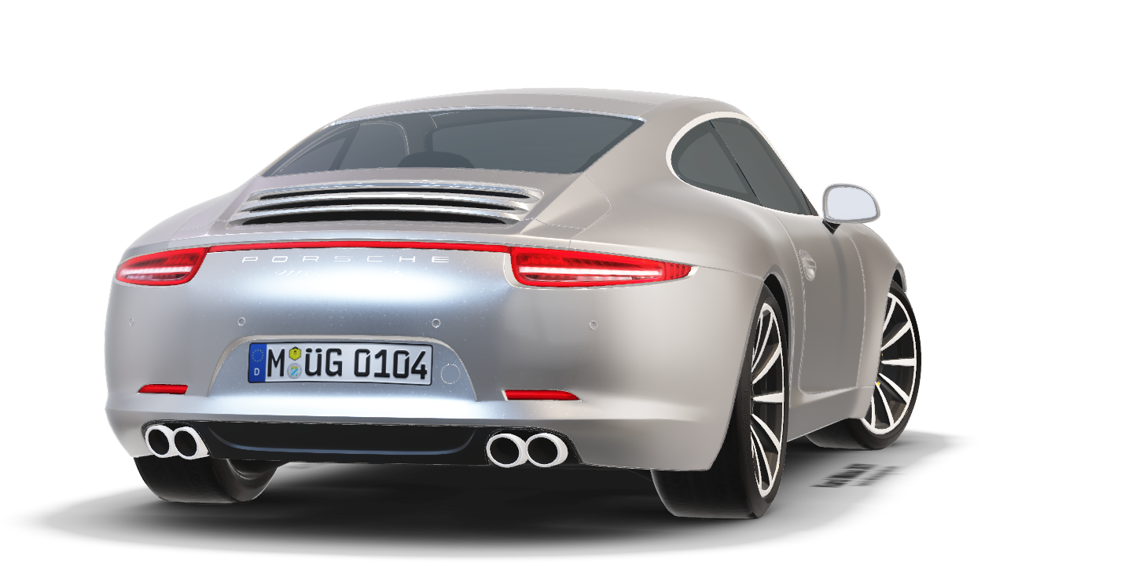
Timeless design,
Contemporary interpretation.
The shape of the 911 Carrera is
Unmistakable because of its iconic flyline and elegant roof lines. These
Have characterized Porsche since
1963, as have sports cars with astonishing performance.
Porsche Carrera S
When contact with the road is even more important,
When every pound less means more agility.
That’s when sportsmanship takes over.
The 911 Carrera 4S is a commitment to purism,
A conscious release for increased driving pleasure
D E T A I L S :
The harmony of tradition and modesty – the iconic flyline and the continuous light strip.
379 hp
Max. power
4.0s
0-60 mph
180 mph
Top max speed

Slide 6




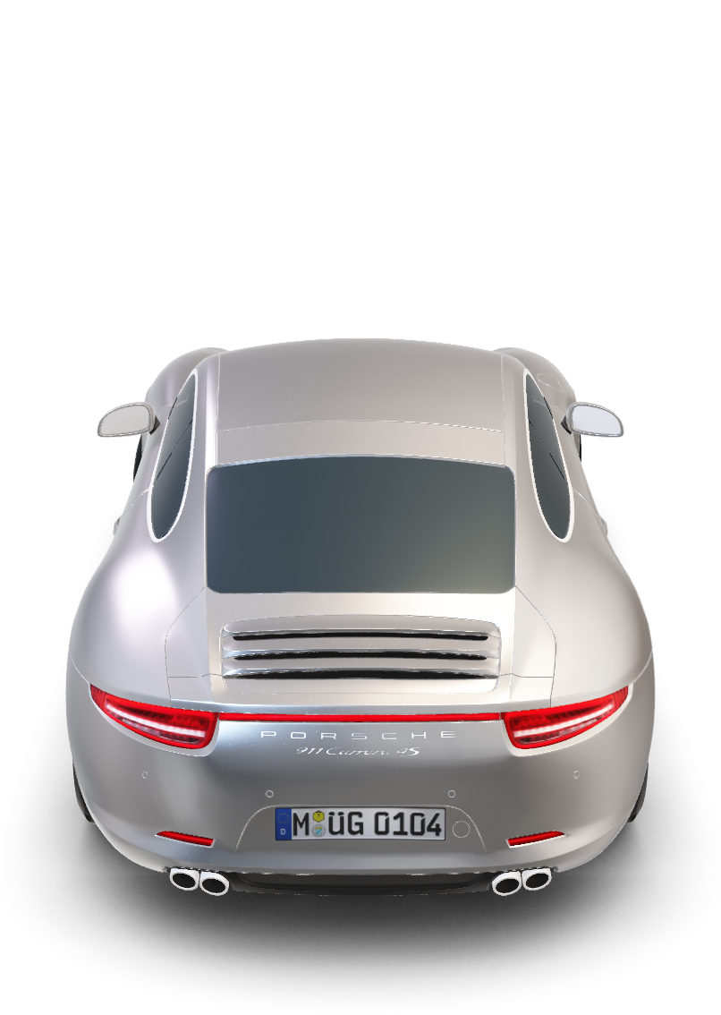
Timeless design,
Contemporary interpretation.
The shape of the 911 Carrera is
Unmistakable because of its iconic flyline and elegant roof lines. These
Have characterized Porsche since
1963, as have sports cars with astonishing performance.
Porsche Carrera S
D E T A I L S :
When contact with the road is even more important,
When every pound less means more agility.
That’s when sportsmanship takes over.
The 911 Carrera 4S is a commitment to purism,
A conscious release for increased driving pleasure
379 hp
Max. power
4.0s
0-60 mph
180 mph
Top max speed
The harmony of tradition and modesty – the iconic flyline and the continuous light strip.

Slide 7
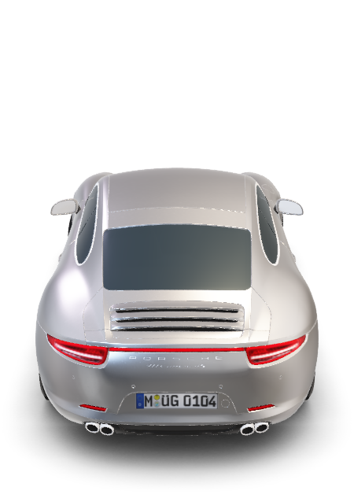
Timeless design,
Contemporary interpretation.
The shape of the 911 Carrera is
Unmistakable because of its iconic flyline and elegant roof lines. These
Have characterized Porsche since
1963, as have sports cars with astonishing performance.
Porsche Carrera S
D E T A I L S :
When contact with the road is even more important,
When every pound less means more agility.
That’s when sportsmanship takes over.
The 911 Carrera 4S is a commitment to purism,
A conscious release for increased driving pleasure
379 hp
Max. power
4.0s
0-60 mph
180 mph
Top max speed
The harmony of tradition and modesty – the iconic flyline and the continuous light strip.

