Slide 1
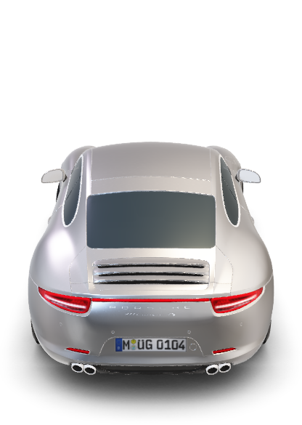
Porsche Carrera S

Slide 2
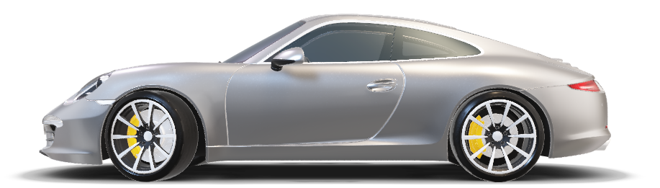
Porsche Carrera S

Slide 3
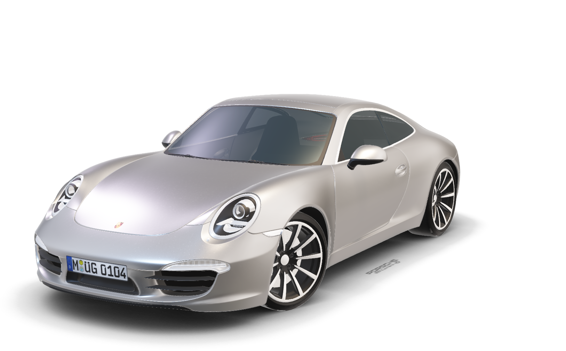
Porsche Carrera S
When contact with the road is even more important,
When every pound less means more agility.
That’s when sportsmanship takes over.
The 911 Carrera 4S is a commitment to purism,
A conscious release for increased driving pleasure

