Slide 1
Computer
Done By: Angelina Lallas
Grade: 7-A

Slide 2
How to stay safe when using a computer
Use these following rules:
Do not open the case of your computer or any other device.
Never use a computer near a liquid that could fall on to it.
Make sure you know what you are doing while dealing with the software of your computer.
Always make sure the electricity is off before touching any hardware.
Make sure all cables are disconnected before trying to move a device around.
If you’re in doubt, stop and ask anyone for help

Slide 3
Computer comparison
How to use a computer
How to NOT use a computer
Always have your computer backed up
Never let it sit on the charger for too long
Be careful of the surroundings from any liquids
Don’t use it constantly because it may heat up, which is not good
Never sit or stay on it for too long it will damage your eyes
Not backing up your accounts constantly
Letting it sit on the charger for too long
Always having a cup of water or anything that could spill on the computer beside you
Always using it and letting it heat up
Using it too much were it can damage your eyes

Slide 4
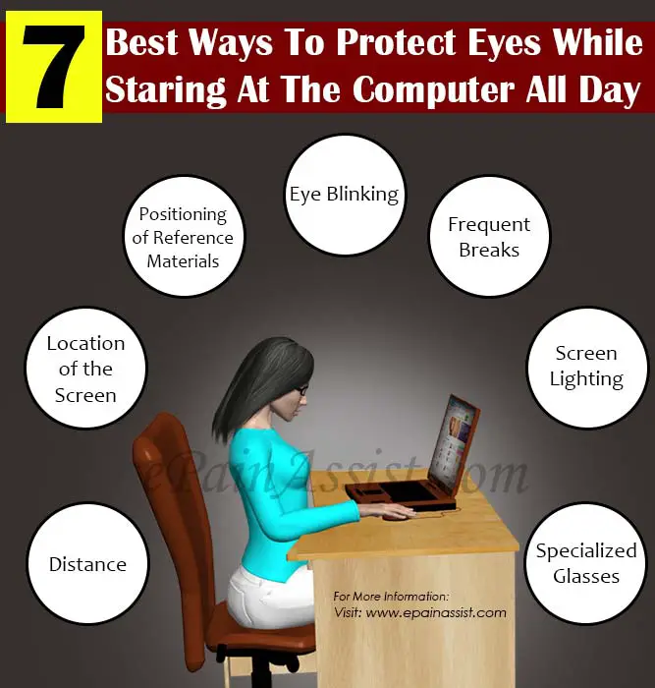
Ways you protect your eyes
Ways you affect your eyes

