Slide 1
Online Dangers
Criminals use several methods to steal people’s money and identities:

Slide 2
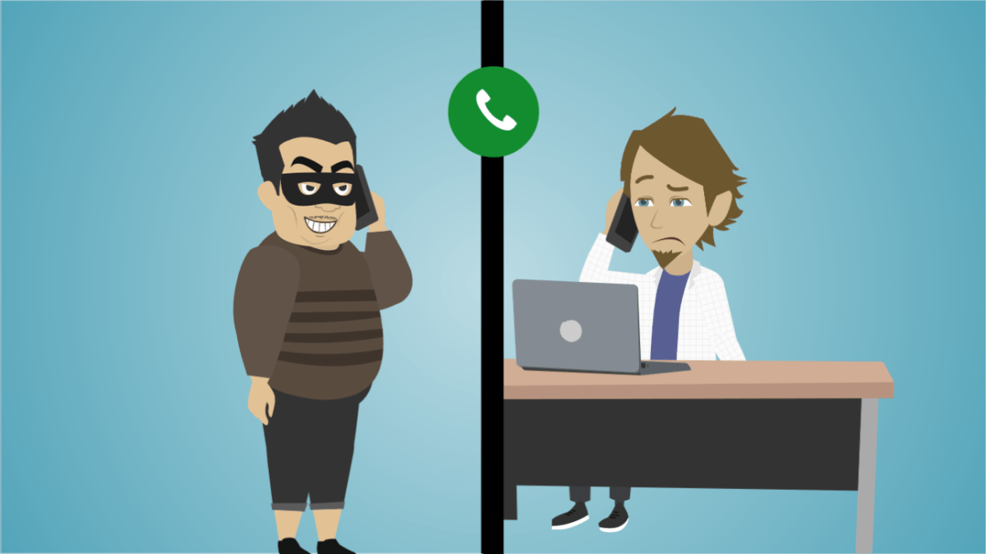
SCAMMING
Crime in which the perpetrator develops a scheme using one or more elements of the Internet to deprive a person of property or any interest, estate, or right by a false representation of a matter of fact, whether by providing misleading information or by concealment of information.
Crime in which the perpetrator develops a scheme using one or more elements of the Internet to deprive a person of property or any interest, estate, or right by a false representation of a matter of fact, whether by providing misleading information or by concealment of information.

Slide 3
HACKING
A commonly used hacking definition is the act of compromising digital devices and networks through unauthorized access to an account or computer system. Hacking is not always a malicious act, but it is most commonly associated with illegal activity and data theft by cyber criminals.

Slide 4
IDENTITY THEFT
Identity theft is a broad term that applies anytime someone steals your personal information, such as your Social Security number, and uses it to create a new account, make a purchase or commit other fraud.

Slide 5
PHISHING
Phishing Campaign: In a phishing campaign, attackers send emails to thousands and millions of users. These messages are relevant or of interest to a broad audience. For example, emails that inform users of suspicious activity on their accounts and ask them to change their password.

