Slide 1
How to use a computer safely :
By:Helana

Slide 2
what are the safety tips for using a computer :
Make sure you're using a secure interne connection.
Choose strong passwords.
keep software and operating systems updated.
Check the websites look and feel reliable.
Use a personal firewall.

Slide 3
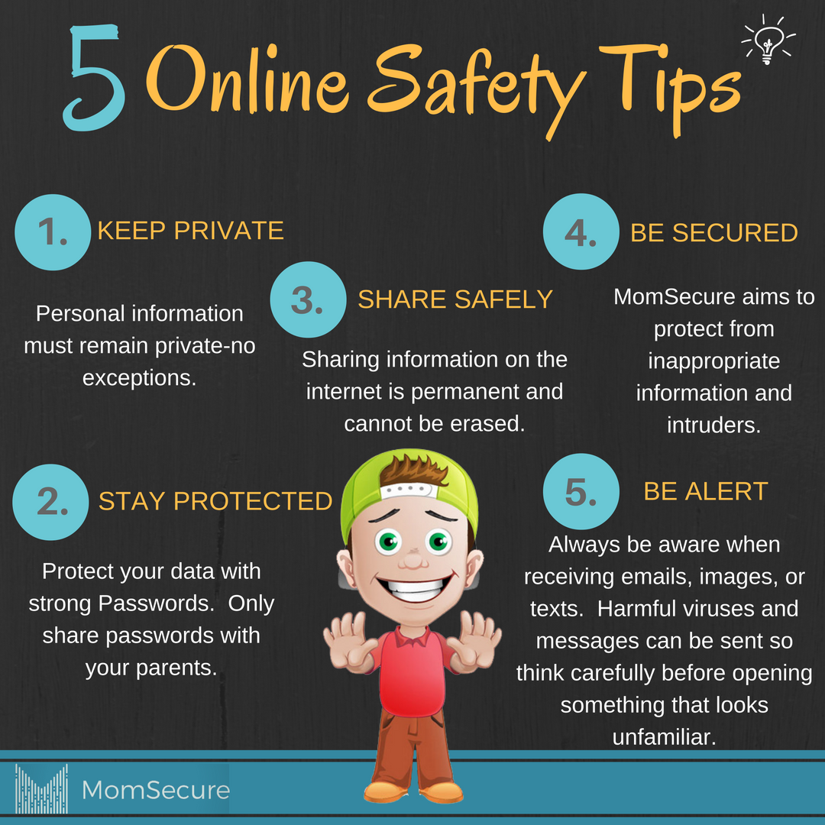
This short video will talk about tips for the computer :
https://www.youtube.com/watch?v=6mMZFoXbKqIhttps://www.youtube.com/watch?v=6mMZFoXbKqI
This Photo by Unknown Author is licensed under CC BY-NC-ND

