Slide 1
Be aware of online danger
BY Teresa-Al Rabadi 7 D

Slide 2
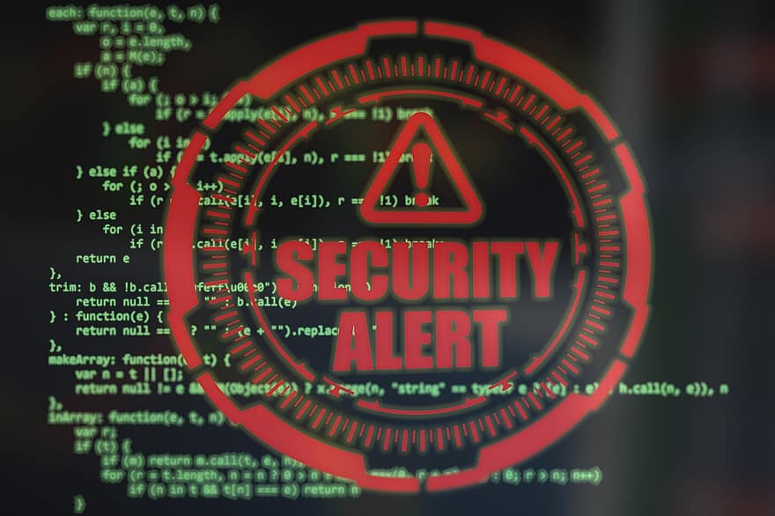
Danger Of Online Crime
- Stay informed and educate others about online dangers. - Be cautious, think critically, and practice safe online habits. - Report any suspicious activities to help create a safer online environment for everyone. If u get any email from a bank or something call the bank to make sure if u get a call that sounds like someone you know but not sure end the call and call the persons asking if it was them or not because these days using Ai technology scammers are high these days and the risk of them being pulled on you is very high.
Cybercrime, is someone who uses the internet to commit their crimes .Cybercrime on the rise, be vigilant! - Protect your devices with strong passwords and keep them up to date. - Avoid downloading files from unknown sources to prevent malware infections. - Report any suspicious activities or cyberattacks to the appropriate authorities.
Identity Theft is when a criminal steals your identity(personal information social security numbers or even passport number) Guard your personal information carefully. - Beware of phishing emails or calls asking for sensitive data. - Use secure websites when making online transactions. - Regularly monitor your bank accounts and credit card statements for any unauthorized activity.
Phishing is when someone creates a fake account pretending to be a famous person or creates a fake website - Watch out for phishing scams! They often appear as legitimate emails or websites. - Be cautious when clicking on links or providing. personal information. - Double-check email senders and website URLs for authenticity
Scamming- Don't fall for online scams promising easy money or prizes. - Be skeptical of unsolicited emails, messages, or pop-up ads. - Research and verify before engaging in online transactions or investments. - Trust your instincts. If something seems too good to be true, it probably is
Hacking: Use strong, unique passwords for each online account. - Enable two-factor authentication whenever possible. - Regularly update your software and install security patches

