Slide 1
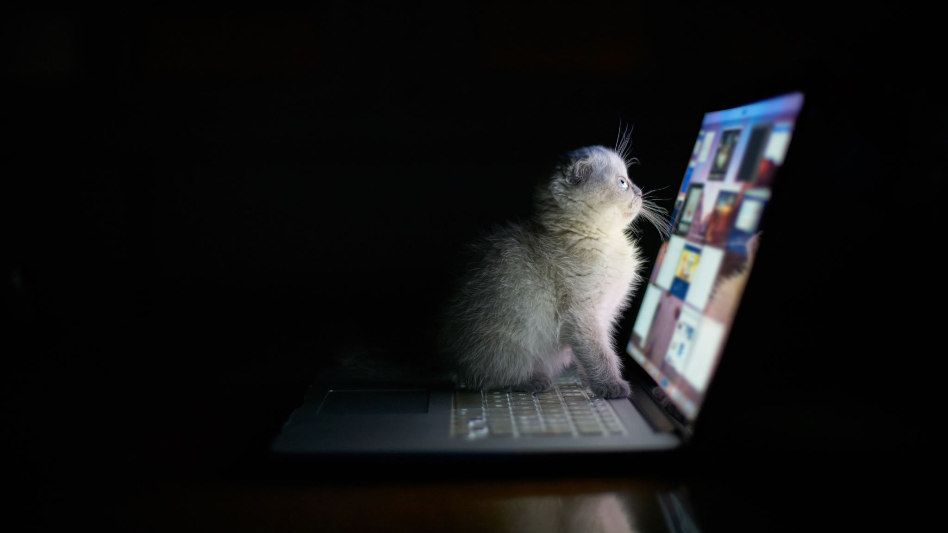
Be aware of online danger
BY Teresa-Al Rabadi 7 D

Slide 2
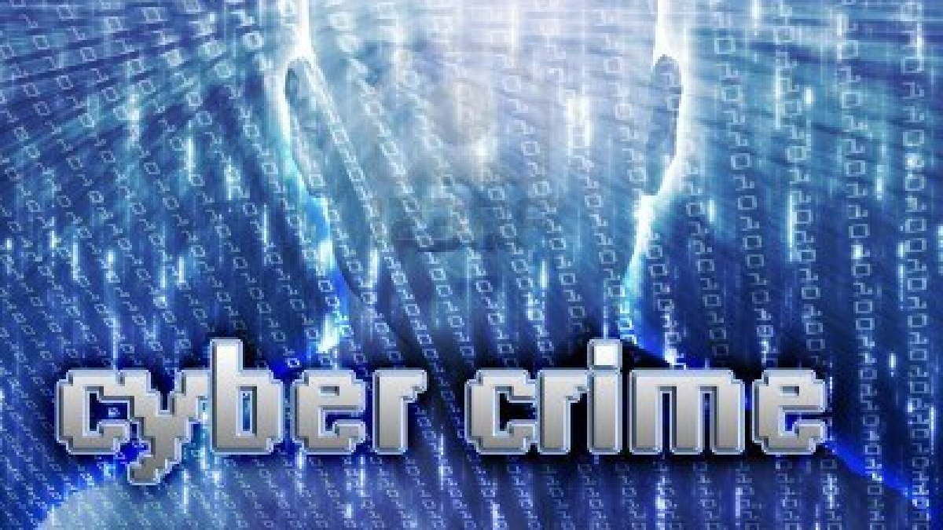
Cybercrime
Cybercrime, is someone who uses the internet to commit their crimes .Cybercrime on the rise, be vigilant! - Protect your devices with strong passwords and keep them up to date. - Avoid downloading files from unknown sources to prevent malware infections. - Report any suspicious activities or cyberattacks to the appropriate authorities.
This Photo by Unknown Author is licensed under CC BY

Slide 3
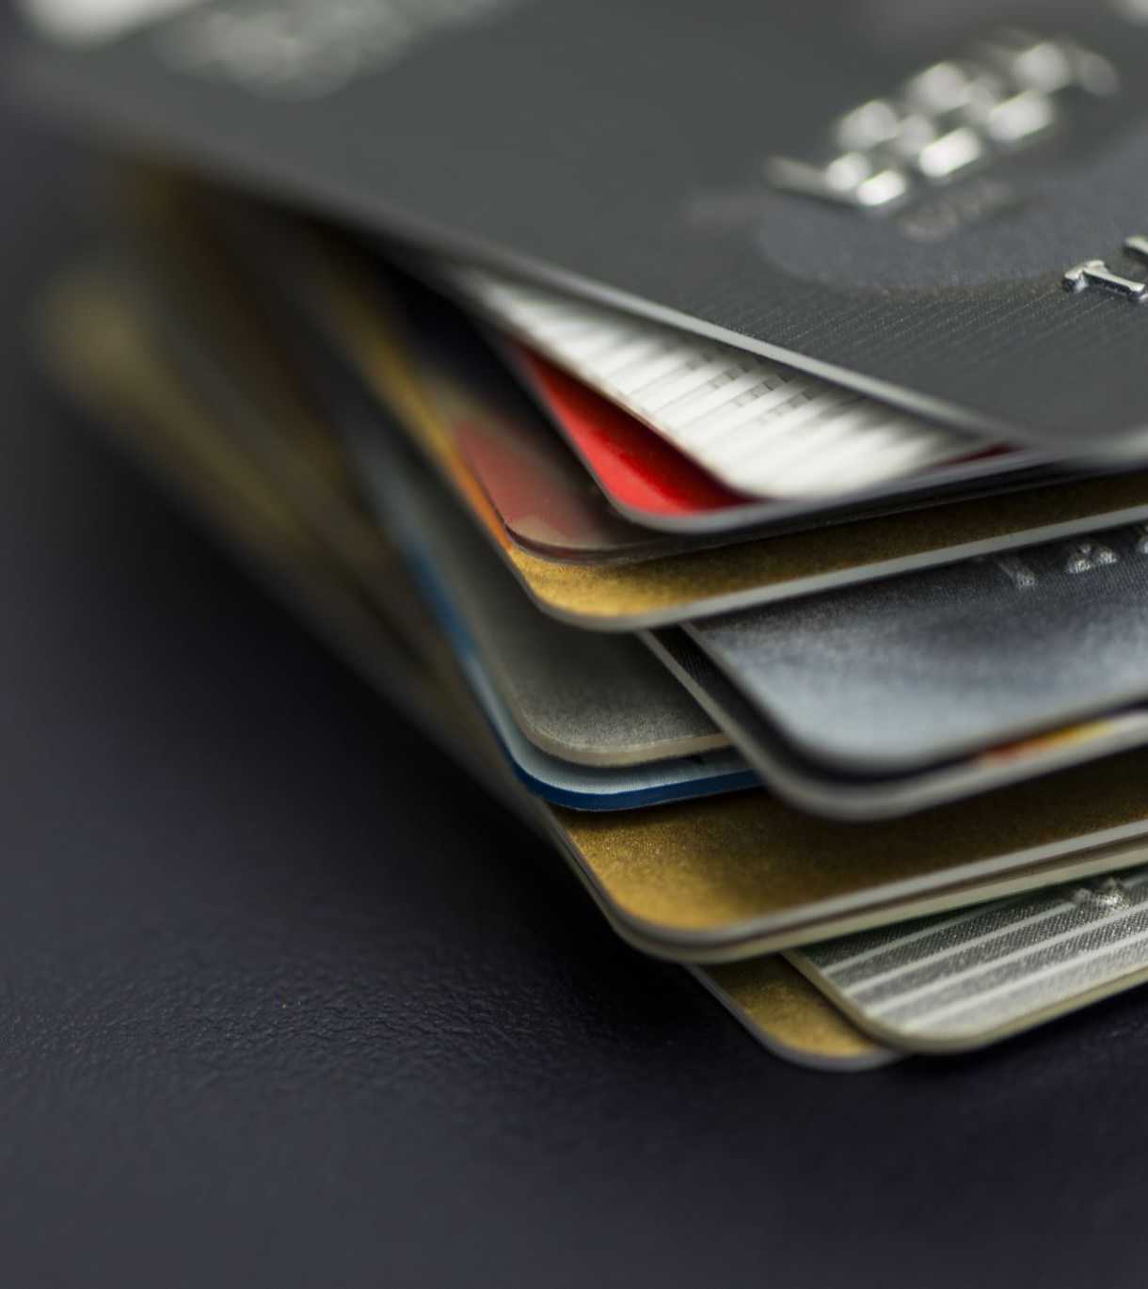
Identity Theft
Identity Theft is when a criminal steals your identity(personal information social security numbers or even passport number) criminals can use stolen identity to pretend they are someone else, they can open bank accounts ore credit card accounts in someone else name and steal the money - Guard your personal information carefully. - Beware of phishing emails or calls asking for sensitive data. - Use secure websites when making online transactions. - Regularly monitor your bank accounts and credit card statements for any unauthorized activity.

Slide 4
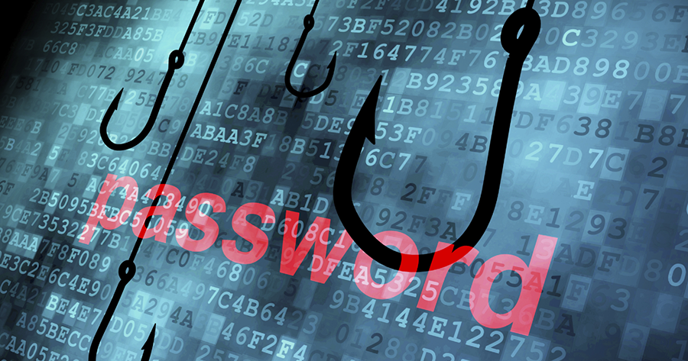
Phishing
Phishing is when someone creates a fake account pretending to be a famous person or creates a fake website ,bank emails, or accounts the fake email could be a email says that there is a problem when a shipping or their account and they must log in using the link but the link is fake so sometimes the website uses cookie which saves their information and steals everything therefor they have lost the account. - Watch out for phishing scams! They often appear as legitimate emails or websites. - Be cautious when clicking on links or providing personal information. - Double-check email senders and website URLs for authenticity.

Slide 5
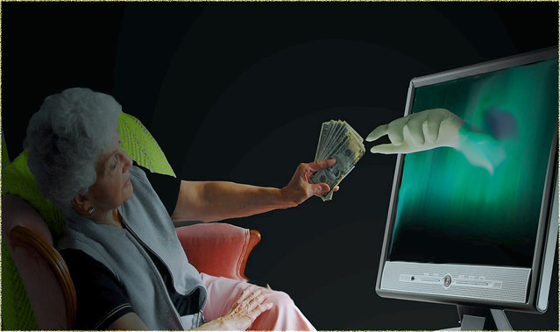
Scamming
Scamming- Don't fall for online scams promising easy money or prizes. - Be skeptical of unsolicited emails, messages, or pop-up ads. - Research and verify before engaging in online transactions or investments. - Trust your instincts. If something seems too good to be true, it probably is. ( The criminal send out an email asking for money or that he donated money by wrong and needs it back and if he does not give it back they will have to go to court) little does the person know that email is fake
This Photo by Unknown Author is licensed under CC BY

Slide 6
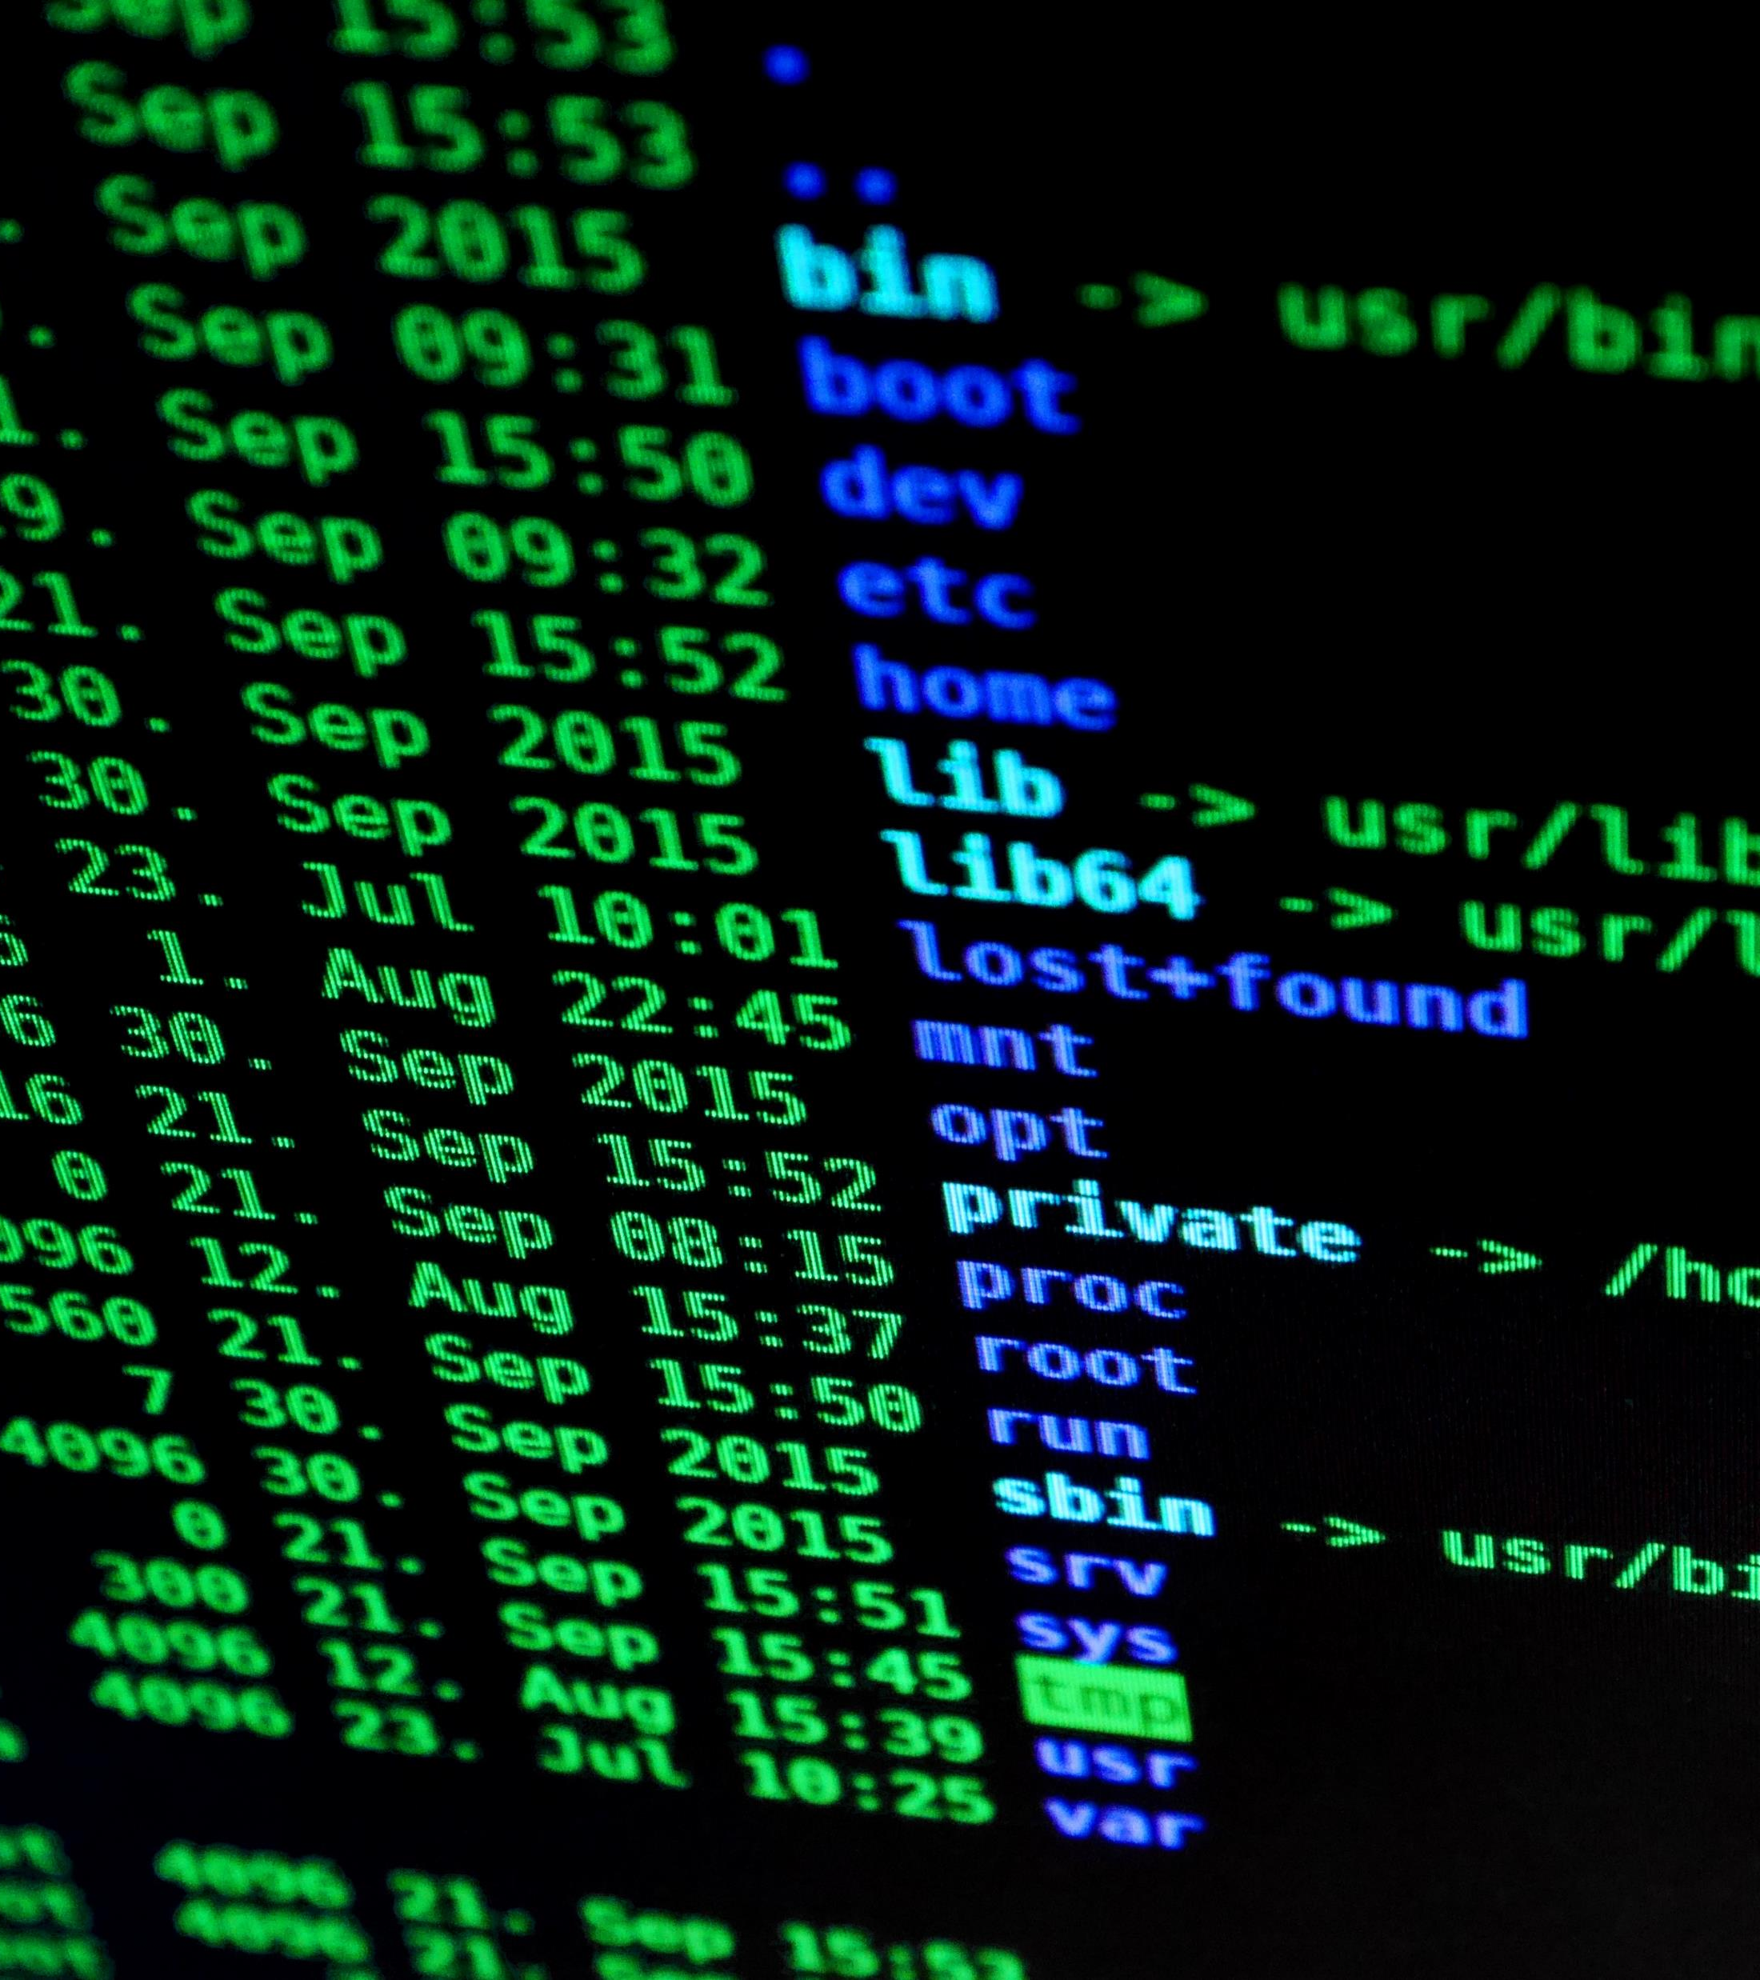
Hacking
Hacking, hacking definition is the act of compromising digital devices and networks through unauthorized access to an account or computer system. Hacking is not always a malicious act, but it is most associated with illegal activity and data theft by cyber criminals. - Protect your digital life from hackers. - Use strong, unique passwords for each online account. - Enable two-factor authentication whenever possible. - Regularly update your software and install security patches
we have 3 different types of hackers:
Hackers fall into one of three general categories:
white hat hackers,
black hat hackers
gray hat hackers. But these aren't the only types of hackers that exist

Slide 7
Conclusion
Stay informed and educate others about online dangers. - Be cautious, think critically, and practice safe online habits. - Report any suspicious activities to help create a safer online environment for everyone.

