Slide 1
BE RESPONSIBLE AND WORK SAFELY WHILE SOLVING COMPUTER PROBLEMS
DONE BY : NADEEN ABU DAYYEH
GRADE : 8 A

Slide 2
TURN OFF THE POWER
THIS WILL PREVENT ELECTRIC SHOCKS , OVERHEATING OR ANY DANGER.

Slide 3
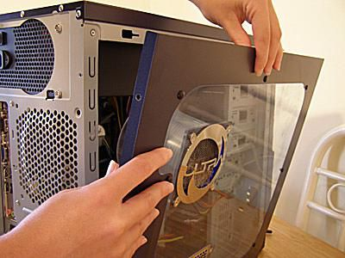
DO NOT OPEN THE CASE OF THE COMPUTER
IT S SO DANGEROUS TO WORK WITH THE ELECTRICAL DEVICES INSIDE YOUR CASE

Slide 4
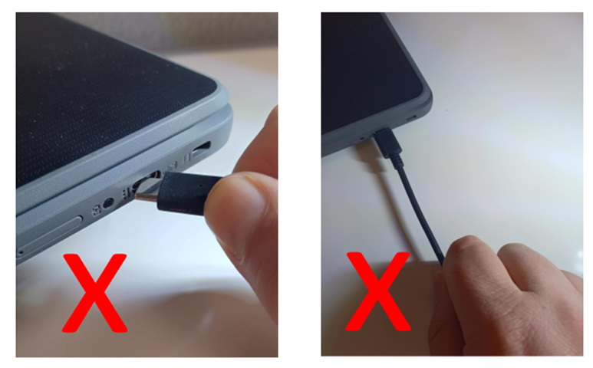
NEVER USE FORCE WHILE CONNECTING AND DISCONNECTING A CABLE

Slide 5
IF YOU WANT TO MOVE A DEVICE MAKE SURE ALL CABLES ARE DISCONNECTED

Slide 6
DO NOT LIFT HEAVY EQUIPMENT ON YOUR OWN

Slide 7
ASK FOR HELP
YOU ARE NOT AN EXPERT SO ASK FOR HELP WHEN YOU FACE A PROBLEM WITH YOUR COMPUTER

Slide 8
REMEMBER STAY SAFE AND BE RESPONSIBLE OF WORKING WITH ELECTRICAL DEVICES . STAY SAFE
THANKS A LOT

