Slide 1
CYBERCRIME

Slide 2
WHAT IS CYBERCRIME?
A type of crime that involves a computer, a computer network or a networked device.
Cybercrime is committed by cybercriminals or hackers who want to make money.

Slide 3
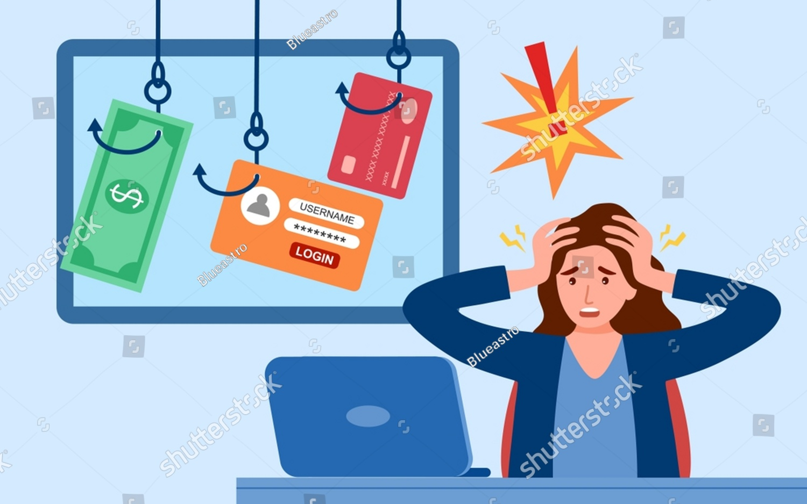
Effects of cybercrime
Victims of cybercrime often feel violated vulnerable, leading
to fear and anxiety.
It can have a long lasting impact on an individual’s mental health and can cause damage to an individual’s reputation.

Slide 4
Preventing cybercrime
Keep software and operating system updated
Use anti-virus software and keep it updated
Use strong passwords
Never open attachments in spam emails
Don’t give out personal information unless secure
Keep an eye on your bank statements

