Slide 1
How to solve Network problems in a safe way
By: Raina Barhoumeh

Slide 2
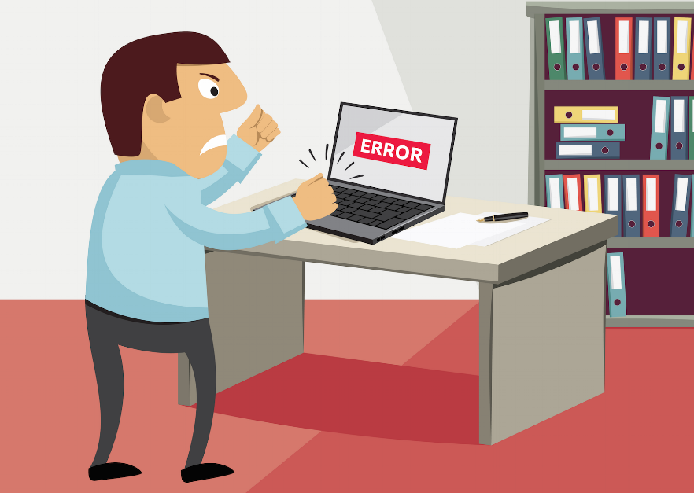
Solving Network Problems
When you are solving computer problems, you will be working with electrical equipment. Your priority is to stay safe. Always follow your school computer use safety rules. Always check with your parents before trying to deal with problems with your home network.

Slide 3
Being Safe is important
Switch off power points at the wall before connecting or disconnecting a mains electricity table.
Do not open the case of your computer or any other device.
Never use force when connecting or disconnecting a cable or a component.
Make sure all cables are disconnected before attempting to move a device (for example, a printer).
Do not lift heavy equipment on your own.
If in doubt, Stop and ask for help.

