Slide 1
Solving computer problems.
Done by : William Ayoub
8c

Slide 2
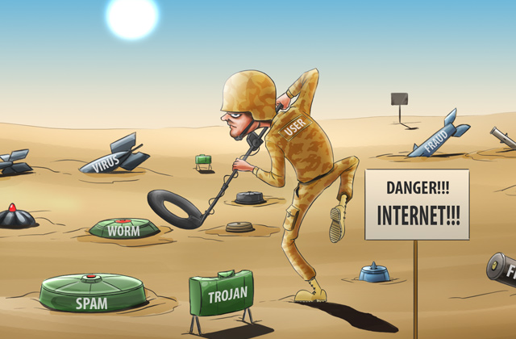
How to act safely and responsibly with viruses in your computer.
When you see a suspicious message from an unknown user don’t ever try to open it or send him any message, because the hacker can take anything from you and steal your information, contacts, banking details and maybe even you identification.

Slide 3
I know what your thinking what does an email have to do with computer problems.
If you receive an email from a work company first think to do it check with what the companies site ends with like : if it ends with .com , .gov , .jo , .edu , and .net then its real but if it doesn’t end with any of those extensions the its fake and the company wants to scan you and lure in something.

Slide 4
Types of problems you may have in your computer.
If your screen has been has been hacked always ask for your parents help.
If your computer has overheated firstly get away from it, secondly close all the tabs, thirdly check if the insides of the computer such as the fans.
If your computer isn’t processing then it might be an internet problem or a server problem.

Slide 5
Thank you for being here

