Slide 1
Circuts

Slide 2
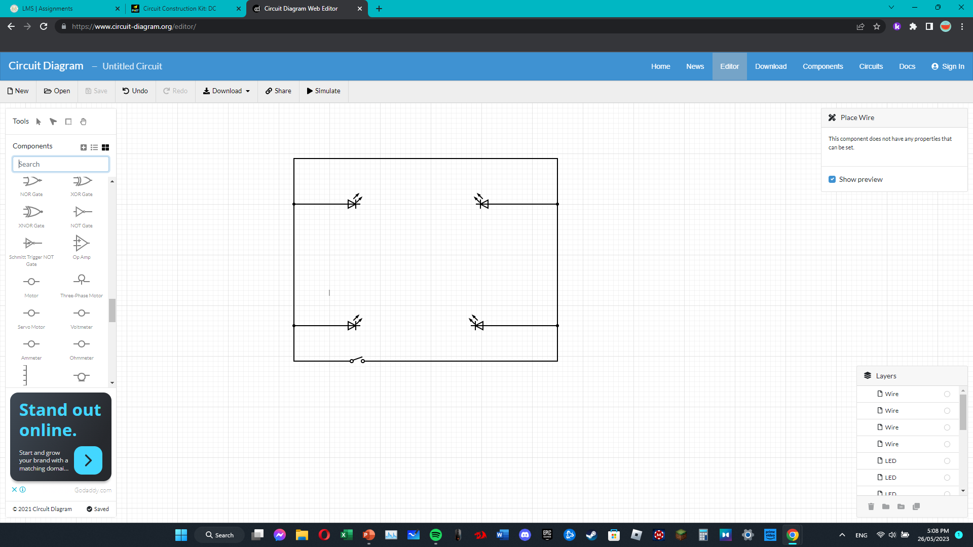
Bedroom
We put 4 led lights and attaching the led light was 1 meter of wire and we also added a fancy switch and a socket on the bottom write but we didn’t find sockets on the websites

Slide 3
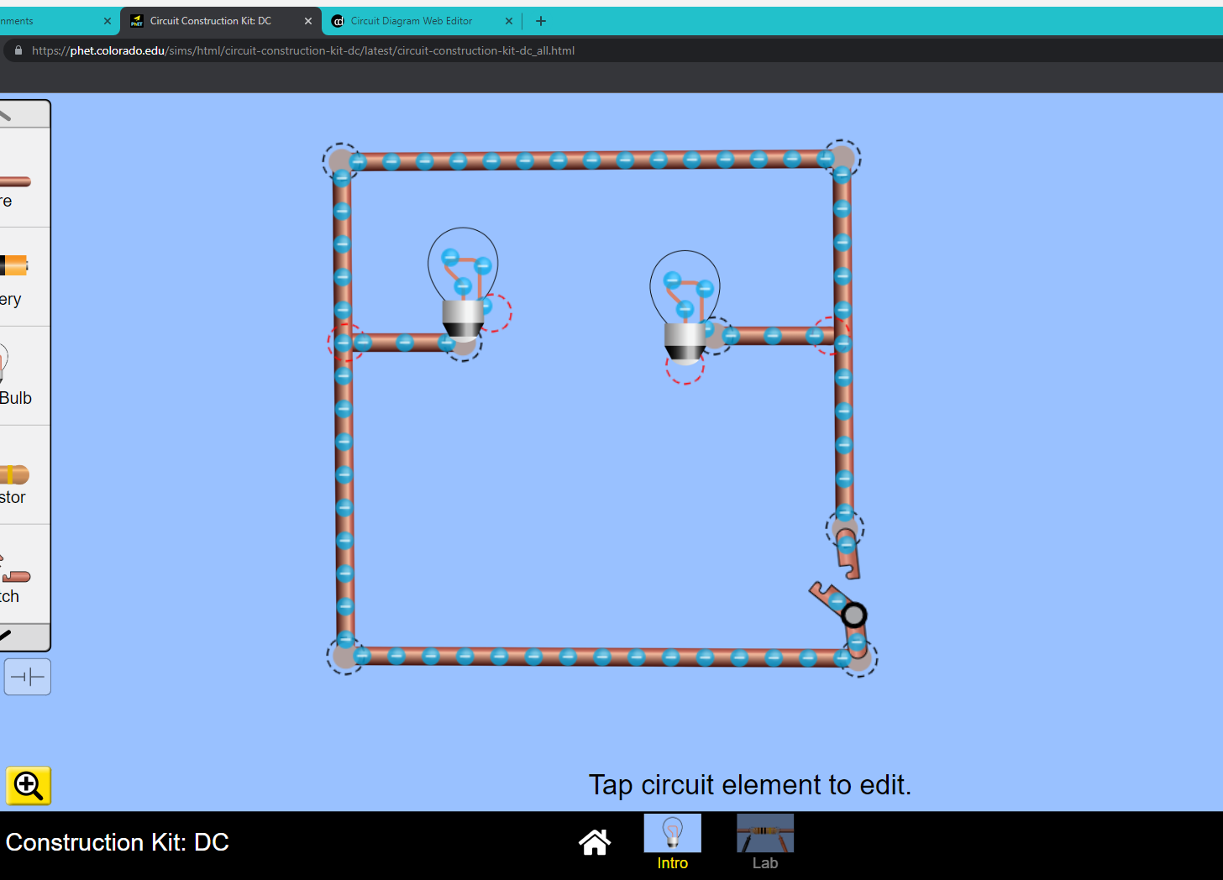
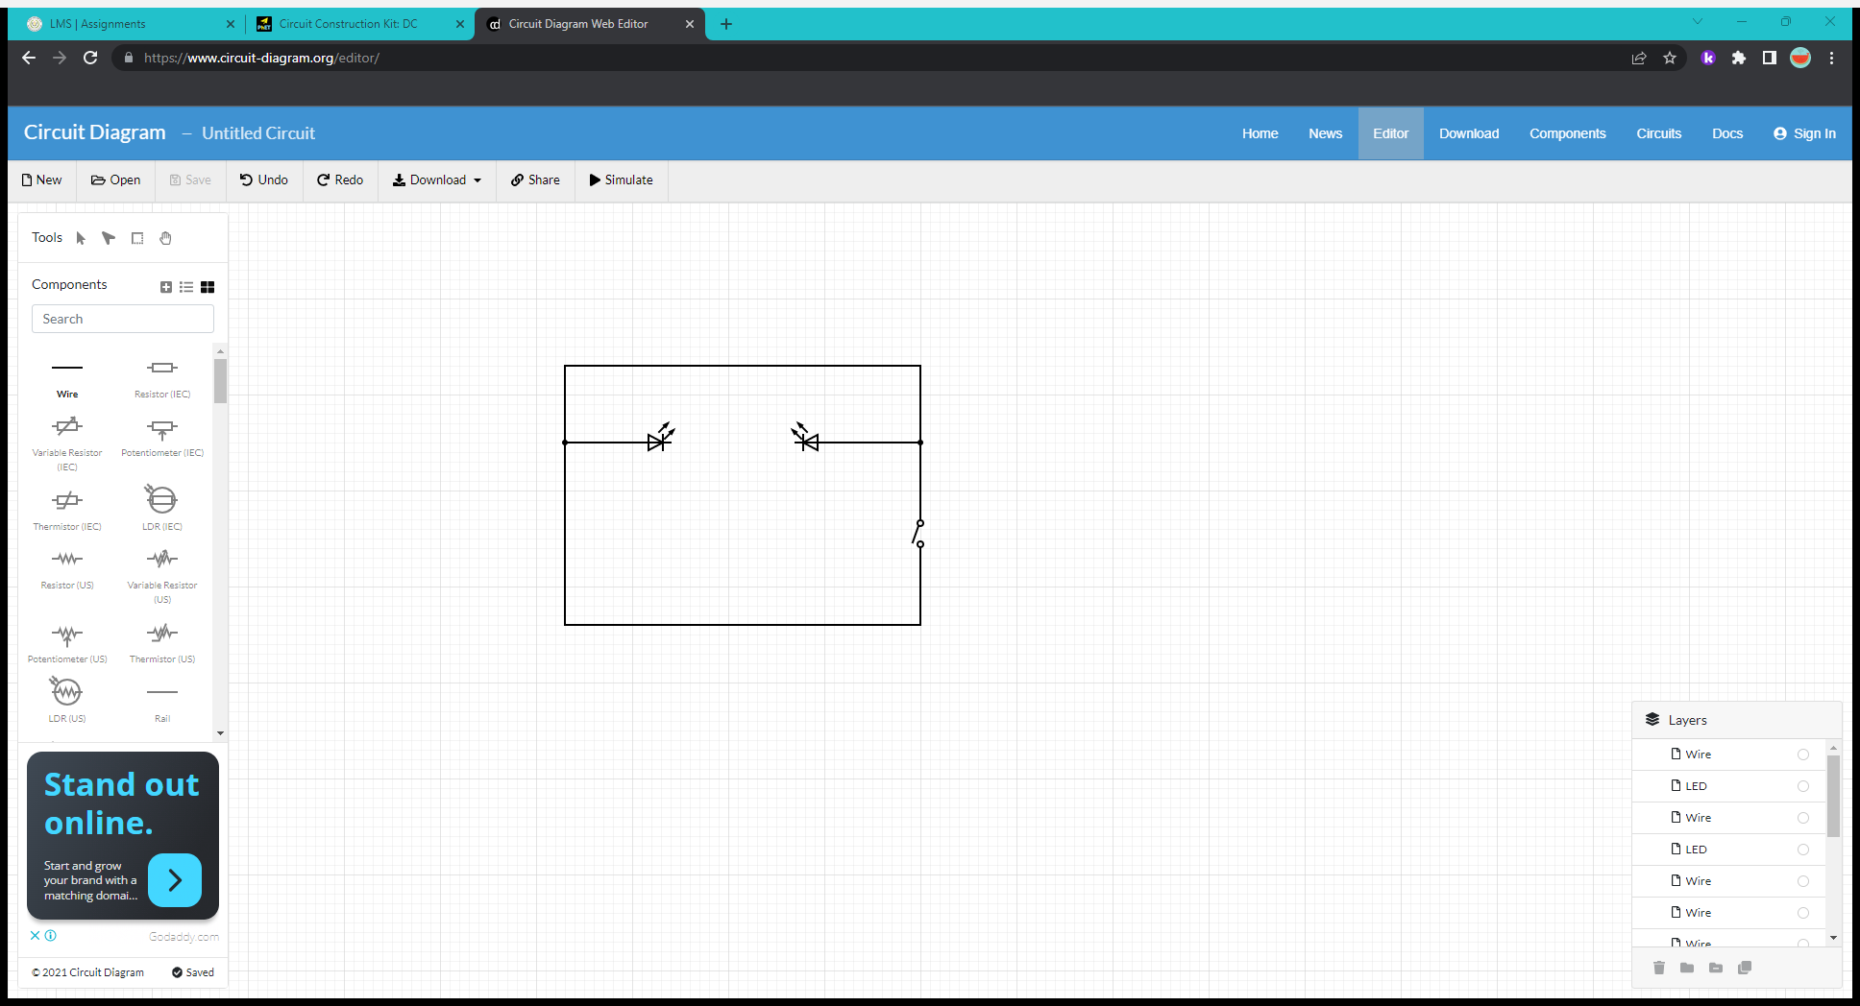
Bathroom
We put 2 led lights and attached them with 1 meter of wire and we placed a fancy switch and a socket, but we didn’t find a socket in the website

Slide 4
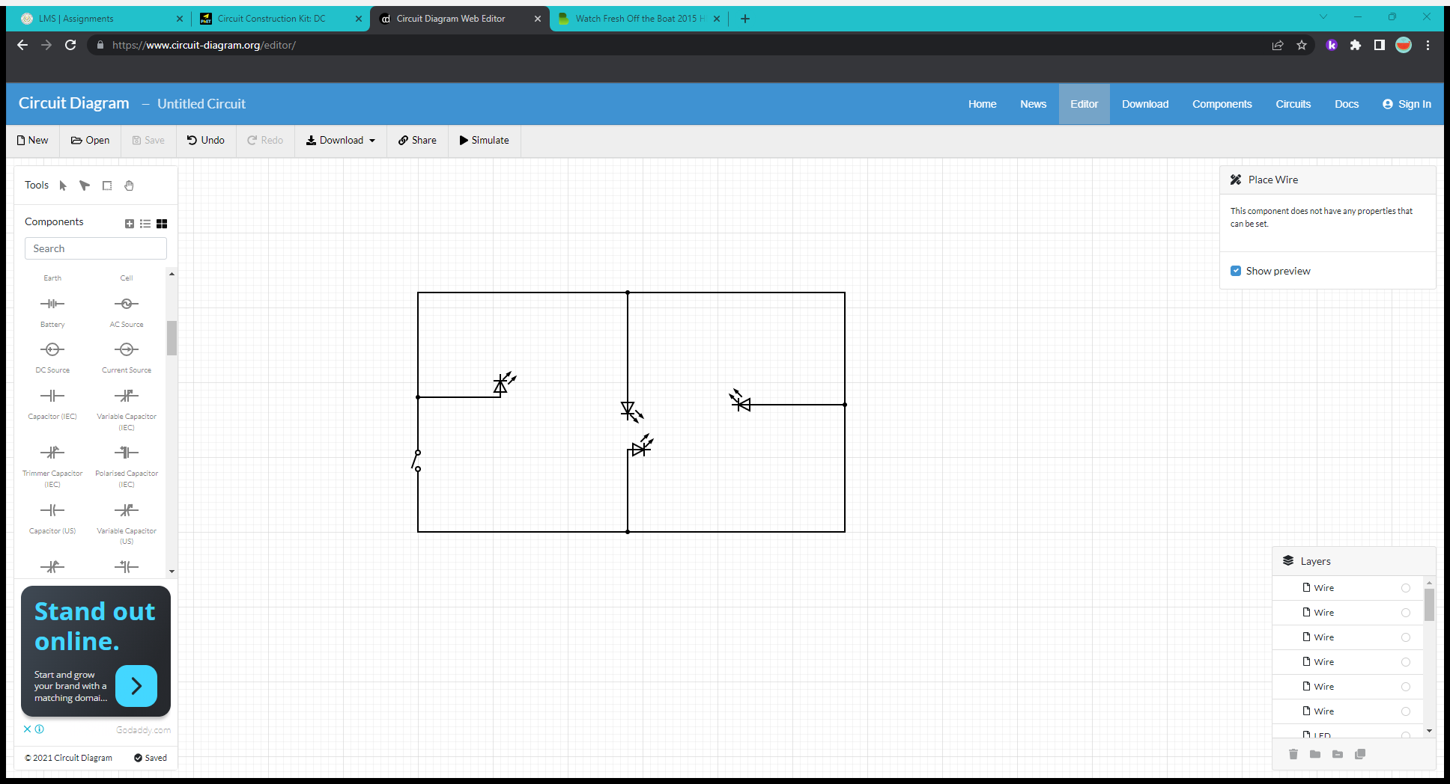
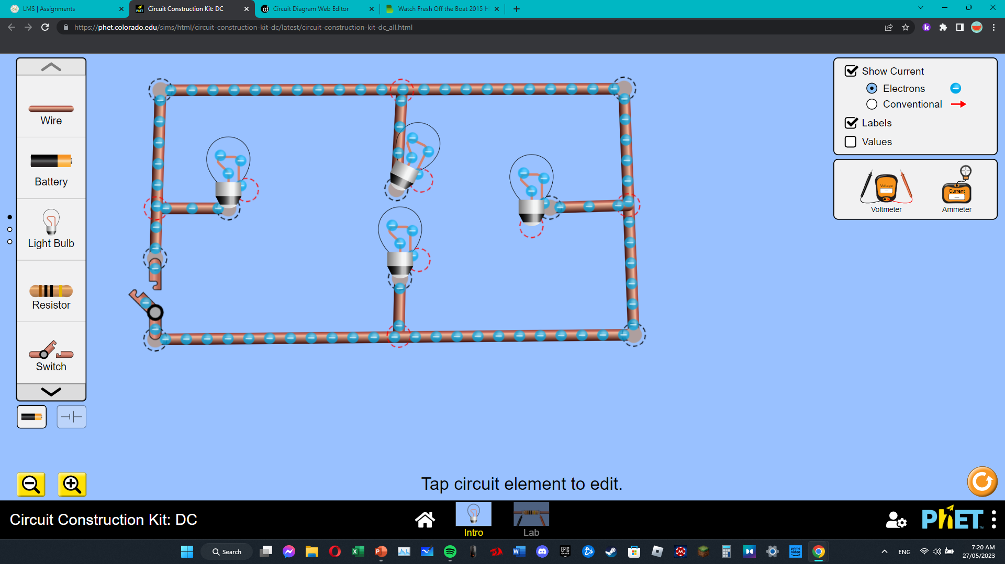
Kitchen
We put 4 led light bulbs and a automatic switch on the bottom left and we put 2 sockets one on the top right and one on the bottom left

Slide 5
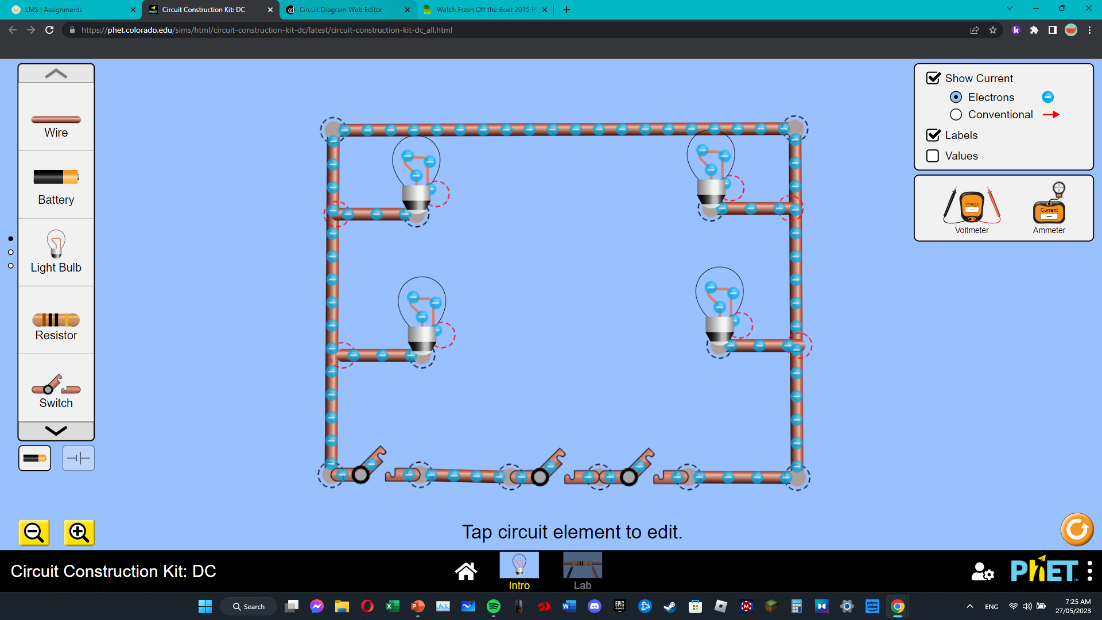
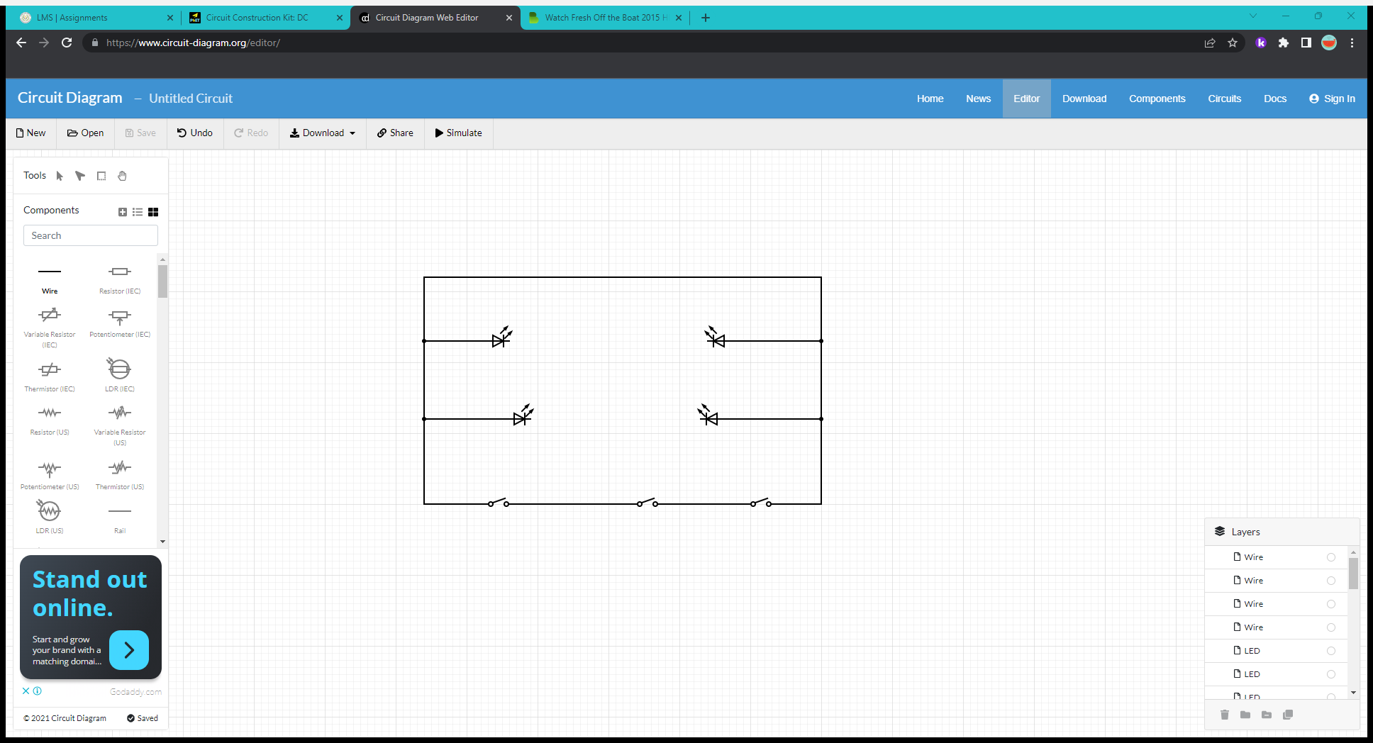
Living room
We put 4 led light and 2 fancy switches, and 1 automatic switch and we put a socket on the top left and the top right, and we attached the led lights with 1 meter of wire

