Slide 1
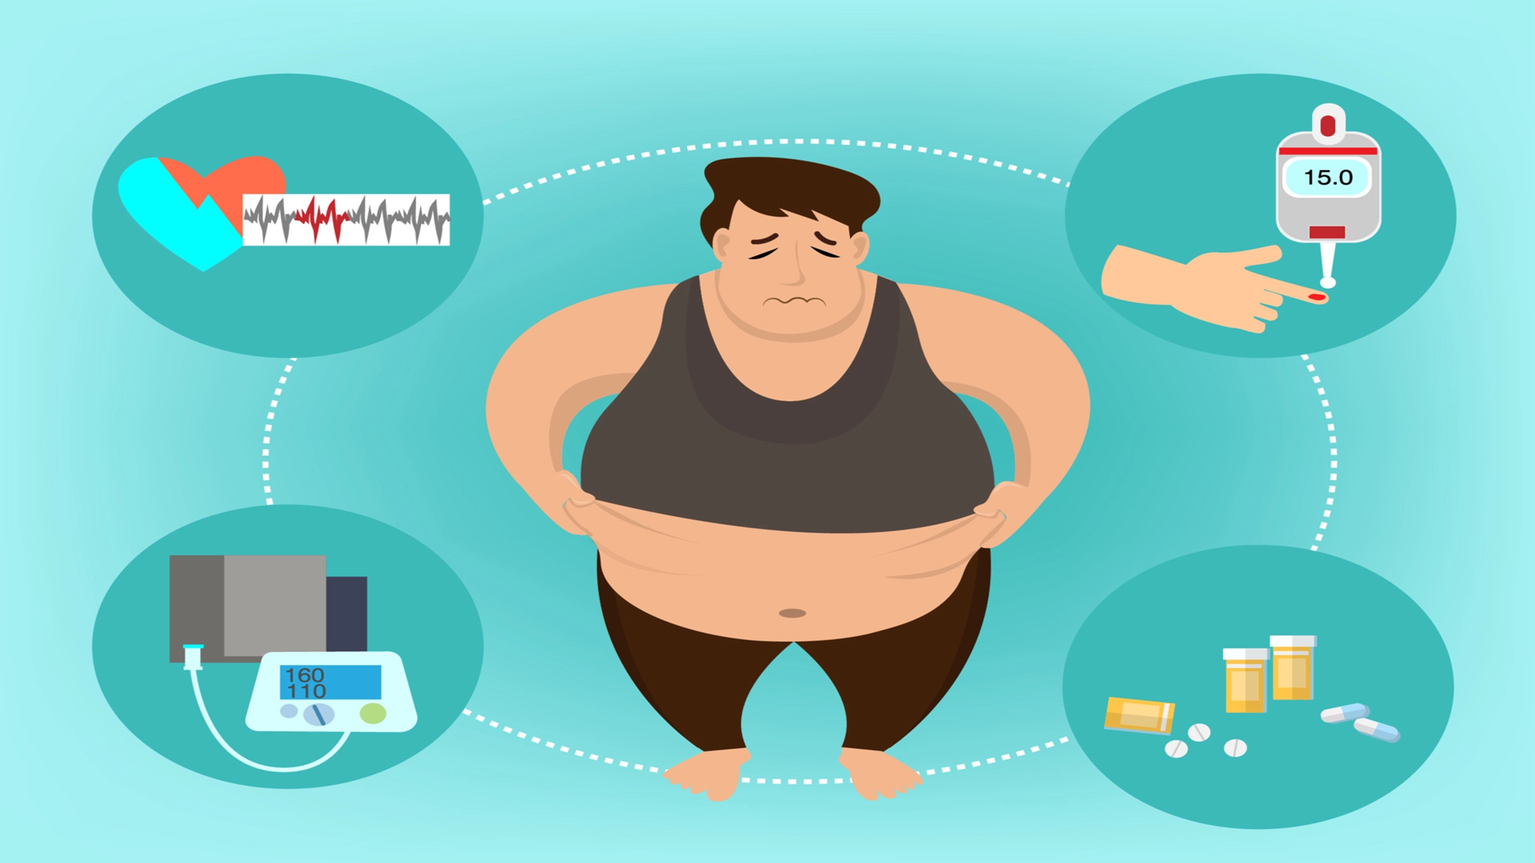

Slide 3
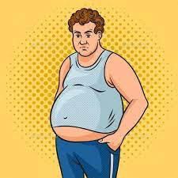
Obesity is a pressing global health issue that has reached alarming levels in recent years. It is a complex condition characterized by excessive body fat accumulation, posing serious health risks and impacting individuals' quality of life. In this project, we aim to raise awareness about obesity, its causes, consequences,

Slide 4
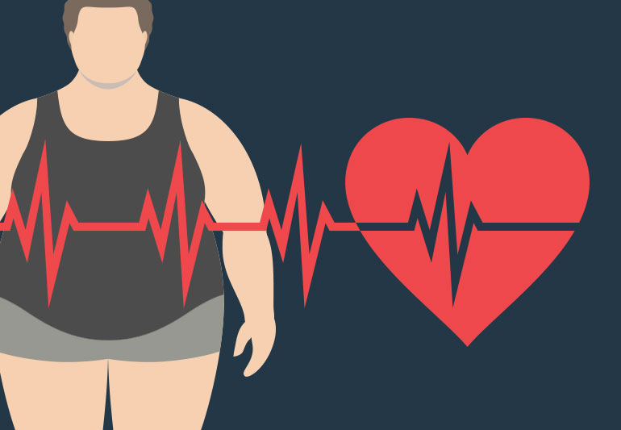
What is obesity?
Obesity is a medical condition characterized by an excessive accumulation of body fat. It is typically determined by a person's body mass index (BMI), which is calculated based on their height and weight.

Slide 5
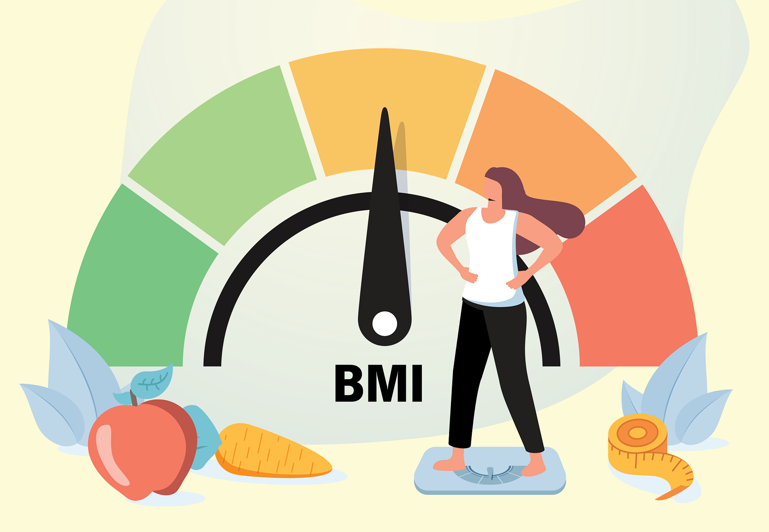
What is a BmI?
How to calculate BMI?
BMI stands for Body Mass Index, and it is a simple calculation that relates a person's weight to their height. It is used as an indicator of whether a person has a healthy weight for their height.
BMI = divide your weight in kilograms by your height in meters squared.
Measure your weight in kilograms.
Measure your height in meters.
Square your height value (multiply it by itself).
Divide your weight by the squared height value.
The result will be your BMI.
For example, if your weight is 70 kilograms and your height is 1.75 meters:
BMI = 70 / (1.75 * 1.75) = 22.86

Slide 6
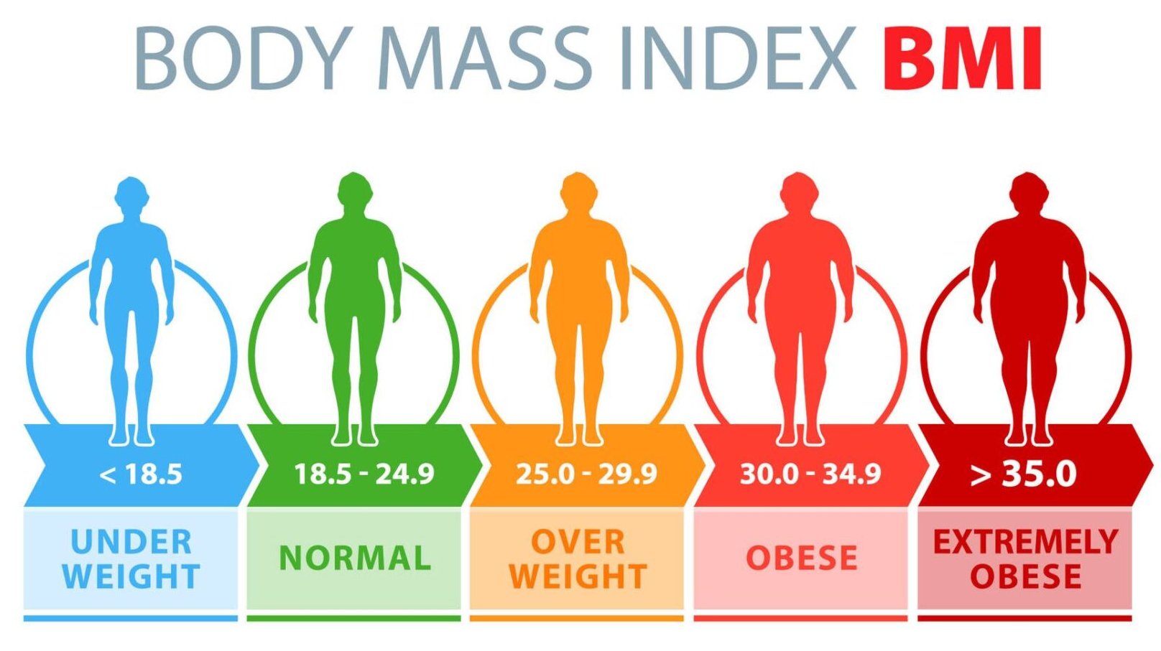

Slide 7
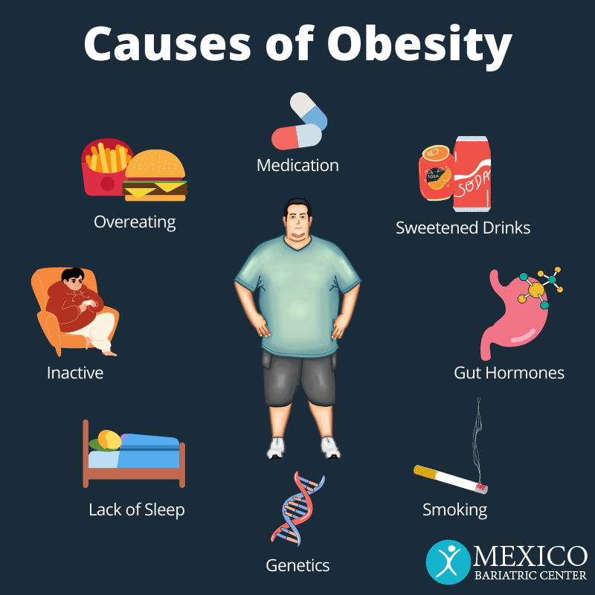
Causes of Obesity
Unhealthy diet and excessive calorie intake.
Lack of physical activity and sedentary lifestyle.
Genetic factors.
Socioeconomic factors and limited access to healthy options.
Environmental factors such as easy access to high-calorie foods.
Psychological factors like emotional eating and stress.

Slide 8
Health symptoms of obesity
Increased risk of chronic diseases such as heart disease, diabetes, and certain types of cancer.
High blood pressure and hypertension.
High cholesterol levels.
Sleep apnea and other breathing problems.
Joint pain and mobility issues.
Fatigue and low energy levels.
Increased risk of mental health conditions like depression and anxiety.
Reduced quality of life and overall well-being.

Slide 9
Social symptoms of obesity include:
Social isolation
Anxiety to go in public
Bullying
Limited participation in activities
Negative impact on relationships

Slide 10
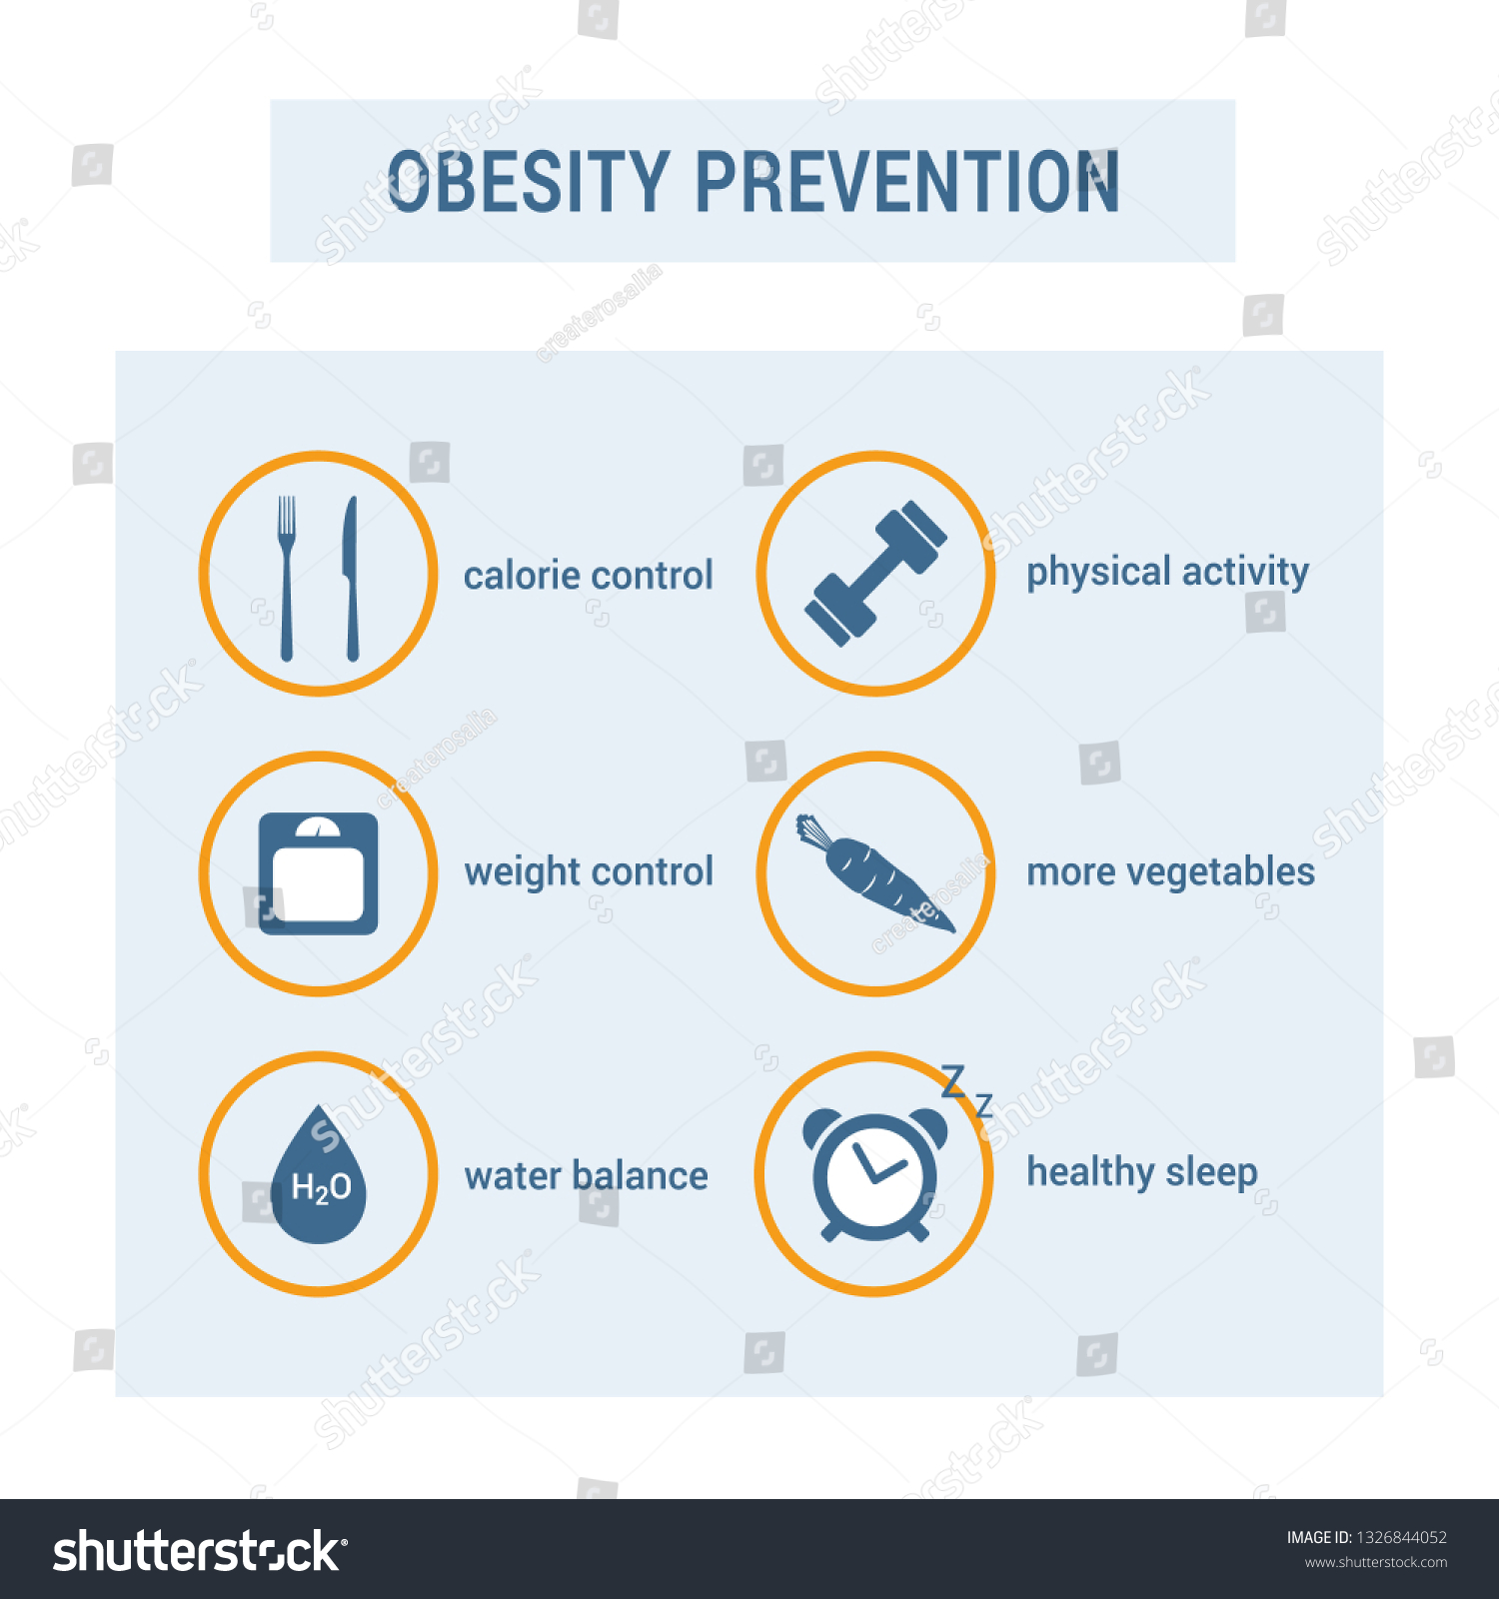

Slide 11
In conclusion: obesity is a complex and serious health issue that has significant consequences for individuals and society as a whole. It is essential to address and raise awareness about the causes, symptoms, and consequences of obesity. By understanding the factors that contribute to obesity, promoting healthy lifestyles, and providing support and resources for individuals affected by obesity, we can work towards preventing and managing this condition. It is crucial to prioritize initiatives that promote physical activity, healthy eating habits, and overall well-being. Together, we can create a healthier future and combat the challenges posed by obesity.

Slide 12
Resources used
https://health.clevelandclinic.org/is-bmi-accurate/
https://www.nhlbi.nih.gov/health/overweight-and-obesity/symptoms
https://www.hopkinsmedicine.org/health/conditions-and-diseases/obesity/medical-treatment-for-obesity
https://www.mayoclinic.org/diseases-conditions/obesity/symptoms-causes/syc-20375742
https://www.cdc.gov/obesity/basics/adult-defining.html
https://www.healthdirect.gov.au/obesity

